Slide 1
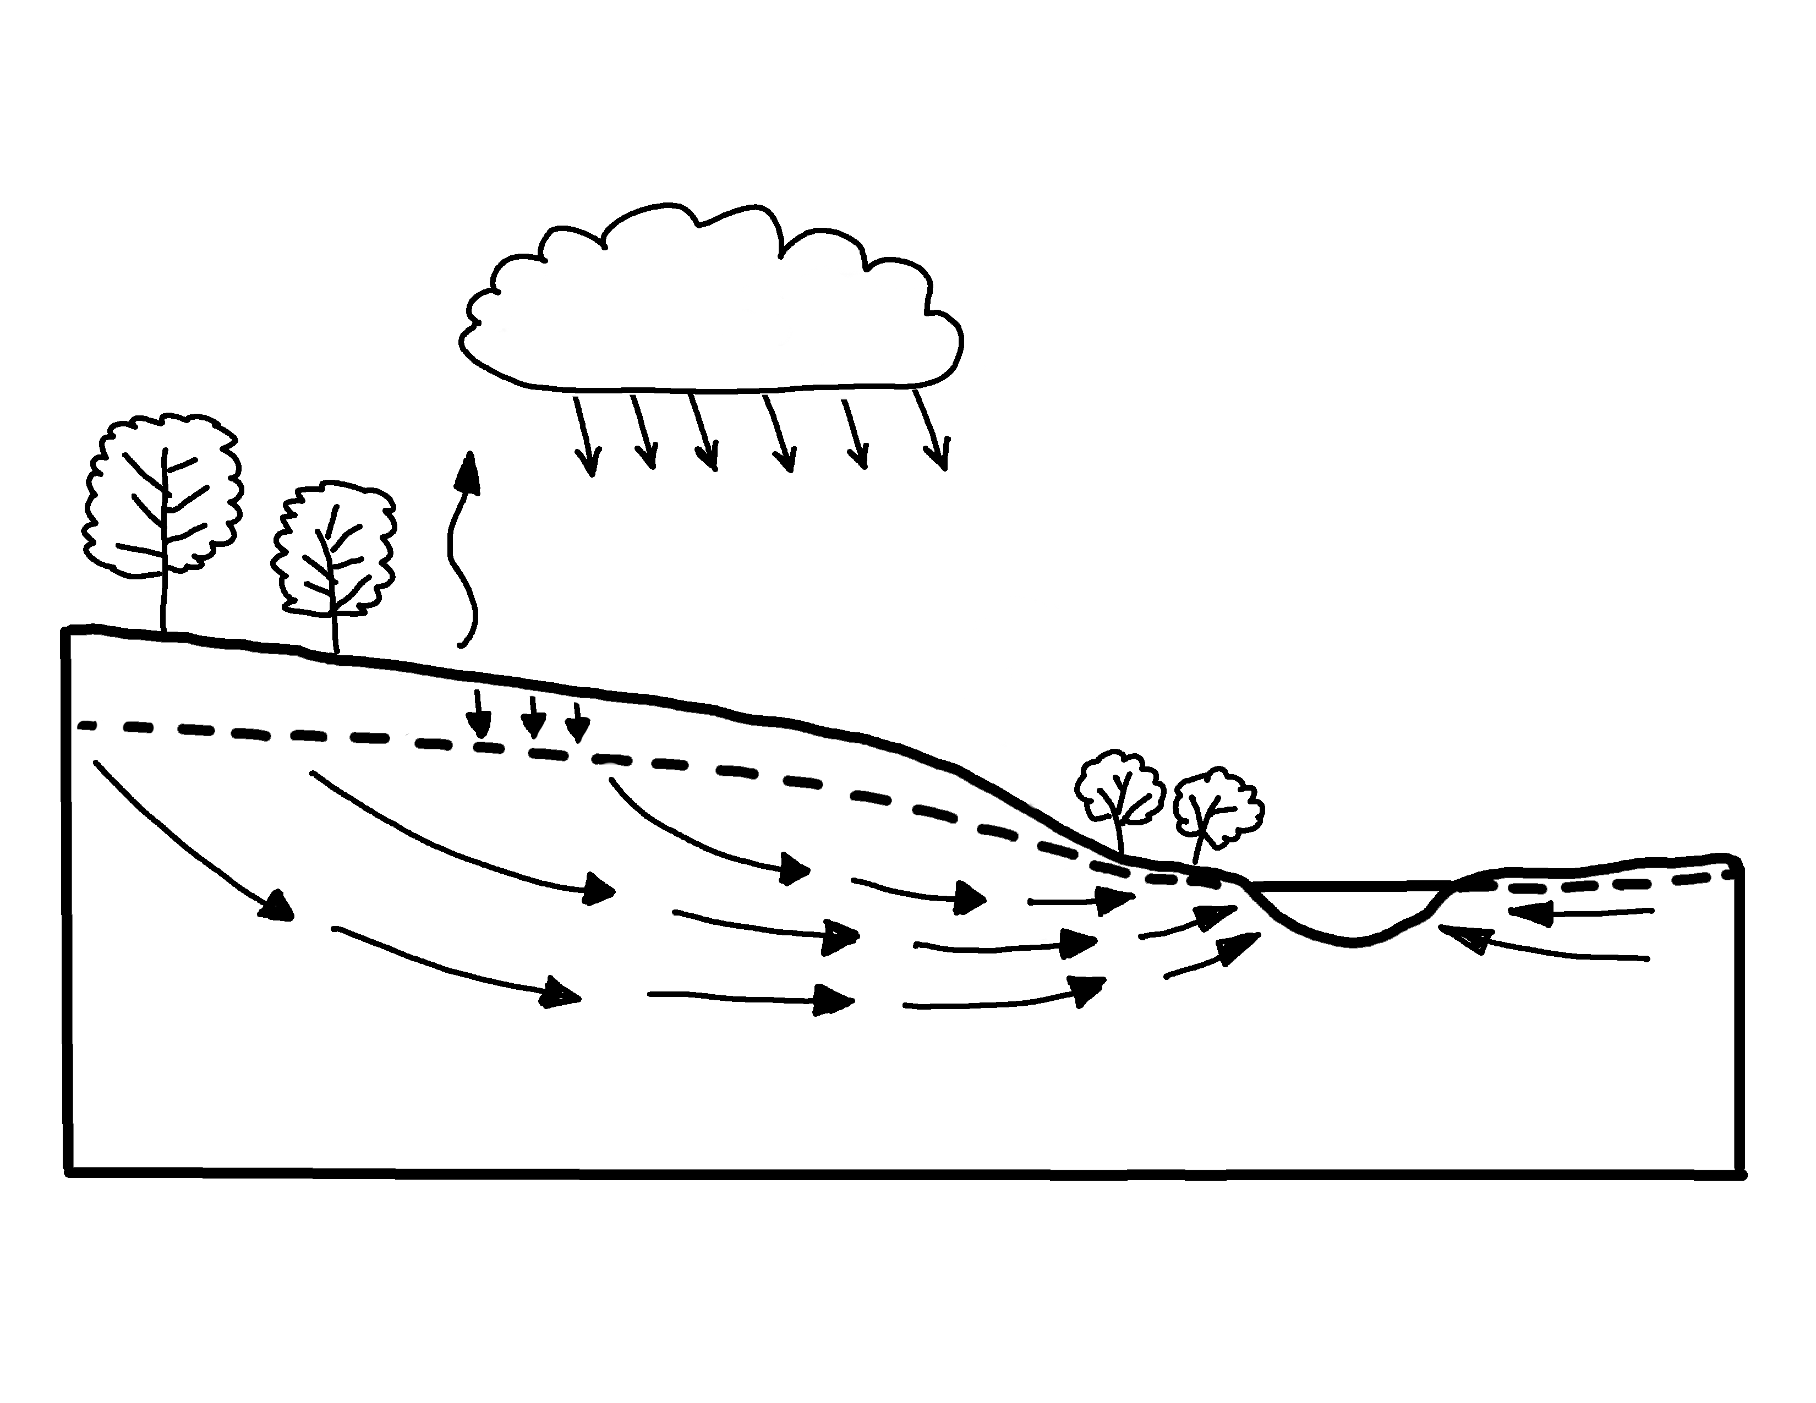

Groundwater Flow Showing Natural Conditions
✄
evaporation
precipitation
water table
infiltration
riparian
zone
stream
groundwater flow
modified from https://www.usgs.gov/media/images/groundwater-flow-showing-natural-conditions

Slide 2
⠠⠛⠗⠳⠝⠙⠺⠁⠞⠻⠀⠠⠋⠇⠪⠀⠠⠩⠪⠬⠀
⠠⠝⠁⠞⠥⠗⠁⠇⠀⠠⠉⠕⠝⠙⠊⠞⠊⠕⠝⠎
✄
⠑⠧⠏⠕⠗⠁⠰⠝
⠏⠗⠑⠉⠊⠏⠊⠞⠁⠰⠝
⠔⠋⠊⠇⠞⠗⠁⠰⠝
⠺⠁⠞⠻⠀⠞⠁⠃⠇⠑
⠗⠊⠏⠜⠊⠁⠝⠀⠵⠐⠕
⠌⠗⠂⠍
⠛⠗⠳⠝⠙⠺⠁⠞⠻⠀⠋⠇⠪

Slide 3
✄

