Slide 1
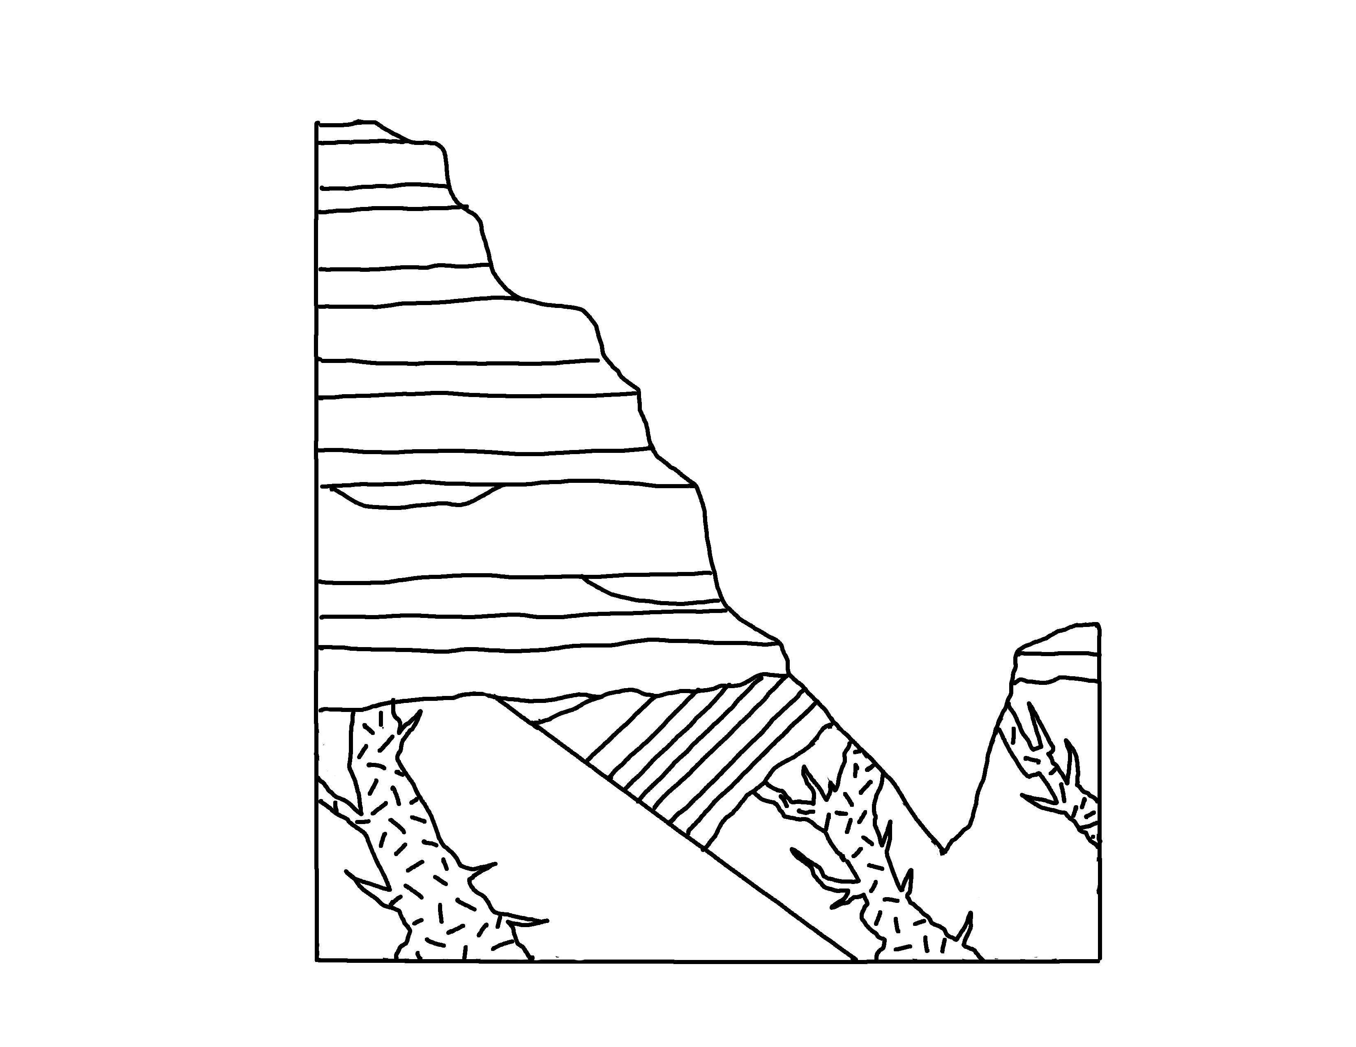
Grand Canyon
✄
1
2
3
4
5
6
Paleozoic
7
8
9
Great Unconformity
10
Colorado River
Proterozoic
11
13
13
12
12

Slide 2
Grand Canyon Legend
✄
1 Moenkopi Fm.
2 Kaibab Limestone
3 Toroweap Fm.
4 Coconino Sanstone
5 Hermit Shale
7 Redwall Limestone and Surprise Canyon Fm.
6 Supai Group
8 Muav and Temple Butte Limestones
9 Bright Angel Shale
10 Tapeats Sandstone
11 Grand Canyon Supergroup
12 Zoroaster Granite
13 Vishnu Schist
modified from
https://azgs.arizona.edu/photo/grand-canyon-stratigraphy

Slide 3
⠠⠛⠗⠯⠀⠠⠉⠁⠝⠽⠕⠝
✄
⠼⠁
⠼⠃
⠼⠉
⠼⠙
⠼⠑
⠼⠋
⠠⠏⠁⠇⠑⠕⠵⠕⠊⠉
⠠⠉⠕⠇⠕⠗⠁⠙⠕⠀
⠠⠗⠲
⠼⠛
⠼⠓
⠼⠊
⠠⠛⠗⠞⠠⠥⠝⠒⠿⠍⠰⠽
⠼⠁⠚
⠠⠏⠗⠕⠞⠻⠕⠵⠕⠊⠉
⠼⠁⠁
⠼⠁⠉
⠼⠁⠉
⠼⠁⠃
⠼⠁⠃

Slide 4
⠠⠛⠗⠯⠀⠠⠉⠁⠝⠽⠕⠝⠀⠠⠇⠑⠛⠢⠙
✄
1 ⠠⠍⠕⠢⠅⠕⠏⠊⠀⠠⠋⠍⠲
2 ⠠⠅⠁⠊⠃⠁⠃⠀⠠⠇⠊⠍⠑⠌⠐⠕
3 ⠠⠞⠕⠗⠪⠂⠏⠀⠠⠋⠍⠲
4 ⠠⠉⠕⠒⠔⠕⠀⠠⠎⠯⠌⠐⠕
5 ⠠⠓⠻⠍⠊⠞⠀⠠⠩⠁⠇⠑
6 ⠠⠎⠥⠏⠁⠊⠀⠠⠛⠗⠳⠏
7 ⠠⠗⠫⠺⠁⠇⠇⠀⠠⠇⠊⠍⠑⠌⠐⠕⠀⠯⠀
⠠⠎⠥⠗⠏⠗⠊⠎⠑⠀⠠⠉⠁⠝⠽⠕⠝⠀⠠⠋⠍⠲
8 ⠠⠍⠥⠁⠧⠀⠯⠀⠠⠞⠑⠍⠏⠇⠑⠀⠠⠃⠥⠞⠞⠑⠀
⠠⠇⠊⠍⠑⠌⠐⠕⠎
9 ⠠⠃⠐⠗⠀⠠⠁⠝⠛⠑⠇⠀⠠⠩⠁⠇⠑
10 ⠠⠞⠁⠏⠂⠞⠎⠀⠠⠎⠯⠌⠐⠕
11 ⠠⠛⠗⠯⠀⠠⠉⠁⠝⠽⠕⠝⠀⠠⠎⠥⠏⠻⠛⠗⠳⠏
12 ⠠⠵⠕⠗⠕⠁⠌⠻⠀⠠⠛⠗⠁⠝⠊⠞⠑
13 ⠠⠧⠊⠎⠝⠥⠀⠠⠎⠡⠊⠌

Slide 5
✄

