Slide 1
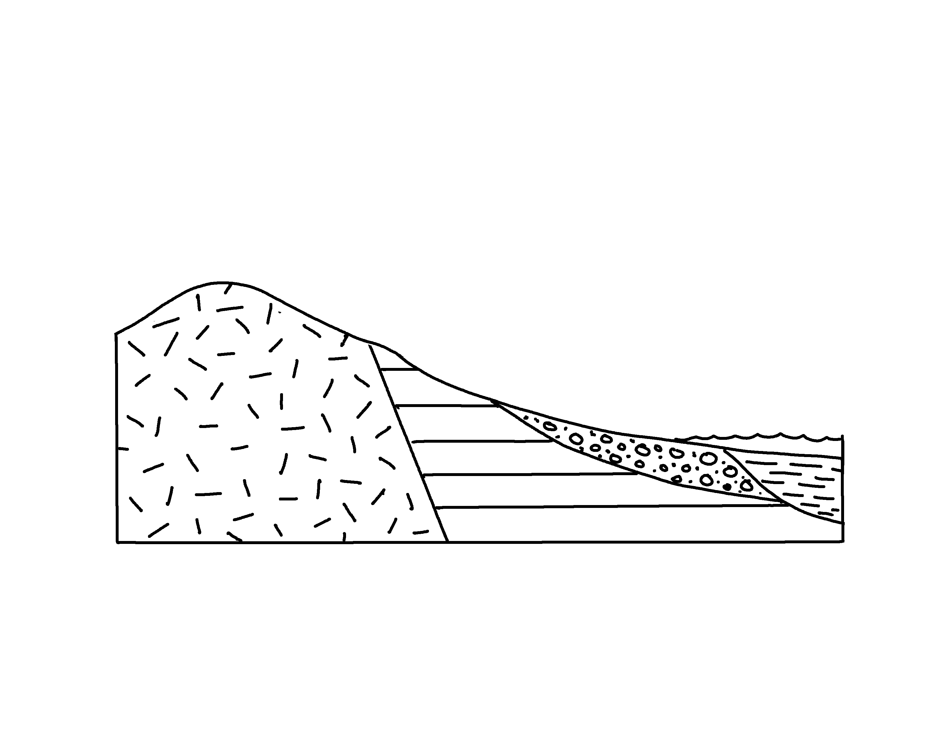
✄
Seismic Amplification
alluvium
silt, mud
hard igneous rock
sedimentary
bedrock
modified from Fig. 6.16 in Keller, 2000, Environmental Geology, 8th edition

Slide 2
⠠⠎⠑⠊⠎⠍⠊⠉⠀⠠⠁⠍⠏⠇⠊⠋⠊⠉⠁⠰⠝
✄
⠎⠊⠇⠞⠂⠀
⠍⠥⠙
⠓⠜⠙
⠊⠛⠝⠑⠳⠎
⠗⠕⠉⠅
⠁⠇⠇⠥⠧⠊⠥⠍
⠎⠫⠊⠍⠢⠞⠜⠽⠀⠃⠫⠗⠕⠉⠅

Slide 3
✄

