Slide 1
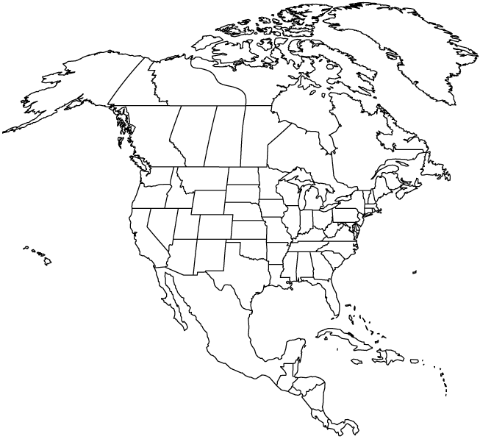
North America
(US States and Canadian Provinces)
✄
Greenland

Slide 2
⠠⠝⠕⠗⠹⠀⠠⠁⠍⠻⠊⠉⠁⠀
⠐⠣⠥⠀⠠⠌⠁⠞⠑⠎⠀⠯⠀⠠⠉⠁⠝⠁⠙⠊⠁⠝⠀⠠⠏⠗⠕⠧⠔⠉⠑⠎⠐⠜
✄
⠠⠛⠗⠑⠢⠇⠯

Slide 3
✄

