Slide 1
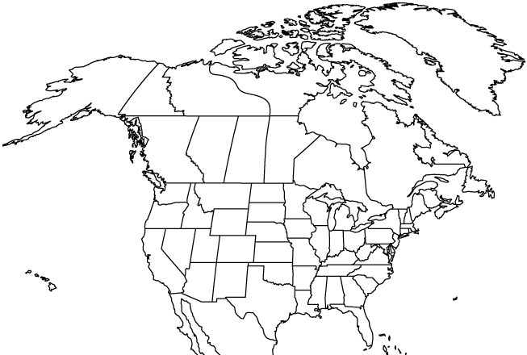
✄
Pleistocene Glacial Maximum
Greenland Ice Sheet
Cordilleran Ice Sheet
Laurentide Ice Sheet
modifed from https://opinicon.wordpress.com/physical-environment/quaternary/

Slide 2
⠠⠏⠇⠑⠊⠌⠕⠉⠢⠑⠀⠠⠛⠇⠁⠉⠊⠁⠇⠀⠠⠍⠁⠭⠊⠍⠥⠍
✄
⠠⠛⠗⠑⠢⠇⠯⠀⠠⠊⠉⠑⠀⠠⠩⠑⠑⠞
⠠⠉⠕⠗⠙⠊⠇⠇⠻⠁⠝⠀
⠠⠊⠉⠑⠀⠠⠩⠑⠑⠞
⠠⠇⠁⠥⠗⠢⠞⠊⠙⠑⠀⠠⠊⠉⠑⠀⠠⠩⠑⠑⠞

Slide 3
✄

