Slide 1
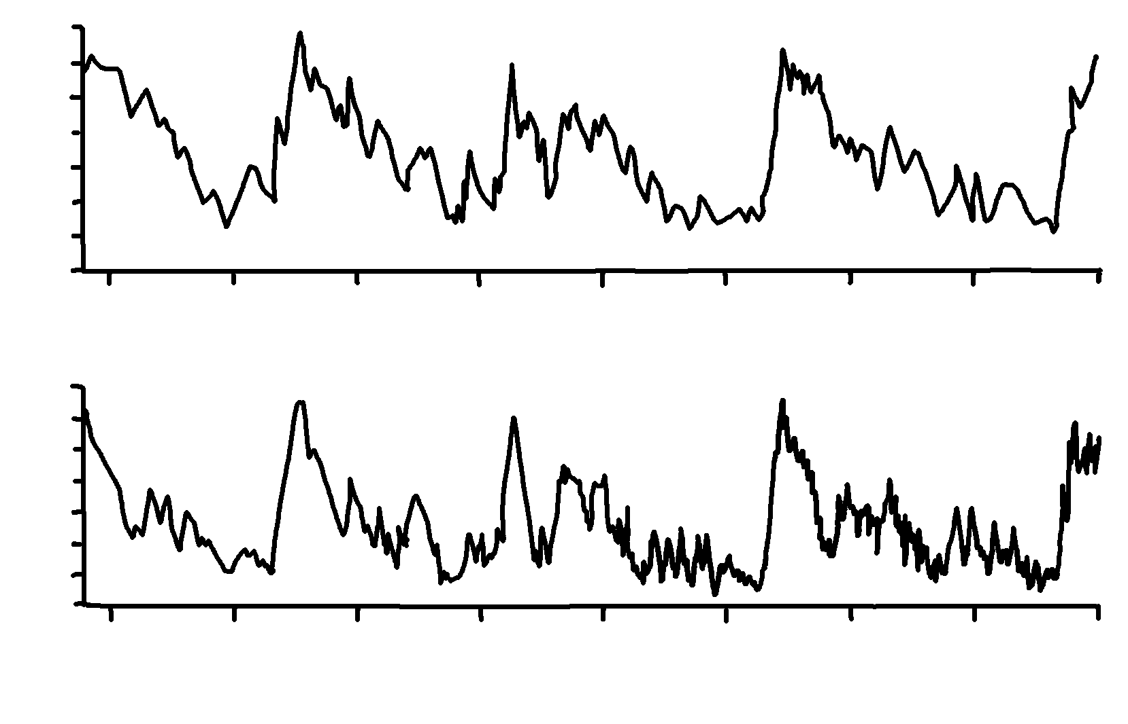
Vostok Ice Core
✄
CO2 concentration (ppm)
modified from https://www.grida.no/resources/6443
300
160
T change from present (present = 1950)
+4
0
-10
400000 300000 200000 100000 0
Years before present (present = 1950)

Slide 2
⠠⠧⠕⠌⠕⠅⠀⠠⠊⠉⠑⠀⠠⠉⠕⠗⠑
✄
⠠⠠⠉⠕⠼⠃⠀⠉⠕⠝⠉⠢⠞⠗⠁⠰⠝⠀⠐⠣⠏⠏⠍⠐⠜
⠼⠉⠚⠚
⠼⠁⠋⠚
⠠⠞⠀⠡⠁⠝⠛⠑⠀⠋⠀⠏⠗⠑⠎⠢⠞⠀⠐⠣⠏⠗⠑⠎⠑⠝⠞⠀⠐⠶⠀⠼⠁⠊⠑⠚⠐⠜
⠼⠙
⠼⠚
⠤⠼⠁⠚
⠼⠙⠚⠚⠚⠚⠚
⠼⠉⠚⠚⠚⠚⠚
⠼⠃⠚⠚⠚⠚⠚
⠼⠁⠚⠚⠚⠚⠚
⠼⠚
⠠⠽⠑⠜⠎⠀⠆⠋⠀⠏⠗⠑⠎⠢⠞⠀⠐⠣⠏⠗⠑⠎⠑⠝⠞⠀⠐⠶⠀⠼⠁⠊⠑⠚⠐⠜

Slide 3
✄

