Slide 1
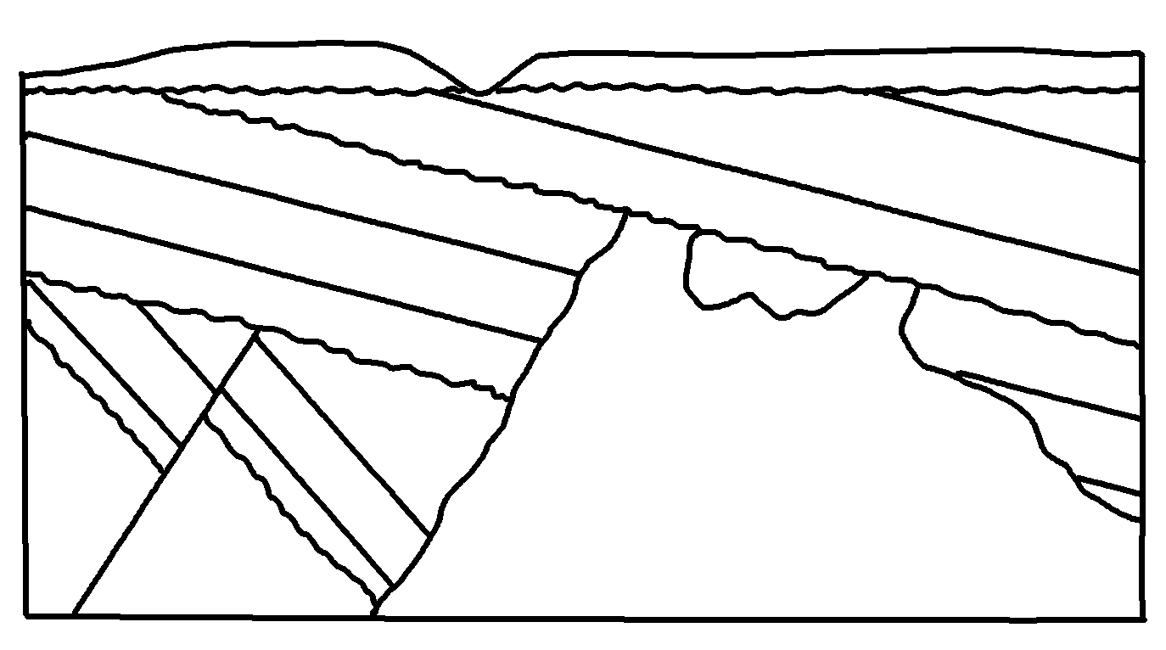
Relative Dating Exercise
✄
F
F
B
J
N
K
D
G
J
M
L
C
J
G
C
A
D
E
L
E
M
H
Units:
A and E – granites
H – fault
Everything else is a sedimentary rock
modified from http://profharwood.x10host.com/GEOL101/Labs/Dating/index.htm

Slide 2
⠠⠗⠑⠇⠁⠞⠊⠧⠑⠀⠠⠙⠁⠞⠬⠀⠠⠑⠭⠻⠉⠊⠎⠑
✄
⠠⠋
⠠⠋
⠠⠃
⠠⠝
⠠⠅
⠠⠚
⠠⠙
⠠⠛
⠠⠚
⠠⠍
⠠⠇
⠠⠉
⠠⠚
⠠⠛
⠠⠉
⠠⠁
⠠⠙
⠠⠑
⠠⠑
⠠⠇
⠠⠍
⠠⠓
⠠⠥⠝⠊⠞⠎⠒
⠠⠁⠀⠯⠀⠠⠑⠀⠤⠀⠛⠗⠁⠝⠊⠞⠑⠎
⠠⠓⠀⠤⠀⠋⠁⠥⠇⠞
⠠⠐⠑⠽⠹⠬⠀⠑⠇⠎⠑⠀⠊⠎⠀⠁⠀⠎⠫⠊⠍⠢⠞⠜⠽⠀⠗⠕⠉⠅

Slide 3
✄

