Slide 1
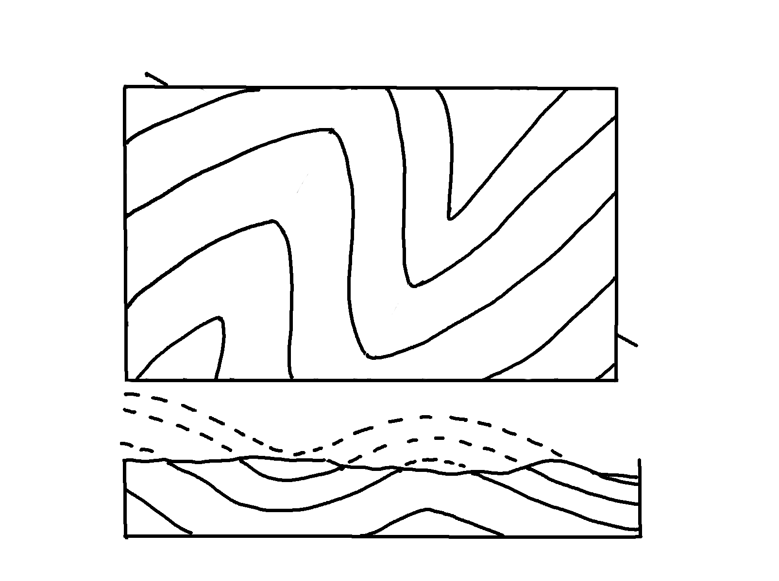
Plunging Folds – Cross-Section, A-B
✄
5
A
B
4
4
3
3
2
2
1
1

Slide 2
⠠⠏⠇⠥⠝⠛⠬⠀⠠⠋⠕⠇⠙⠎⠀⠤⠀⠠⠉⠗⠕⠎⠎⠤⠎⠑⠉⠰⠝⠀⠠⠁⠤⠃
✄
⠠⠁
⠼⠙
⠼⠙
⠼⠑
⠼⠋
⠼⠉
⠼⠉
⠼⠃
⠼⠃
⠼⠁
⠼⠁

Slide 3
✄

