Slide 1
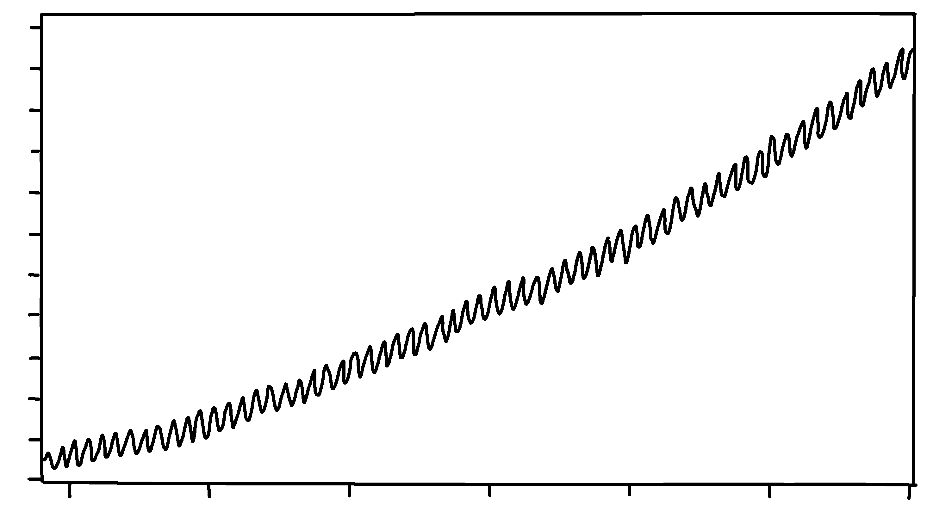
The Keeling Curve
(Carbon Dioxide Concentration at Mauna Loa Observatory, 1958-2020)
✄
420
CO2 concentration (ppm)
410
400
390
380
370
360
350
340
330
320
310
1960
1970
1980
1990
2000
2010
2020
modified from https://scripps.ucsd.edu/programs/keelingcurve/wp-content/plugins/sio-bluemoon/graphs/mlo_full_record.png

Slide 2
⠠⠮⠀⠠⠅⠑⠑⠇⠬⠀⠠⠉⠥⠗⠧⠑
⠐⠣⠉⠜⠃⠕⠝⠀⠠⠙⠊⠕⠭⠊⠙⠑⠀⠠⠉⠕⠝⠉⠢⠞⠗⠁⠰⠝⠀⠁⠞
⠠⠍⠁⠥⠝⠁⠀⠠⠇⠕⠁⠀⠠⠕⠃⠎⠻⠧⠁⠞⠕⠗⠽⠂⠀⠼⠁⠊⠑⠓⠤⠼⠃⠚⠃⠚⠐⠜
✄
⠼⠙⠃⠚
⠠⠠⠉⠕⠼⠃⠀⠉⠕⠝⠉⠢⠞⠗⠁⠰⠝⠀
⠐⠣⠏⠏⠍⠐⠜
⠼⠙⠁⠚
⠼⠙⠚⠚
⠼⠉⠊⠚
⠼⠉⠓⠚
⠼⠉⠛⠚
⠼⠉⠋⠚
⠼⠉⠑⠚
⠼⠉⠙⠚
⠼⠉⠉⠚
⠼⠉⠃⠚
⠼⠉⠁⠚
⠼⠁⠊⠋⠚
⠼⠁⠊⠓⠚
⠼⠃⠚⠚⠚
⠼⠃⠚⠃⠚
⠼⠁⠊⠛⠚
⠼⠁⠊⠊⠚
⠼⠃⠚⠁⠚

Slide 3
✄

