Slide 1
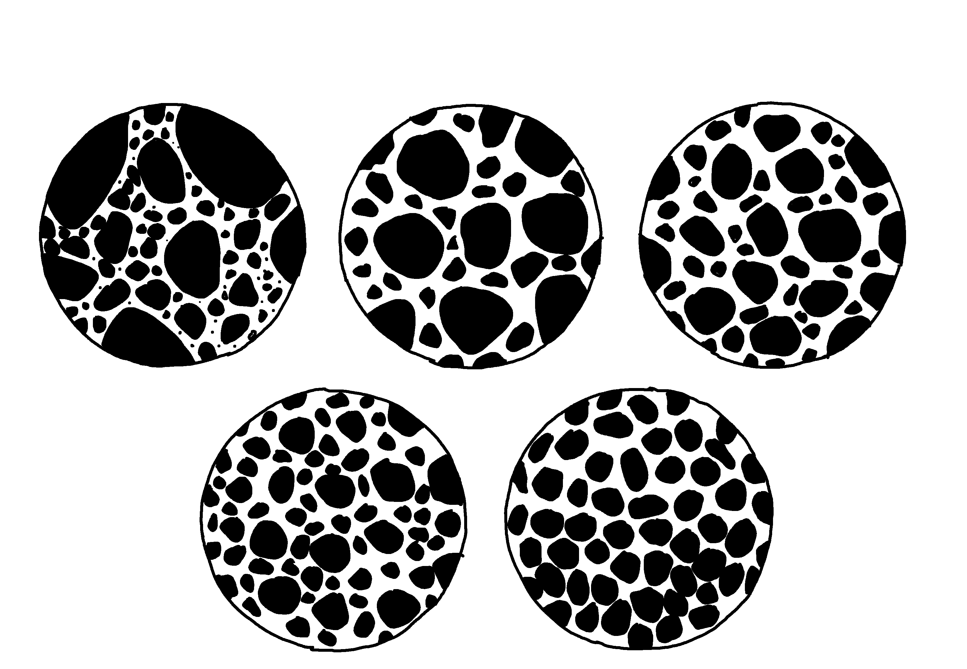
Sedimentary Sorting
✄
very poorly sorted
poorly sorted
moderately sorted
well sorted
very well
sorted
modified from Fig. 7.5 (c) in Marshak, 2019, Earth: Portrait of a Planet, 6th edition

Slide 2
⠎⠫⠊⠍⠢⠞⠜⠽⠀⠎⠕⠗⠞⠬
✄
⠧⠀⠏⠕⠕⠗⠇⠽
⠎⠕⠗⠞⠫
⠏⠕⠕⠗⠇⠽
⠎⠕⠗⠞⠫
⠍⠕⠙⠻⠁⠞⠑⠇⠽
⠎⠕⠗⠞⠫
⠺⠑⠇⠇
⠎⠕⠗⠞⠫
⠧⠀⠺⠑⠇⠇
⠎⠕⠗⠞⠫

Slide 3
✄

