Slide 1
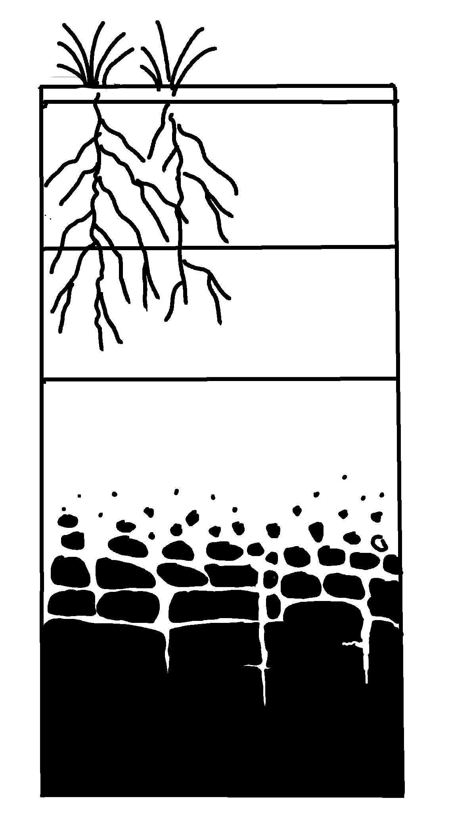
Soil Horizons
✄
O
topsoil
A
E
transition
regolith
B
subsoil
C
weathered
bedrock
solid bedrock
modified from Fig. B.11 (b) in Marshak, 2019, Earth: Portrait of a Planet, 6th edition and https://www.soils4teachers.org/soil-horizons

Slide 2
✄
⠠⠎⠕⠊⠇⠀⠠⠓⠕⠗⠊⠵⠕⠝⠎
⠠⠕
⠠⠁
⠞⠕⠏⠎⠕⠊⠇
⠠⠑
⠞⠗⠁⠝⠎⠊⠰⠝
⠗⠑⠛⠕⠇⠊⠹
⠠⠃
⠎⠥⠃⠎⠕⠊⠇
⠠⠉
⠺⠂⠞⠐⠓⠙
⠃⠫⠗⠕⠉⠅
⠎⠕⠇⠊⠙⠀⠃⠫⠗⠕⠉⠅

Slide 3
✄

