Slide 1
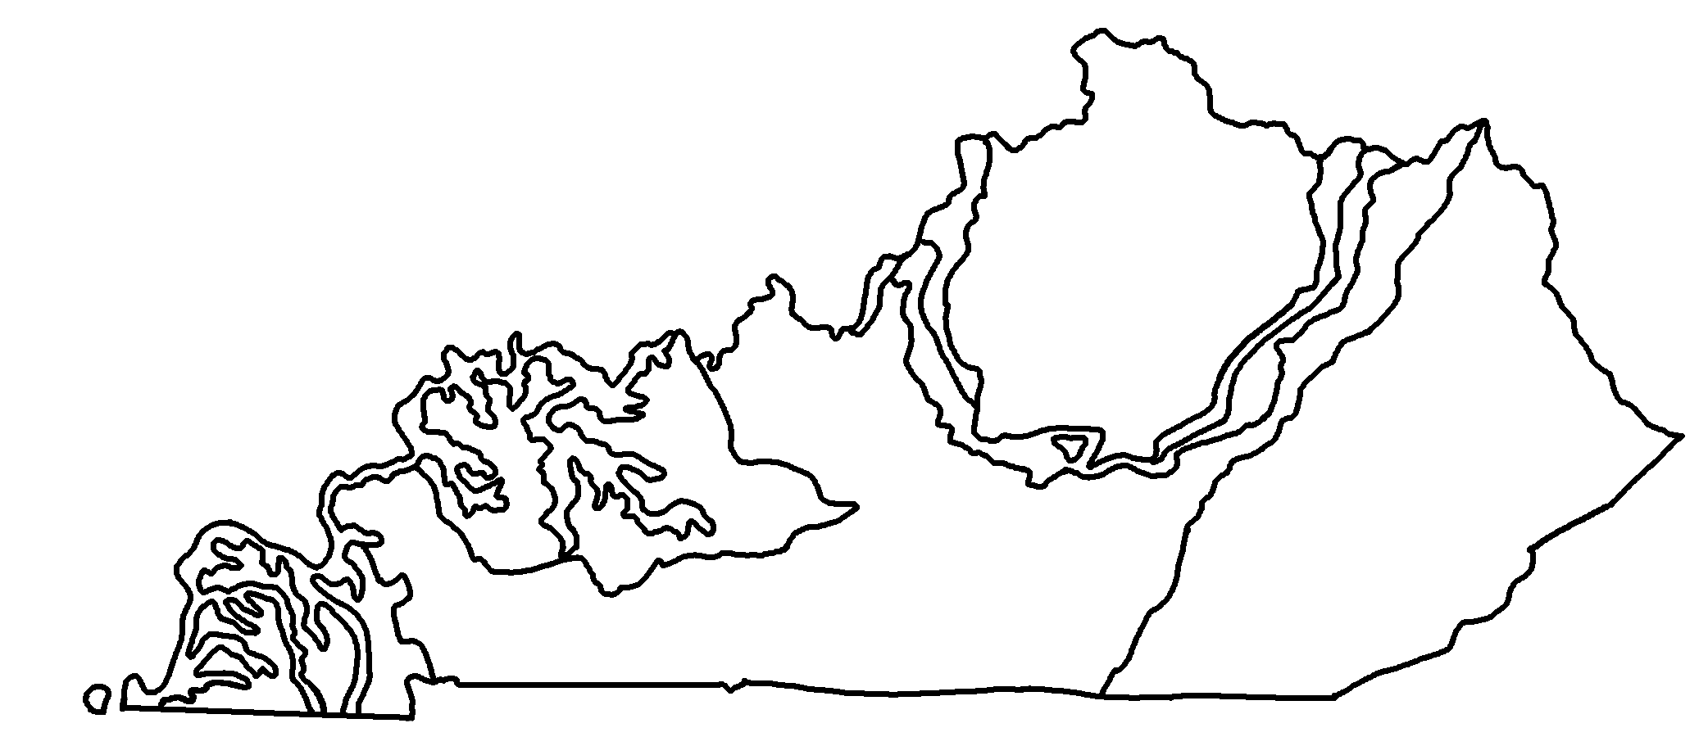
Geologic Map of Kentucky
✄
modified from https://www.uky.edu/KGS/geoky/index.htm

Slide 2
Geologic Map of Kentucky - Legend
✄
Quaternary
Tertiary / Cretaceous
Pennsylvanian
Mississippian
Buried (do not outcrop)
Devonian
Cambrian
Silurian
Precambrian
Ordovician
modified from https://www.uky.edu/KGS/geoky/index.htm

Slide 3
⠠⠛⠑⠕⠇⠕⠛⠊⠉⠀⠠⠍⠁⠏⠀⠷⠀⠠⠅⠢⠞⠥⠉⠅⠽
✄
⠠⠍⠁⠚⠕⠗⠀⠉⠊⠞⠊⠑⠎⠀⠜⠑⠀⠥⠝⠇⠁⠆⠇⠫⠂
⠃⠀⠜⠑⠀⠩⠪⠝⠀⠵⠀⠎⠍⠁⠇⠇⠀⠙⠕⠞⠎⠲

Slide 4
⠠⠛⠑⠕⠇⠕⠛⠊⠉⠀⠠⠍⠁⠏⠀⠷⠀⠠⠅⠢⠞⠥⠉⠅⠽⠀⠤⠀⠠⠇⠑⠛⠑⠝⠙
✄
⠠⠟⠥⠁⠞⠻⠝⠜⠽
⠠⠞⠻⠞⠊⠜⠽⠀⠸⠌⠀⠠⠉⠗⠑⠞⠁⠉⠑⠳⠎
⠠⠏⠢⠝⠎⠽⠇⠧⠁⠝⠊⠁⠝
⠠⠍⠊⠎⠎⠊⠎⠎⠊⠏⠏⠊⠁⠝
⠠⠃⠥⠗⠊⠫⠀⠐⠣⠙⠀⠝⠀
⠳⠞⠉⠗⠕⠏⠐⠜
⠠⠙⠑⠧⠕⠝⠊⠁⠝
⠠⠉⠁⠍⠃⠗⠊⠁⠝
⠠⠎⠊⠇⠥⠗⠊⠁⠝
⠠⠏⠗⠑⠉⠁⠍⠃⠗⠊⠁⠝
⠠⠕⠗⠙⠕⠧⠊⠉⠊⠁⠝

Slide 5
✄

