Slide 1
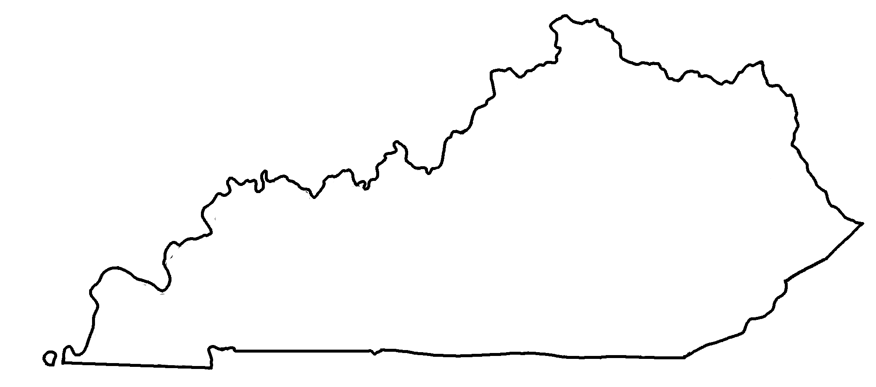
Major Cities in Kentucky
✄
Covington
Ashland
Louisville
Frankfort
Owensboro
Lexington
Pikeville
Paducah
Bowling Green
London
Hopkinsville
Middlesboro

Slide 2
⠠⠍⠁⠚⠕⠗⠀⠠⠉⠊⠞⠊⠑⠎⠀⠔⠀⠠⠅⠢⠞⠥⠉⠅⠽
✄
⠠⠉⠕⠧⠬⠞⠕⠝
⠠⠁⠩⠇⠯
⠠⠇⠳⠊⠎⠧⠊⠇⠇⠑
⠠⠋⠗⠁⠝⠅⠿⠞
⠠⠪⠢⠎⠃⠕⠗⠕
⠠⠇⠑⠭⠬⠞⠕⠝
⠠⠏⠊⠅⠑⠧⠊⠇⠇⠑
⠠⠏⠁⠙⠥⠉⠁⠓
⠠⠃⠪⠇⠬⠀⠠⠛⠗⠑⠑⠝
⠠⠇⠕⠝⠙⠕⠝
⠠⠓⠕⠏⠅⠔⠎⠧⠊⠇⠇⠑
⠠⠍⠊⠙⠙⠇⠑⠎⠃⠕⠗⠕

Slide 3
✄

