Slide 1
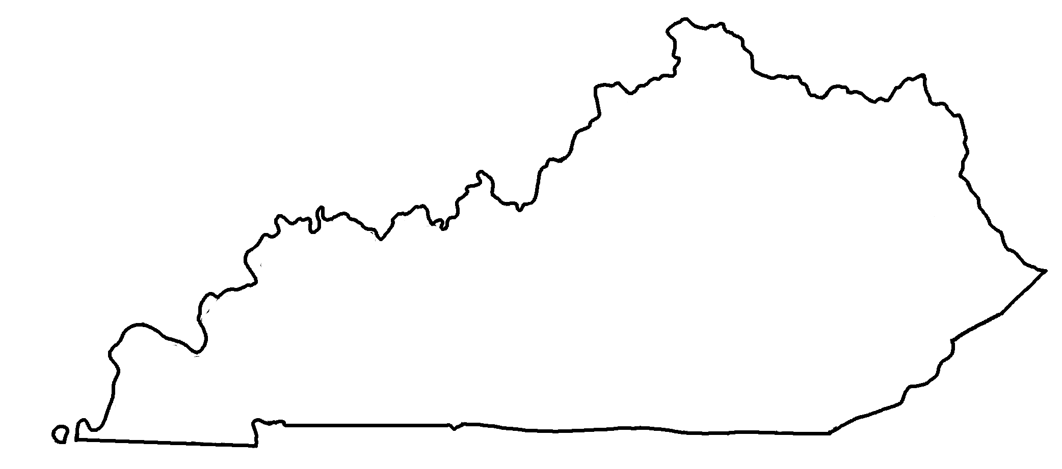


Kentucky Geologic Cross-Section A-B
✄
B
A
A
Mississippi Embayment
Illinois Basin
B
Cincinnati Arch
Appalachian Basin

Slide 2
Geologic Map of Kentucky - Legend
✄
Quaternary
Tertiary / Cretaceous
Pennsylvanian
Mississippian
Buried (do not outcrop)
Devonian
Cambrian
Silurian
Precambrian
Ordovician
modified from https://www.uky.edu/KGS/geoky/index.htm

Slide 3
⠠⠅⠢⠞⠥⠉⠅⠽⠀⠠⠛⠑⠕⠇⠕⠛⠊⠉⠀⠠⠉⠗⠕⠎⠎⠤⠎⠑⠉⠰⠝⠀⠠⠁⠤⠃
✄
⠠⠃
⠠⠁
⠠⠁
⠠⠍⠊⠎⠎⠊⠎⠎⠊⠏⠏⠊
⠠⠑⠍⠃⠁⠽⠰⠞
⠠⠊⠇⠇⠔⠕⠊⠎⠀⠠⠃⠁⠎⠔
⠠⠃
⠠⠁⠏⠏⠁⠇⠁⠡⠊⠁⠝⠀
⠠⠃⠁⠎⠔
⠠⠉⠔⠉⠔⠝⠁⠞⠊⠀⠠⠜⠡

Slide 4
⠠⠛⠑⠕⠇⠕⠛⠊⠉⠀⠠⠍⠁⠏⠀⠷⠀⠠⠅⠢⠞⠥⠉⠅⠽⠀⠤⠀⠠⠇⠑⠛⠑⠝⠙
✄
⠠⠟⠥⠁⠞⠻⠝⠜⠽
⠠⠞⠻⠞⠊⠜⠽⠀⠸⠌⠀⠠⠉⠗⠑⠞⠁⠉⠑⠳⠎
⠠⠏⠢⠝⠎⠽⠇⠧⠁⠝⠊⠁⠝
⠠⠍⠊⠎⠎⠊⠎⠎⠊⠏⠏⠊⠁⠝
⠠⠃⠥⠗⠊⠫⠀⠐⠣⠙⠀⠝⠀
⠳⠞⠉⠗⠕⠏⠐⠜
⠠⠙⠑⠧⠕⠝⠊⠁⠝
⠠⠉⠁⠍⠃⠗⠊⠁⠝
⠠⠎⠊⠇⠥⠗⠊⠁⠝
⠠⠏⠗⠑⠉⠁⠍⠃⠗⠊⠁⠝
⠠⠕⠗⠙⠕⠧⠊⠉⠊⠁⠝

Slide 5
✄

