Slide 1
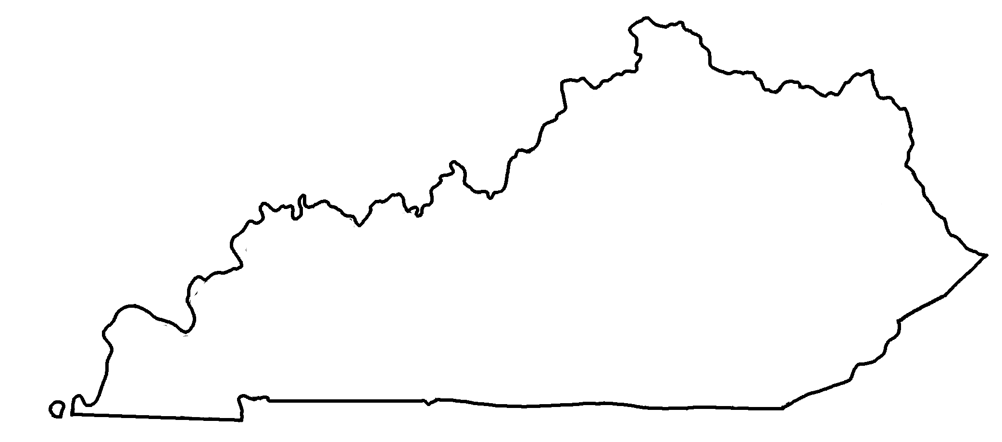
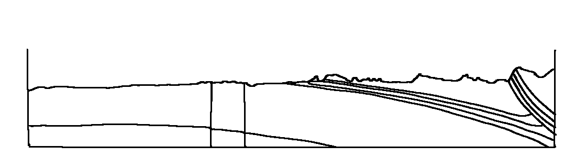
Kentucky Geologic Cross-Section C-D
✄
C
D
C
D
Appalachian Basin
Cincinnati Arch

Slide 2
Geologic Map of Kentucky - Legend
✄
Quaternary
Tertiary / Cretaceous
Pennsylvanian
Mississippian
Buried (do not outcrop)
Devonian
Cambrian
Silurian
Precambrian
Ordovician
modified from https://www.uky.edu/KGS/geoky/index.htm

Slide 3
⠠⠅⠢⠞⠥⠉⠅⠽⠀⠠⠛⠑⠕⠇⠕⠛⠊⠉⠀⠠⠉⠗⠕⠎⠎⠤⠎⠑⠉⠰⠝⠀⠠⠉⠤⠙
✄
⠠⠉
⠠⠙
⠠⠉
⠠⠁⠏⠏⠁⠇⠁⠡⠊⠁⠝
⠠⠃⠁⠎⠔
⠠⠙
⠠⠉⠔⠉⠔⠝⠁⠞⠊⠀⠠⠜⠡

Slide 4
⠠⠛⠑⠕⠇⠕⠛⠊⠉⠀⠠⠍⠁⠏⠀⠷⠀⠠⠅⠢⠞⠥⠉⠅⠽⠀⠤⠀⠠⠇⠑⠛⠑⠝⠙
✄
⠠⠟⠥⠁⠞⠻⠝⠜⠽
⠠⠞⠻⠞⠊⠜⠽⠀⠸⠌⠀⠠⠉⠗⠑⠞⠁⠉⠑⠳⠎
⠠⠏⠢⠝⠎⠽⠇⠧⠁⠝⠊⠁⠝
⠠⠍⠊⠎⠎⠊⠎⠎⠊⠏⠏⠊⠁⠝
⠠⠃⠥⠗⠊⠫⠀⠐⠣⠙⠀⠝⠀
⠳⠞⠉⠗⠕⠏⠐⠜
⠠⠙⠑⠧⠕⠝⠊⠁⠝
⠠⠉⠁⠍⠃⠗⠊⠁⠝
⠠⠎⠊⠇⠥⠗⠊⠁⠝
⠠⠏⠗⠑⠉⠁⠍⠃⠗⠊⠁⠝
⠠⠕⠗⠙⠕⠧⠊⠉⠊⠁⠝

Slide 5
✄

