Slide 1
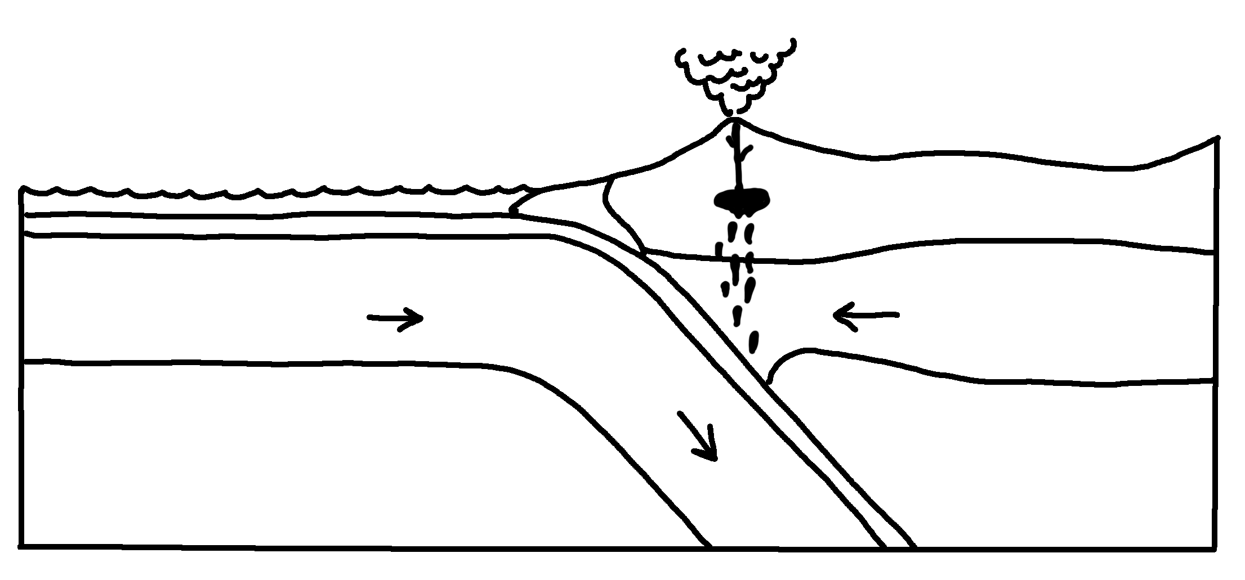
✄
Continental Margin Subduction Zone
volcanic arc
oceanic crust
accretionary wedge
trench
continental crust
lithospheric mantle
lith. mantle
asthenospheric mantle
asth. mantle

Slide 2
⠠⠉⠕⠝⠞⠔⠢⠞⠁⠇⠀⠠⠍⠜⠛⠔⠀⠠⠎⠥⠃⠙⠥⠉⠰⠝⠀⠠⠵⠐⠕
✄
⠕⠉⠂⠝⠊⠉⠀⠉⠗⠥⠌
⠧⠕⠇⠉⠁⠝⠊⠉⠀⠜⠉
⠁⠒⠗⠑⠞⠊⠕⠝⠜⠽⠀⠺⠫⠛⠑
⠞⠗⠢⠡
⠉⠕⠝⠞⠔⠢⠞⠁⠇⠀⠉⠗⠥⠌
⠇⠊⠞⠓⠕⠎⠏⠓⠑⠗⠊⠉⠀
⠍⠁⠝⠞⠇⠑
⠇⠊⠞⠓⠲⠀
⠍⠁⠝⠞⠇⠑
⠁⠎⠞⠓⠑⠝⠕⠎⠏⠓⠑⠗⠊⠉⠀
⠍⠁⠝⠞⠇⠑
⠁⠎⠞⠓⠲⠀⠍⠁⠝⠞⠇⠑

Slide 3
✄

