Slide 1
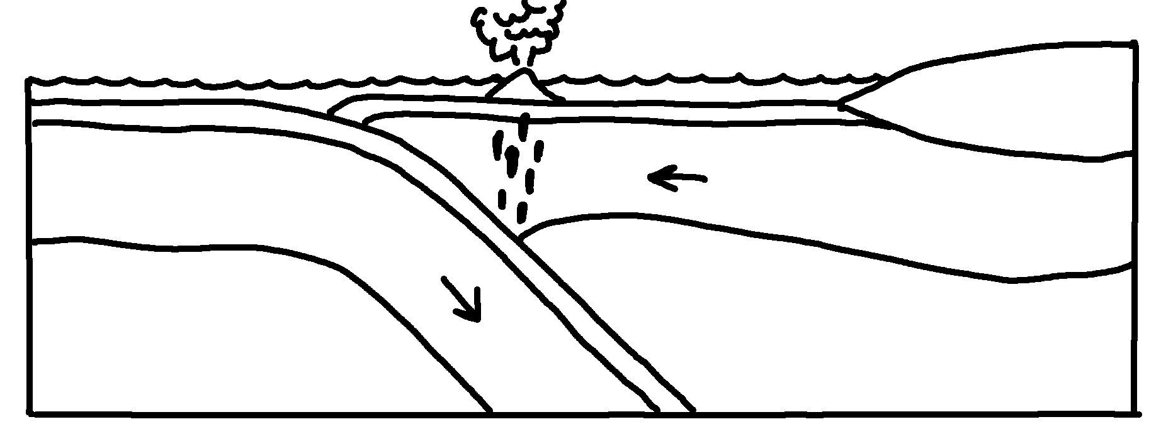
✄
Oceanic Subduction Zone
oceanic crust
island arc
trench
continental crust
lith. mantle
lithospheric mantle
asthenospheric mantle
asthenospheric mantle

Slide 2
oc1nic subduc;n z"o
✄
oc1nic cru/
isl& >c
⠉⠕⠝⠞⠔⠢⠞⠁⠇ ⠉⠗⠥⠌
tr5*
⠇⠊⠞⠓⠲⠀⠍⠁⠝⠞⠇⠑
⠇⠊⠞⠓⠕⠎⠏⠓⠑⠗⠊⠉
⠍⠁⠝⠞⠇⠑
⠁⠎⠞⠓⠑⠝⠕⠎⠏⠓⠑⠗⠊⠉⠀
⠍⠁⠝⠞⠇⠑
⠁⠎⠞⠓⠲⠀⠍⠁⠝⠞⠇⠑

Slide 3
✄

