Slide 1
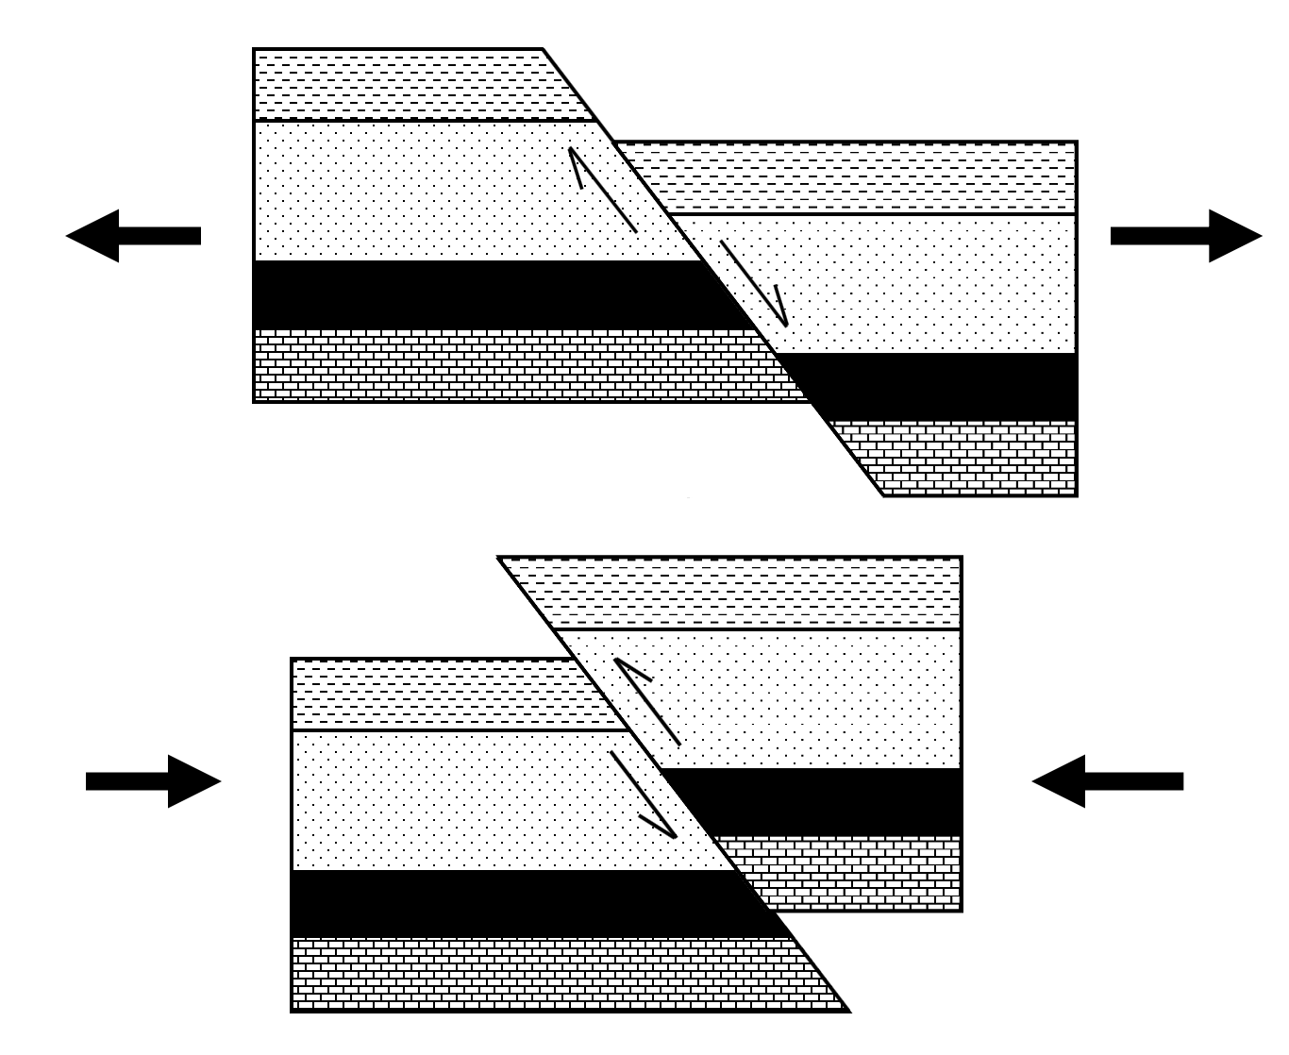
Fault Types
✄
normal fault
reverse fault

Slide 2
⠠⠋⠁⠥⠇⠞⠀⠠⠞⠽⠏⠑⠎
✄
⠝⠕⠗⠍⠁⠇⠀⠋⠁⠥⠇⠞
⠗⠑⠧⠑⠗⠎⠑⠀⠋⠁⠥⠇⠞

Slide 3
✄

