Slide 1
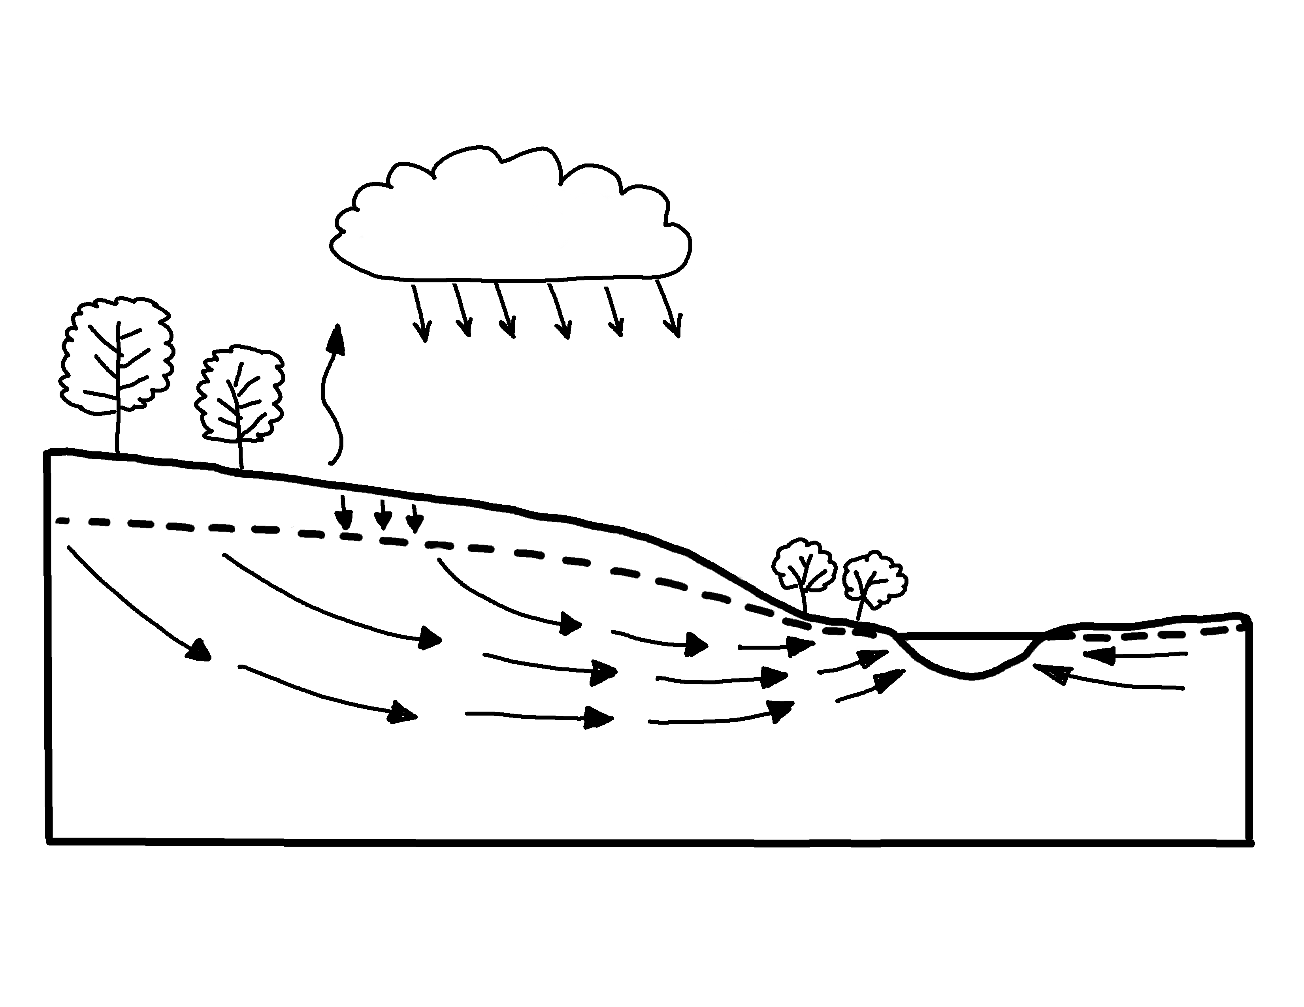

Groundwater Flow Showing Natural Conditions
✄
evaporation
precipitation
infiltration
riparian zone
water table
stream
groundwater flow
modified from https://www.usgs.gov/media/images/groundwater-flow-showing-natural-conditions

Slide 2
⠠⠛⠗⠳⠝⠙⠺⠁⠞⠻⠀⠠⠋⠇⠪⠀⠠⠩⠪⠬⠀
⠠⠝⠁⠞⠥⠗⠁⠇⠀⠠⠉⠕⠝⠙⠊⠞⠊⠕⠝⠎
✄
⠑⠧⠏⠕⠗⠁⠰⠝
⠏⠗⠑⠉⠊⠏⠊⠞⠁⠰⠝
⠔⠋⠊⠇⠞⠗⠁⠰⠝
⠗⠊⠏⠜⠊⠁⠝⠀⠵⠐⠕
⠺⠁⠞⠻⠀⠞⠁⠃⠇⠑
⠌⠗⠂⠍
⠛⠗⠳⠝⠙⠺⠁⠞⠻⠀⠋⠇⠪

Slide 3
✄

