Slide 1
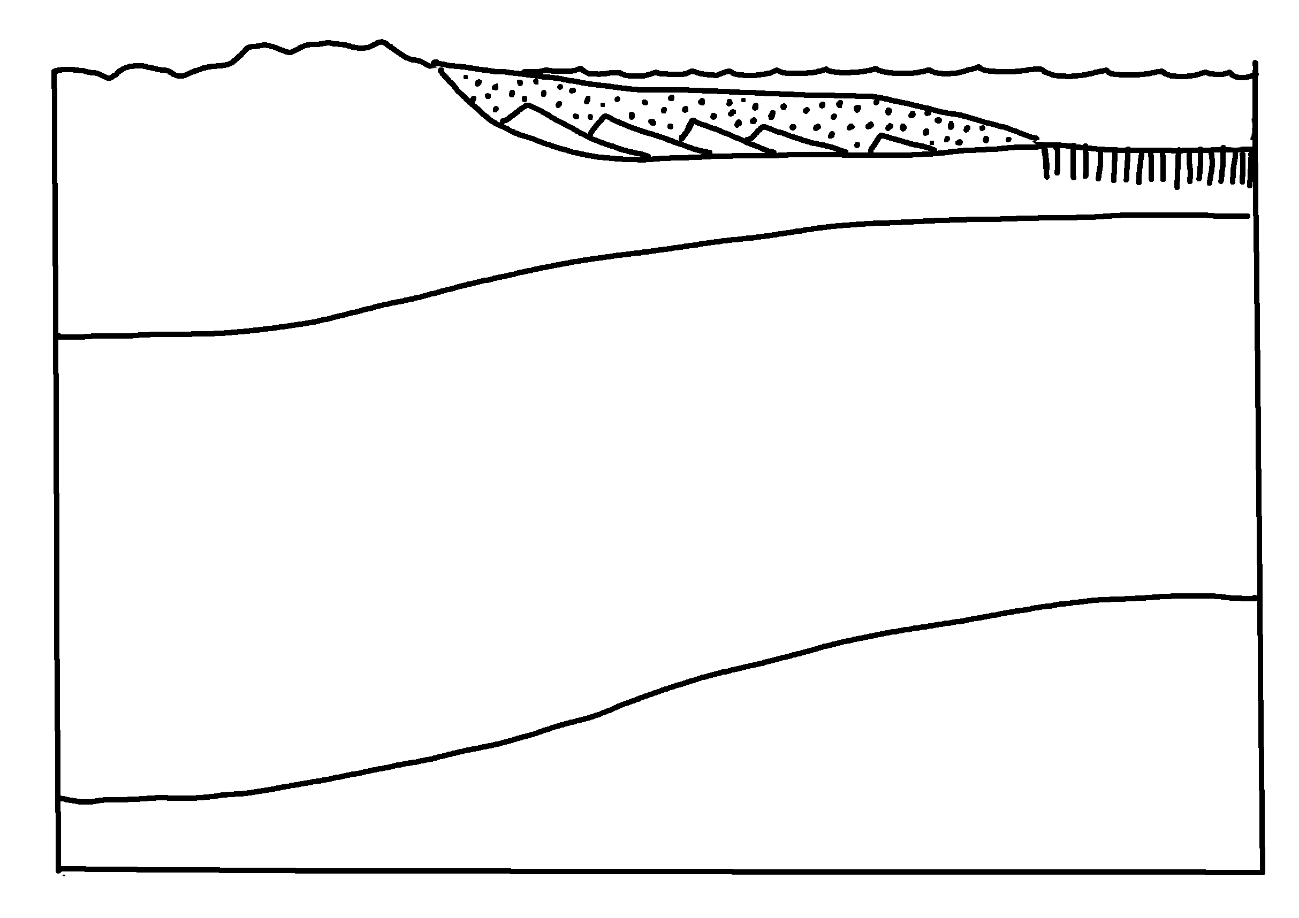
✄
Passive Continental Margin
continent
continental shelf
oceanic crust
continental crust
Moho
continental lithosphere
oceanic lithosphere
lithospheric mantle
asthenospheric mantle
modified from Fig. 4.2 (a) in Marshak, 2019, Earth: Portrait of a Planet, 6th edition

Slide 2
✄
⠠⠓⠁⠇⠊⠞⠑⠀⠠⠉⠗⠽⠌⠁⠇⠀⠠⠌⠗⠥⠉⠞⠥⠗⠑
⠉⠕⠝⠞⠔⠢⠞
⠉⠕⠝⠞⠔⠢⠞⠁⠇⠀⠩⠑⠇⠋
⠕⠉⠂⠝⠊⠉⠀⠉⠗⠥⠌
⠉⠕⠝⠞⠔⠢⠞⠁⠇⠀⠉⠗⠥⠌
⠠⠍⠕⠓⠕
⠉⠕⠝⠞⠊⠝⠑⠝⠞⠁⠇⠀⠇⠊⠞⠓⠕⠎⠏⠓⠑⠗⠑
⠇⠊⠞⠓⠕⠎⠏⠓⠑⠗⠊⠉⠀⠍⠁⠝⠞⠇⠑
⠕⠉⠑⠁⠝⠊⠉⠀⠇⠊⠞⠓⠕⠎⠏⠓⠑⠗⠑
⠁⠎⠞⠓⠑⠝⠕⠎⠏⠓⠑⠗⠊⠉⠀⠍⠁⠝⠞⠇⠑

Slide 3
✄

