Slide 1
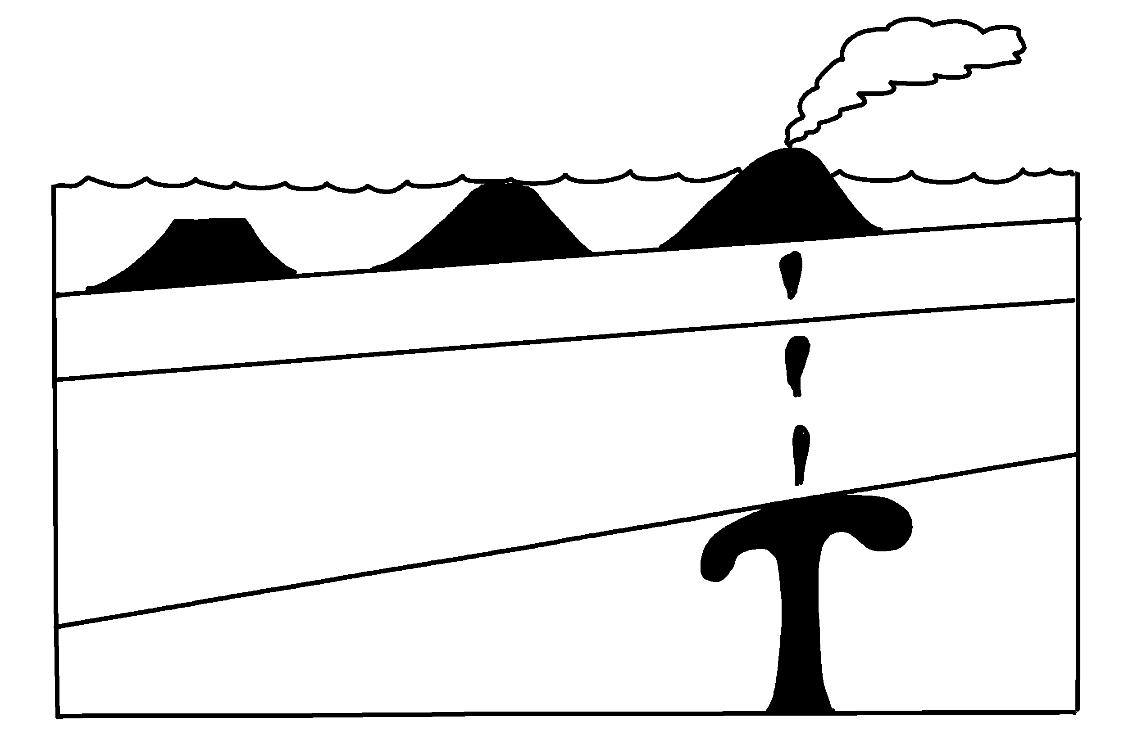
✄
Hotspot Track
atoll
(extinct volcano #2)
seamount
(extinct volcano #1)
active volcano (#3)
oceanic crust
lithospheric mantle
mantle plume
asthenospheric mantle
modified from Fig. 4.17 (b) in Marshak, 2019, Earth: Portrait of a Planet, 6th edition

Slide 2
⠠⠓⠕⠞⠎⠏⠕⠞⠀⠠⠞⠗⠁⠉⠅
✄
⠁⠞⠕⠇⠇⠀
⠐⠣⠧⠕⠇⠉⠁⠝⠕⠀⠼⠃⠐⠜
⠎⠂⠍⠨⠞⠀
⠐⠣⠧⠕⠇⠉⠁⠝⠕⠀⠼⠁⠐⠜
⠁⠉⠞⠊⠧⠑⠀⠧⠕⠇⠉⠁⠝⠕⠀⠐⠣⠼⠉⠐⠜
⠕⠉⠂⠝⠊⠉⠀
⠉⠗⠥⠌
⠇⠊⠞⠓⠕⠎⠏⠓⠑⠗⠊⠉⠀⠍⠁⠝⠞⠇⠑
⠍⠁⠝⠞⠇
⠏⠇⠥⠍⠑
⠁⠎⠞⠓⠑⠝⠕⠎⠏⠓⠑⠗⠊⠉⠀⠍⠁⠝⠞⠇⠑

Slide 3
✄

