Slide 1
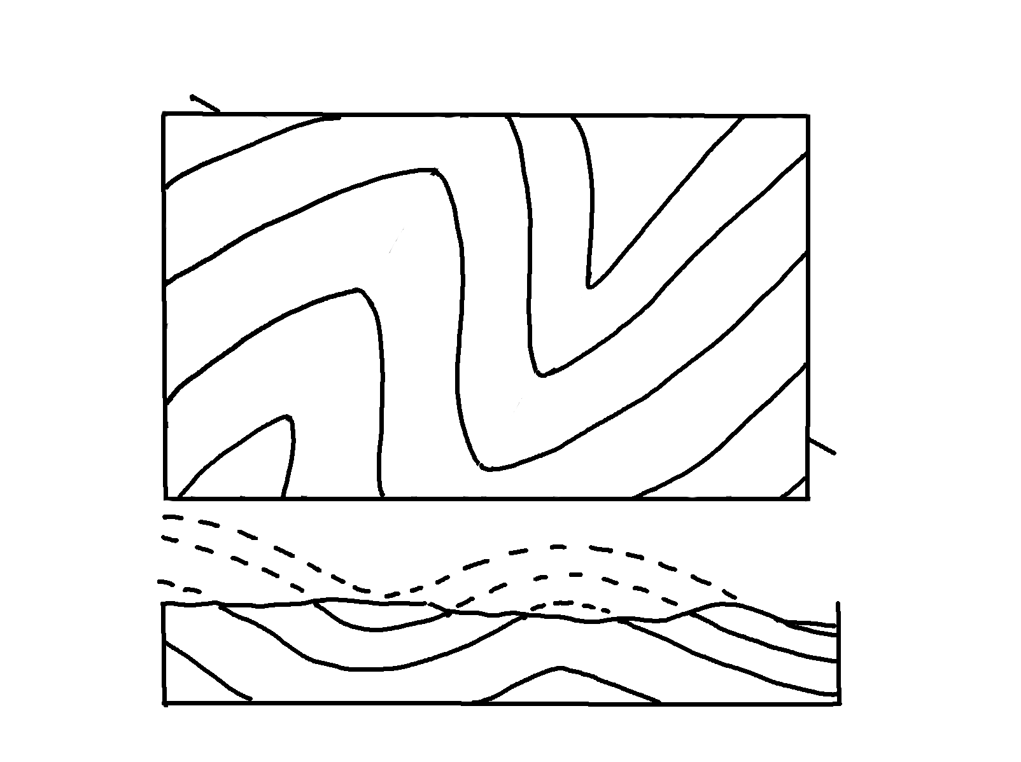
Plunging Folds – Cross-Section, A-B
✄
4
4
5
A
B
3
3
2
2
1
1

Slide 2
⠠⠏⠇⠥⠝⠛⠬⠀⠠⠋⠕⠇⠙⠎⠀⠤⠀⠠⠉⠗⠕⠎⠎⠤⠎⠑⠉⠰⠝⠀⠠⠁⠤⠃
✄
⠼⠙
⠼⠙
⠼⠑
⠠⠁
B
⠼⠉
⠼⠉
⠼⠃
⠼⠃
⠼⠁
⠼⠁

Slide 3
✄

