Slide 1
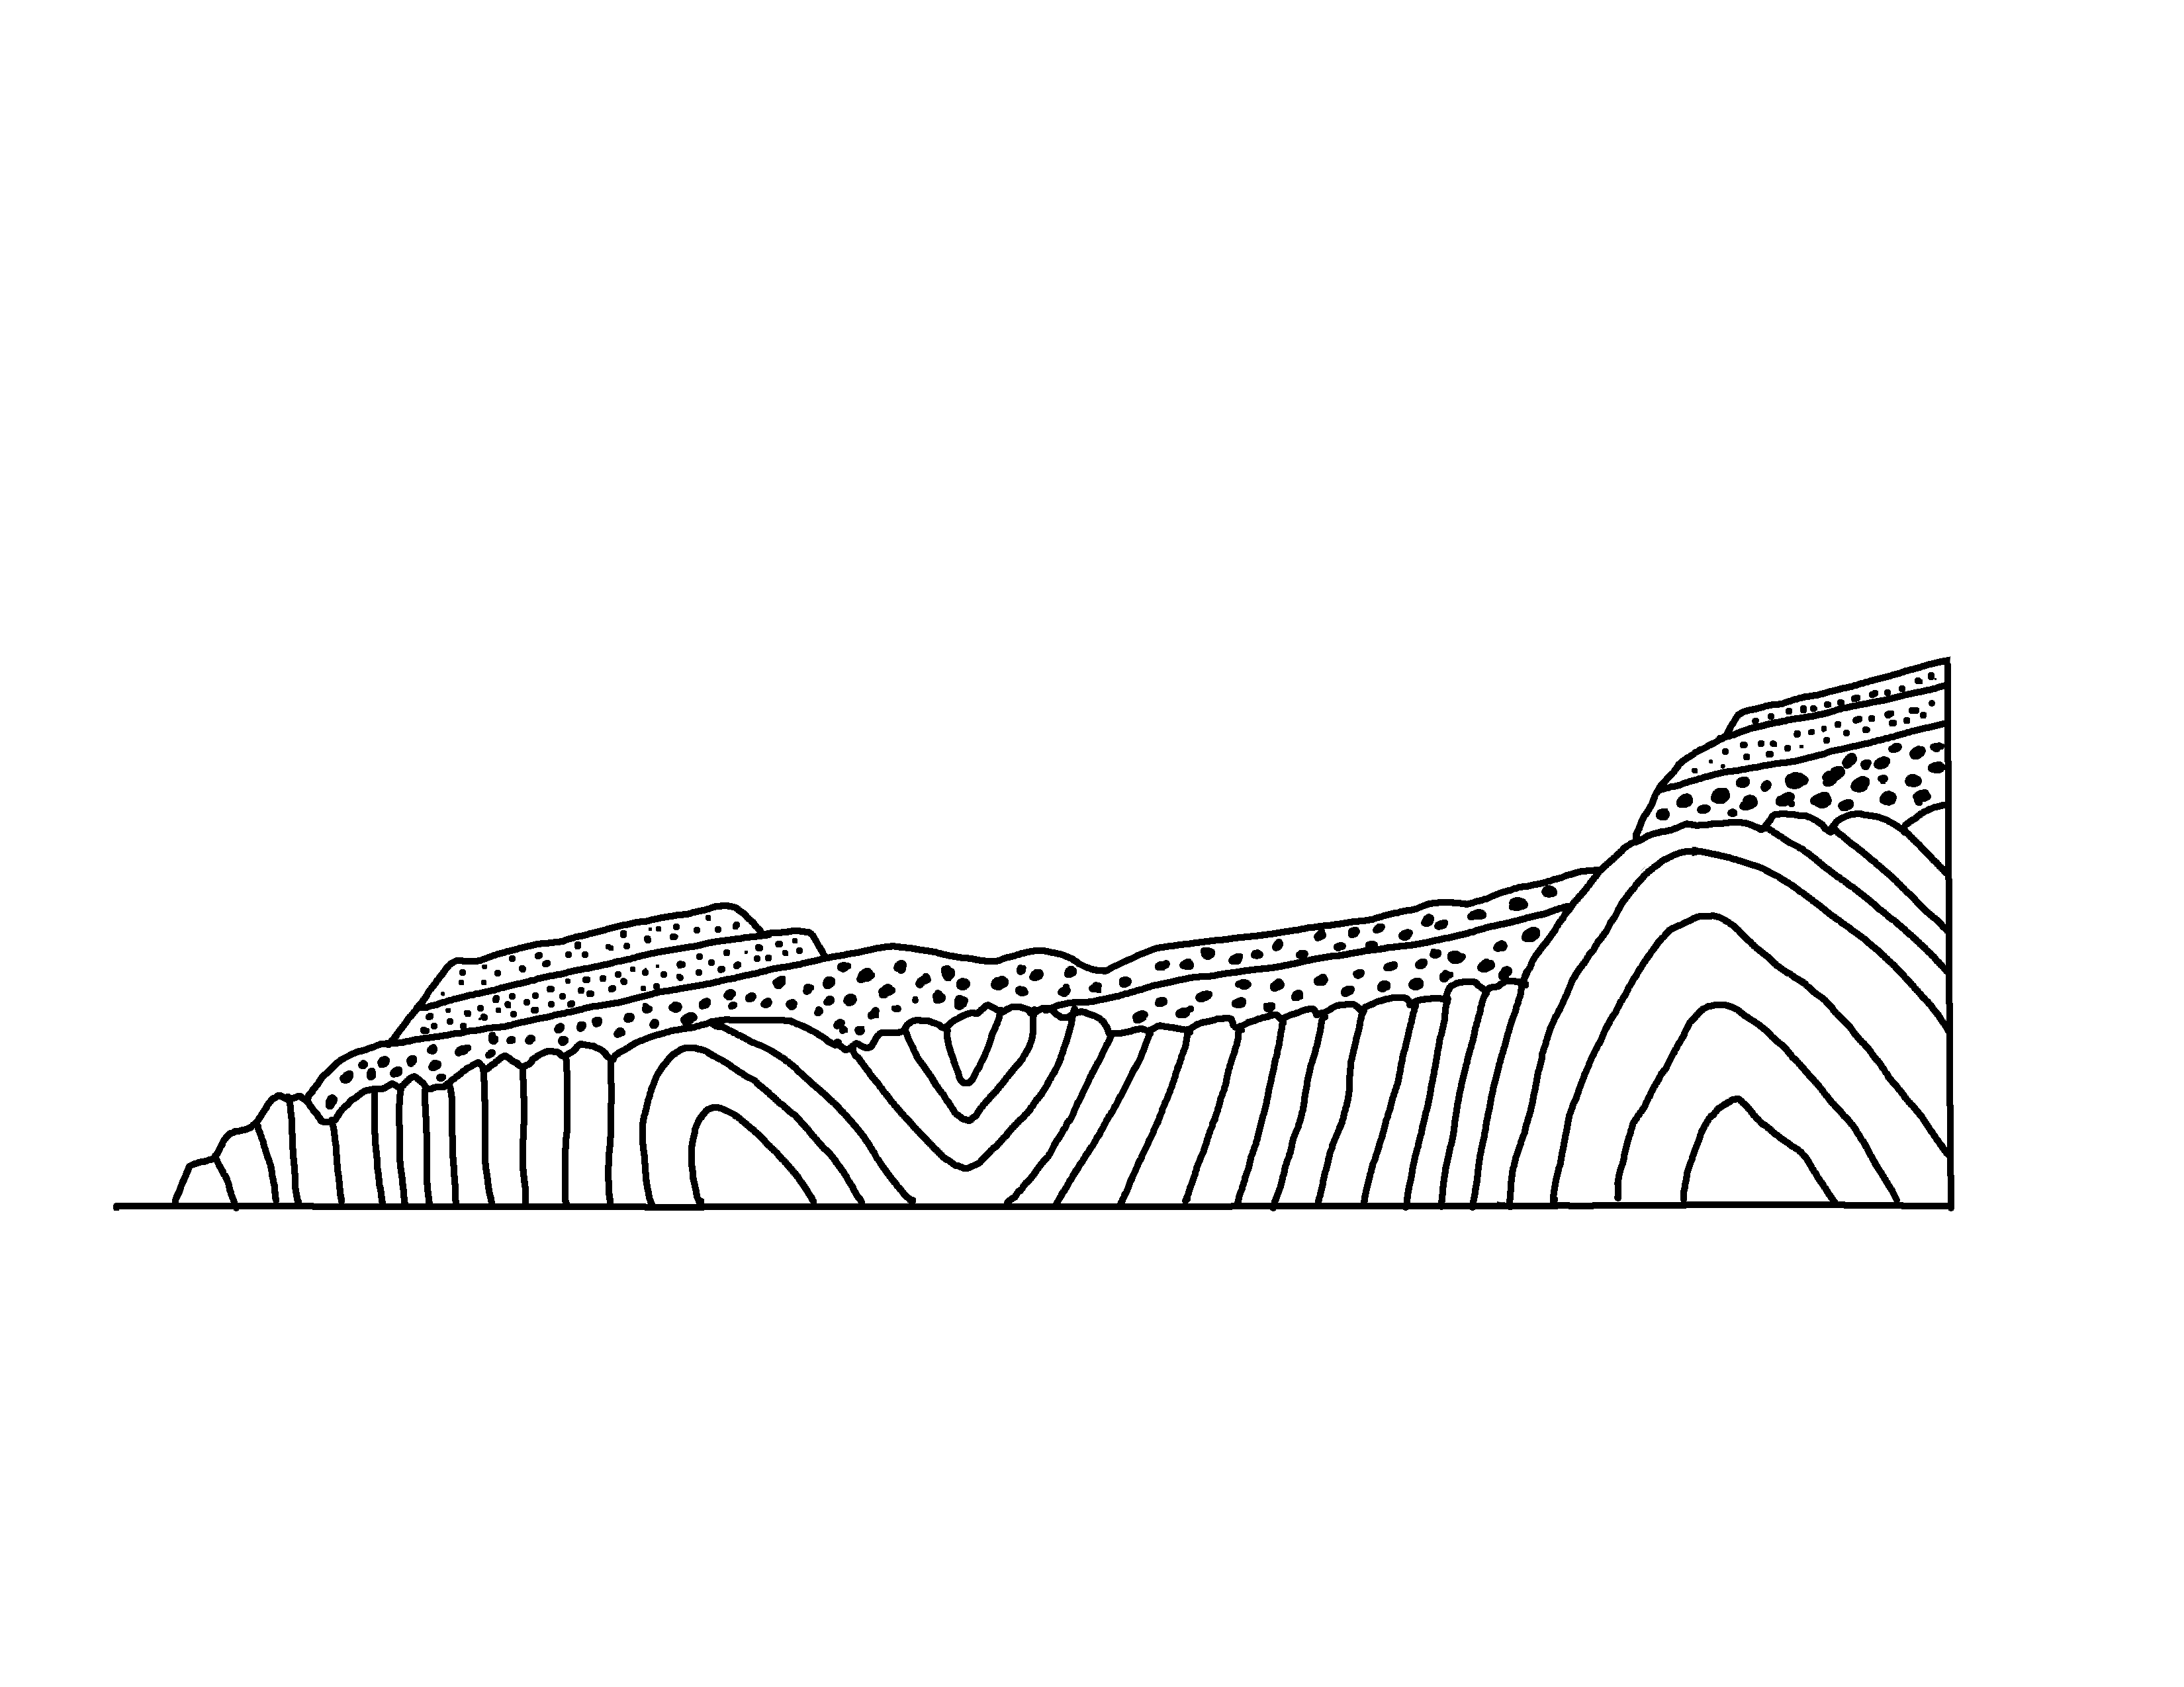
Hutton’s Unconformity at Siccar Point
✄
Devonian clastics
(sandstones and conglomerates)
folded Silurian greywackes
modified from Lyell, C., "Elements of Geology” (1868), p. 78.

Slide 2
⠠⠓⠥⠞⠞⠕⠝⠄⠎⠀⠠⠥⠝⠉⠕⠝⠋⠕⠗⠍⠊⠞⠽⠀⠁⠞⠀⠠⠎⠊⠉⠉⠁⠗⠀⠠⠏⠕⠊⠝⠞
✄
⠠⠙⠑⠧⠕⠝⠊⠁⠝⠀⠉⠇⠁⠌⠊⠉⠎
⠐⠣⠎⠯⠌⠐⠕⠎⠀⠯⠀⠉⠕⠝⠛⠇⠕⠍⠻⠁⠞⠑⠎⠐⠜
⠋⠕⠇⠙⠫⠀⠠⠎⠊⠇⠥⠗⠊⠁⠝⠀⠛⠗⠑⠽⠺⠁⠉⠅⠑⠎

Slide 3
✄

