Slide 1
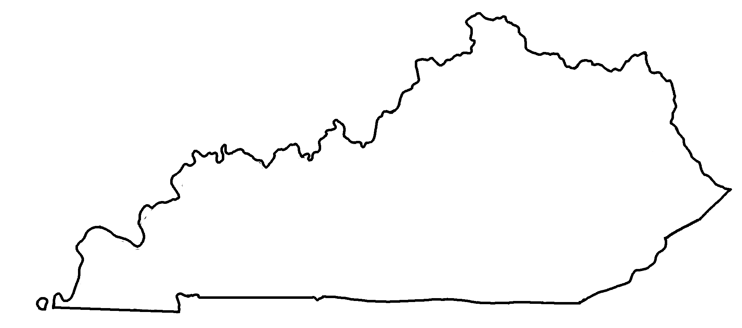
Major Cities in Kentucky
✄
Covington
Louisville
Ashland
Owensboro
Frankfort
Paducah
Lexington
Pikeville
Bowling Green
London
Hopkinsville
Middlesboro

Slide 2
⠠⠍⠁⠚⠕⠗⠀⠠⠉⠊⠞⠊⠑⠎⠀⠔⠀⠠⠅⠢⠞⠥⠉⠅⠽
✄
⠠⠉⠕⠧⠬⠞⠕⠝
⠠⠇⠳⠊⠎⠧⠊⠇⠇⠑
⠠⠁⠩⠇⠯
⠠⠪⠢⠎⠃⠕⠗⠕
⠠⠋⠗⠁⠝⠅⠿⠞
⠠⠏⠁⠙⠥⠉⠁⠓
⠠⠇⠑⠭⠬⠞⠕⠝
⠠⠏⠊⠅⠑⠧⠊⠇⠇⠑
⠠⠃⠪⠇⠬⠀⠠⠛⠗⠑⠑⠝
⠠⠇⠕⠝⠙⠕⠝
⠠⠓⠕⠏⠅⠔⠎⠧⠊⠇⠇⠑
⠠⠍⠊⠙⠙⠇⠑⠎⠃⠕⠗⠕

Slide 3
✄

