Slide 1
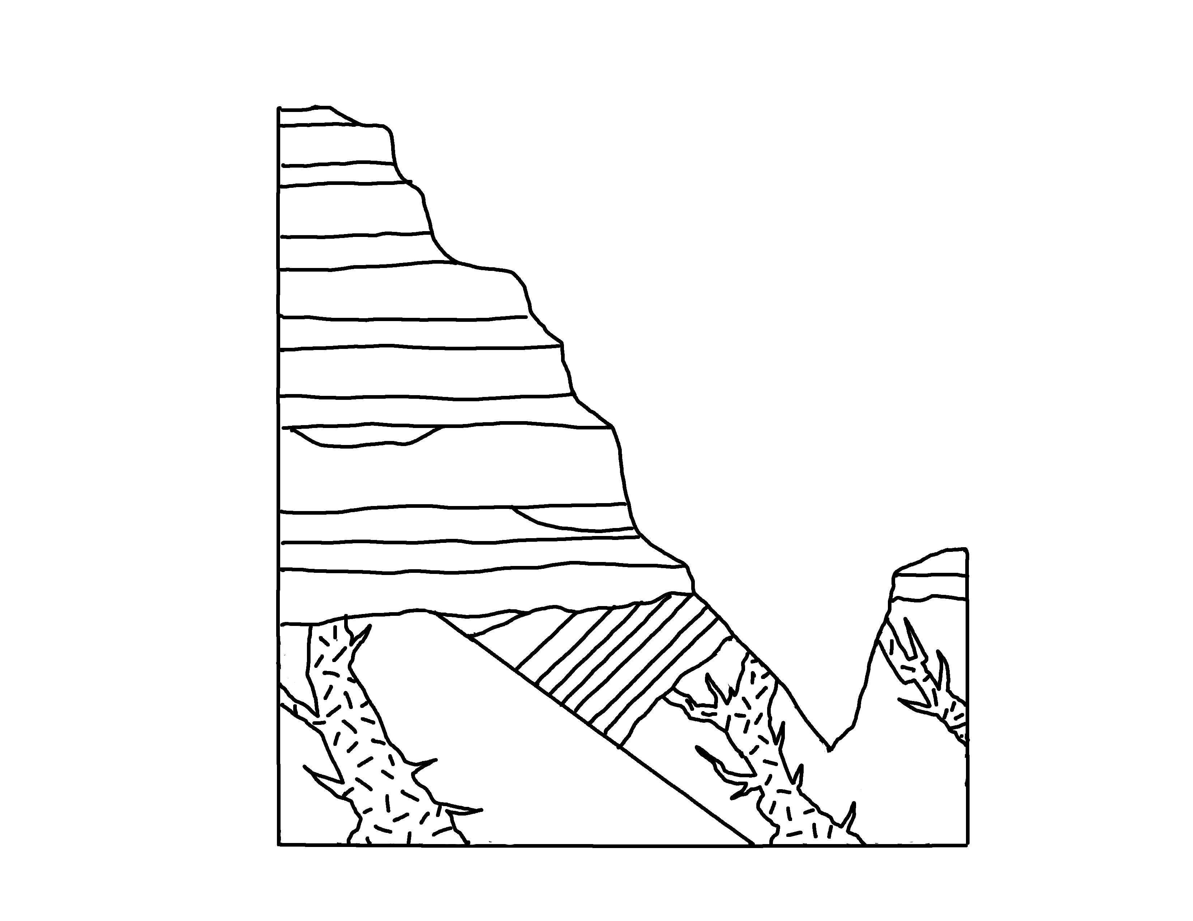
Grand Canyon – Paleozoic Units
✄
Moenkopi Fm.
Kaibab Limestone
Toroweap Fm.
Coconino Sandstone
Hermit Shale
Supai Group
Surprise Canyon Fm.
Temple Butte Lms.
Redwall Limestone
Great Unconformity
Bright Angel Shale
Muav Lms.
Tapeats Sandstone

Slide 2
⠠⠛⠗⠯⠀⠠⠉⠁⠝⠽⠕⠝⠀⠠⠤⠀
⠠⠏⠁⠇⠑⠕⠵⠕⠊⠉⠀⠠⠥⠝⠊⠞⠎
✄
⠠⠍⠕⠢⠅⠕⠏⠊⠀⠠⠋⠍⠲
⠠⠅⠁⠊⠃⠁⠃⠀⠠⠇⠊⠍⠑⠌⠐⠕
⠠⠞⠕⠗⠪⠂⠏⠀⠠⠋⠍⠲
⠠⠉⠕⠒⠔⠕⠀⠠⠎⠯⠌⠐⠕
⠠⠎⠥⠗⠏⠗⠊⠎⠑⠀⠠⠉⠁⠝⠽⠕⠝⠀⠠⠋⠍⠲
⠠⠓⠻⠍⠊⠞⠀⠠⠩⠁⠇⠑
⠠⠞⠑⠍⠏⠇⠑⠀
⠠⠃⠥⠞⠞⠑⠀
⠠⠇⠍⠎⠲
⠠⠎⠥⠏⠁⠊⠀
⠠⠛⠗⠳⠏
⠠⠛⠗⠑⠁⠞⠀⠠⠥⠝⠉⠕⠝⠋⠕⠗⠍⠊⠞⠽
⠠⠃⠗⠊⠛⠓⠞⠀⠠⠁⠝⠛⠑⠇⠀⠠⠎⠓⠁⠇⠑
⠠⠗⠫⠺⠁⠇⠇⠀
⠠⠇⠊⠍⠑⠌⠐⠕
⠠⠍⠥⠁⠧⠀⠠⠇⠍⠎⠲⠀
⠠⠞⠁⠏⠂⠞⠎⠀⠠⠎⠯⠌⠐⠕

Slide 3
✄

