Slide 1
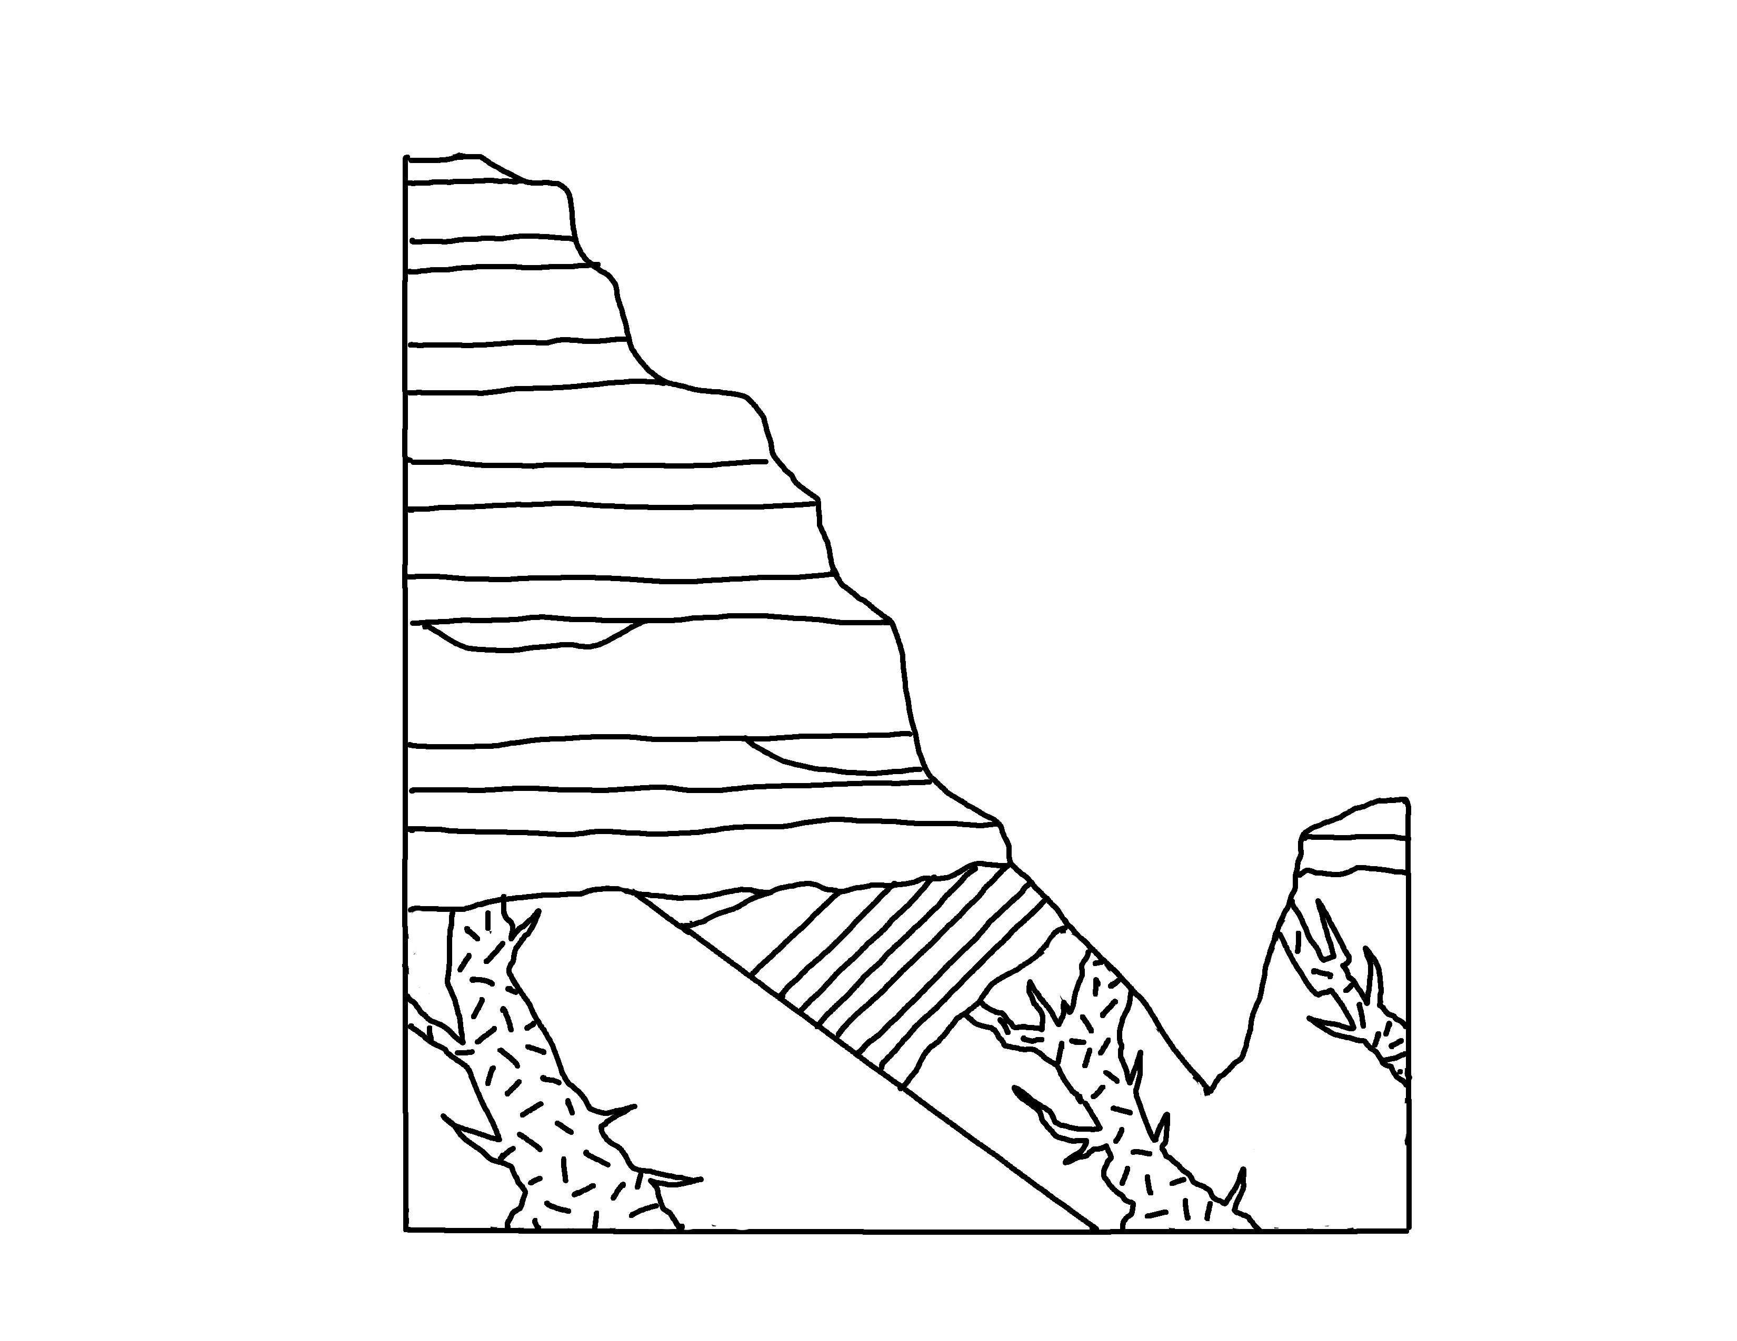
✄
Grand Canyon – Precambrian Units
Great Unconformity
Paleozoic
Tapeats Sandstone
GC Supergroup
Proterozoic
Vishnu Schist
Vishnu Schist
Zoroaster Granite
Zoroaster Granite
12
12

Slide 2
⠠⠛⠗⠯⠀⠠⠉⠁⠝⠽⠕⠝⠀⠤⠀⠠⠏⠗⠑⠉⠁⠍⠃⠗⠊⠁⠝⠀⠠⠥⠝⠊⠞⠎
✄
⠠⠛⠗⠑⠁⠞⠀⠠⠥⠝⠉⠕⠝⠋⠕⠗⠍⠊⠞⠽
⠠⠏⠁⠇⠑⠕⠵⠕⠊⠉
⠠⠞⠁⠏⠑⠁⠞⠎⠀⠠⠎⠁⠝⠙⠎⠞⠕⠝⠑
⠠⠠⠛⠉⠀
⠠⠎⠥⠏⠻⠤
⠛⠗⠳⠏
⠠⠏⠗⠕⠞⠻⠕⠵⠕⠊⠉
⠠⠧⠊⠎⠝⠥⠀⠠⠎⠡⠊⠌
⠠⠧⠊⠎⠝⠥⠀⠠⠎⠡⠊⠌
⠠⠵⠕⠗⠕⠁⠌⠻⠀⠠⠛⠗⠁⠝⠊⠞⠑
12
12

Slide 3
✄
12
12

