Slide 1
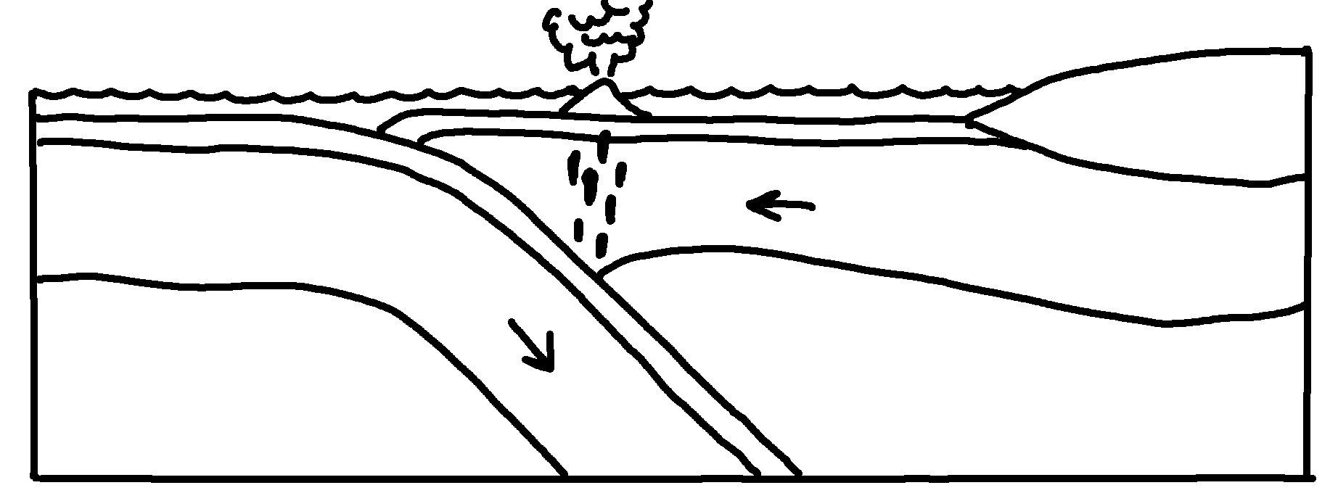
✄
Oceanic Subduction Zone
oceanic crust
island arc
trench
continental crust
lith. mantle
lithospheric mantle
asthenospheric mantle
asthenospheric mantle

Slide 2
⠠oc1nic ⠠subduc;n ⠠z"o
✄
oc1nic cru/
isl& >c
3⠞⠔⠢⠞⠁⠇ ⠉⠗⠥⠌
tr5*
⠇⠊?⠲⠀⠍⠁⠝⠞⠇⠑
⠇⠊?⠕⠎⠏⠓}⠊⠉
⠍⠁⠝⠞⠇⠑
⠁⠎!nosph}ic⠀
⠍⠁⠝⠞⠇⠑
⠁⠎!nosph}ic ⠀
⠍⠁⠝⠞⠇⠑

Slide 3
✄

