Slide 1
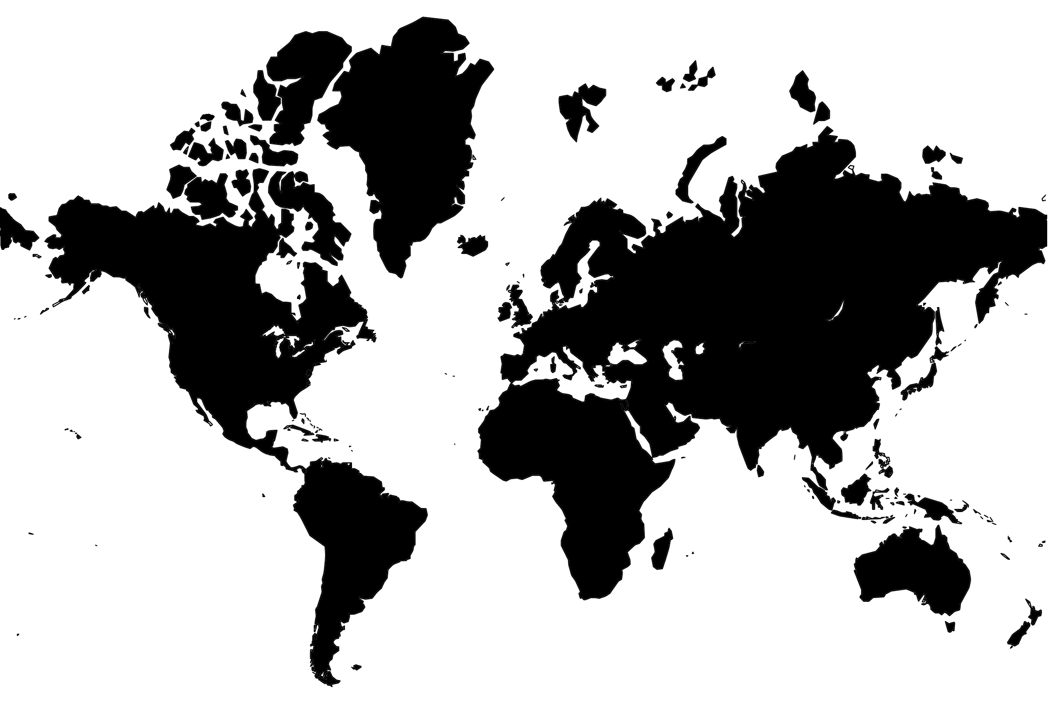
World Map (Mercator)
✄

Slide 2
⠠⠸⠺⠀⠠⠍⠁⠏ "<,m]cator">
✄

Slide 3
✄

