Slide 1
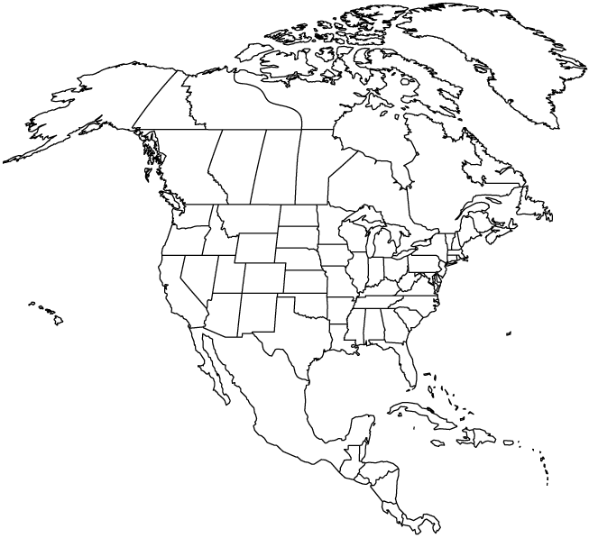
✄
North America Showing the
Present Greenland Ice Sheet

Slide 2
⠠⠝⠕⠗⠹⠀⠠⠁⠍⠻⠊⠉⠁⠀⠠⠩⠪⠬⠀⠮
⠠⠏⠗⠑⠎⠢⠞⠀⠠⠛⠗⠑5⠇⠯⠀⠠⠊⠉⠑⠀⠠⠩⠑⠑⠞
✄

Slide 3
✄

