Slide 1
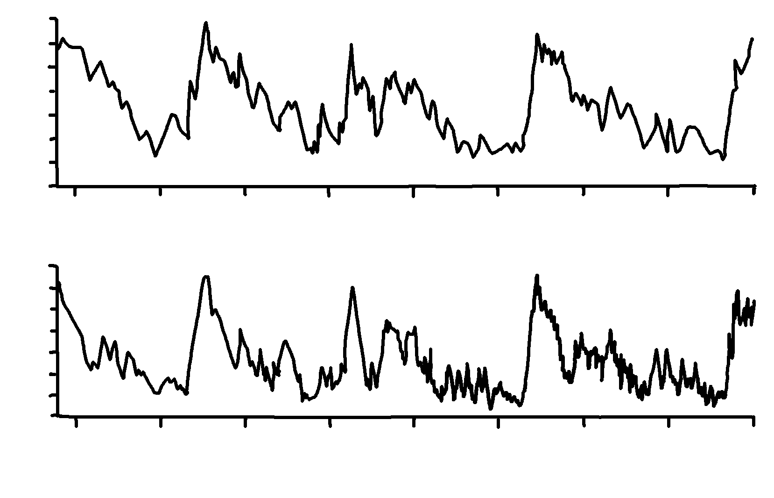
Vostok Ice Core
✄
CO2 concentration (ppm)
modified from https://www.grida.no/resources/6443
300
160
T change from present (present = 1950)
+4
0
-10
400 300 200 100 0
Thousands of years before present (1950)

Slide 2
⠠⠧⠕⠌⠕⠅⠀⠠⠊⠉⠑⠀⠠⠉⠕⠗⠑
✄
⠠⠉,⠕⠼⠃⠀3c⠢⠞⠗⠁⠰⠝⠀⠐⠣⠏⠏⠍⠐⠜
⠼⠉⠚⠚
⠼⠁⠋⠚
;⠠⠞⠀⠡⠁⠝⠛⠑⠀⠋⠀⠏⠗⠑⠎⠢⠞⠀⠐⠣⠏⠗⠑⠎5⠞⠀⠐⠶⠀⠼⠁⠊⠑⠚⠐⠜
⠼⠙
⠼⠚
"⠤⠼⠁⠚
⠼⠙⠚⠚
⠼⠉⠚⠚
⠼⠃⠚⠚
⠼⠁⠚⠚
⠼⠚
⠠⠹⠳⠎⠯⠎⠀⠷⠀⠽⠑⠜⠎⠀2f pres5t ⠐⠣⠼⠁⠊⠑⠚⠐⠜

Slide 3
✄

