Slide 1
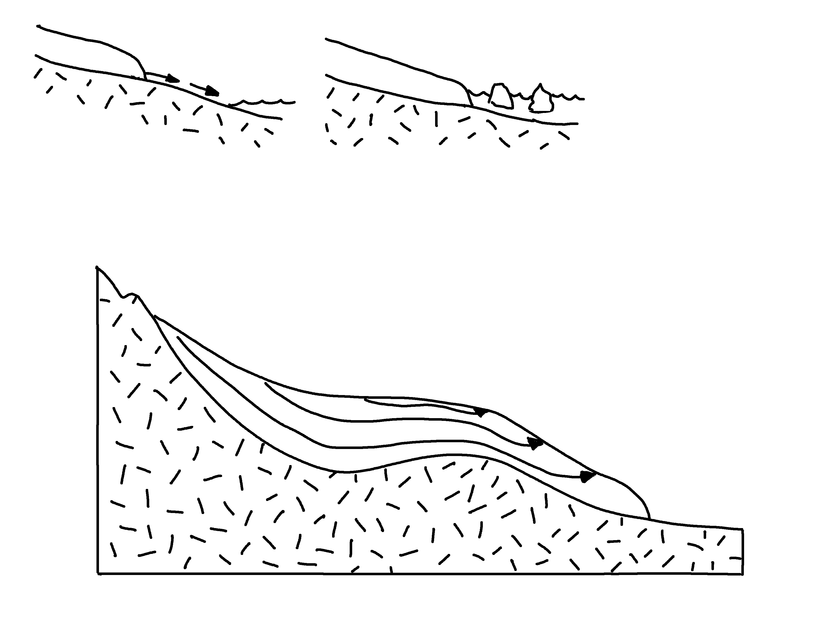
Alpine Glacier
✄
snow
equilibrium line
accumulation
zone of ablation
ice flow
terminus
sublimation
ice
meltwater
stream
ice
iceberg calving
modified from Fig. 22.8 (d) in Marshak, 2019, Earth: Portrait of a Planet, 6th edition

Slide 2
⠠⠁⠇⠏⠔⠑⠀⠠⠛⠇⠁⠉⠊⠻
✄
⠎⠝⠪
⠑⠟⠥⠊⠇⠊⠃⠗⠊⠥⠍⠀⠇⠔⠑
⠁⠒⠥⠍⠥⠇⠁⠰⠝
⠵⠐⠕⠀⠷⠀⠁⠃⠇⠁⠰⠝
⠊⠉⠑
⠋⠇⠪
⠞⠻⠍⠔⠥⠎
⠍⠑⠇⠞⠺⠁⠞⠻⠀
⠌⠗⠂⠍
⠎⠥⠃⠇⠊⠍⠁⠰⠝
⠊⠉⠑
⠊⠉⠑
⠊⠉⠑⠃⠻⠛⠀⠉⠁⠇⠧⠬
modified from

Slide 3
✄
modified from

