Slide 1
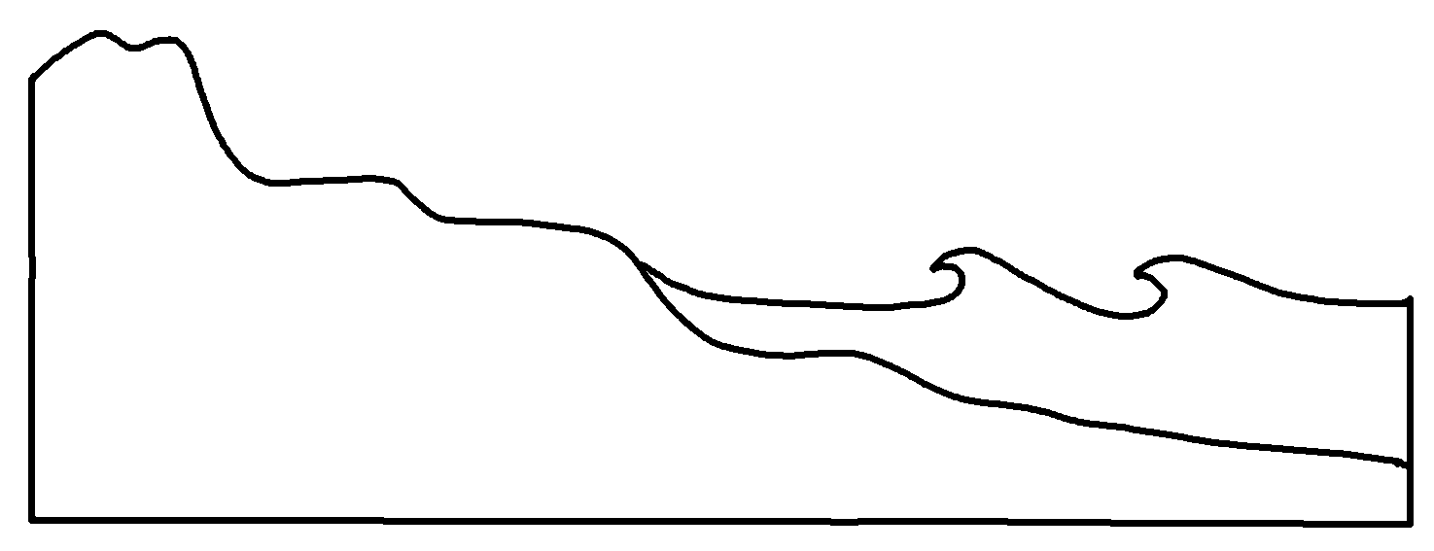
Beach Cross-Section
✄
coastal area
surf zone
upland
backshore
foreshore
shoreface
offshore
dune
berms
high water
breakers
beach
scarp
low water
bottom
sand
modified from https://www.nps.gov/articles/geomonitoring-marine-features-and-processes.htm

Slide 2
⠠⠃⠂⠡⠀⠠⠉⠗⠕⠎⠎⠤⠎⠑⠉⠰⠝
✄
⠉⠕⠁⠌⠁⠇⠀⠜⠑⠁
⠎⠥⠗⠋⠀⠵⠐⠕
⠥⠏⠇⠯
⠃⠁⠉⠅⠩⠕⠗⠑
⠿⠑⠩⠕⠗⠑
⠩⠕⠗⠑⠋⠁⠉⠑
⠷⠋⠩⠕⠗⠑
⠙⠥⠝⠑
⠃⠻⠍⠎
⠓⠊⠣⠀⠺⠁⠞⠻
⠃⠗⠂⠅⠻⠎
⠃⠂⠡⠀⠎⠉⠜⠏
⠇⠪⠻⠀⠺⠁⠞⠻
⠃⠕⠞⠞⠕⠍
s&

Slide 3
✄

