Slide 1
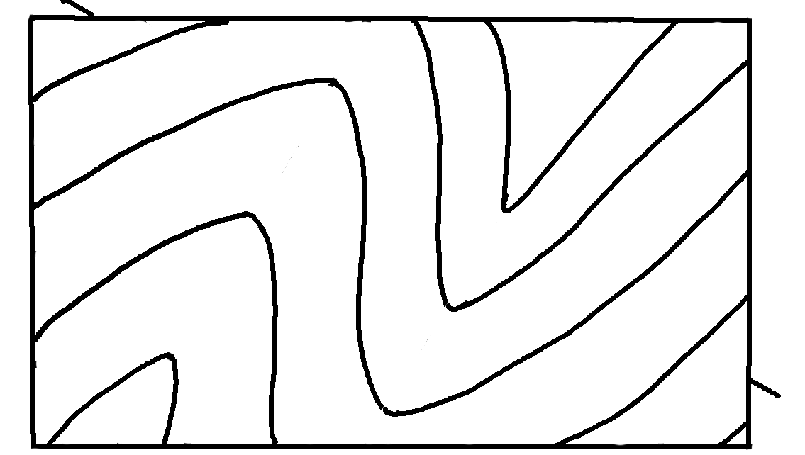
Plunging Folds – Map View
✄
A
North
B

Slide 2
⠠⠏⠇⠥⠝⠛⠬⠀⠠⠋⠕⠇⠙⠎⠀⠤⠀⠠⠍⠁⠏⠀⠠⠧⠊⠑⠺
✄
⠠⠁
⠠⠝⠕⠗⠹
⠠B

Slide 3
✄

