Slide 1
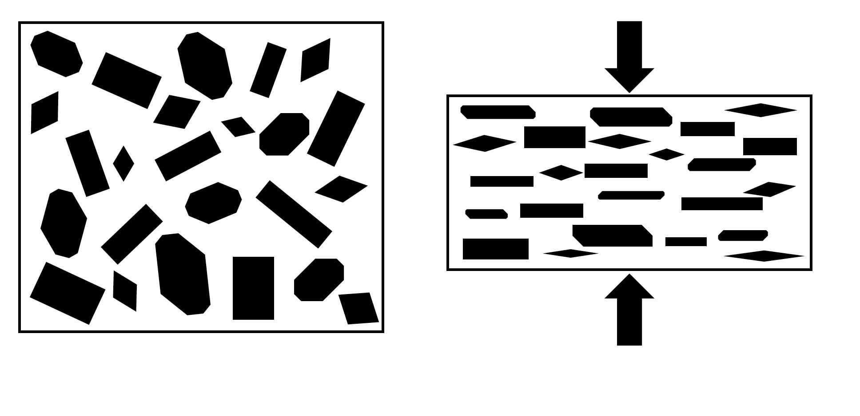
Metamorphic Foliation
✄
unfoliated protolith
foliated metamorphic rock

Slide 2
⠠⠍⠑⠞⠁⠍⠕⠗⠏⠓⠊⠉⠀⠠⠋⠕⠇⠊⠁⠰⠝
✄
⠋⠕⠇⠊⠁⠞⠫
⠍⠑⠞⠁⠍⠕⠗⠏⠓⠊⠉⠀⠗⠕⠉⠅
⠥⠝⠋⠕⠇⠊⠁⠞⠫ ⠏⠗⠕⠞⠕⠇⠊⠹

Slide 3
✄

