Slide 1
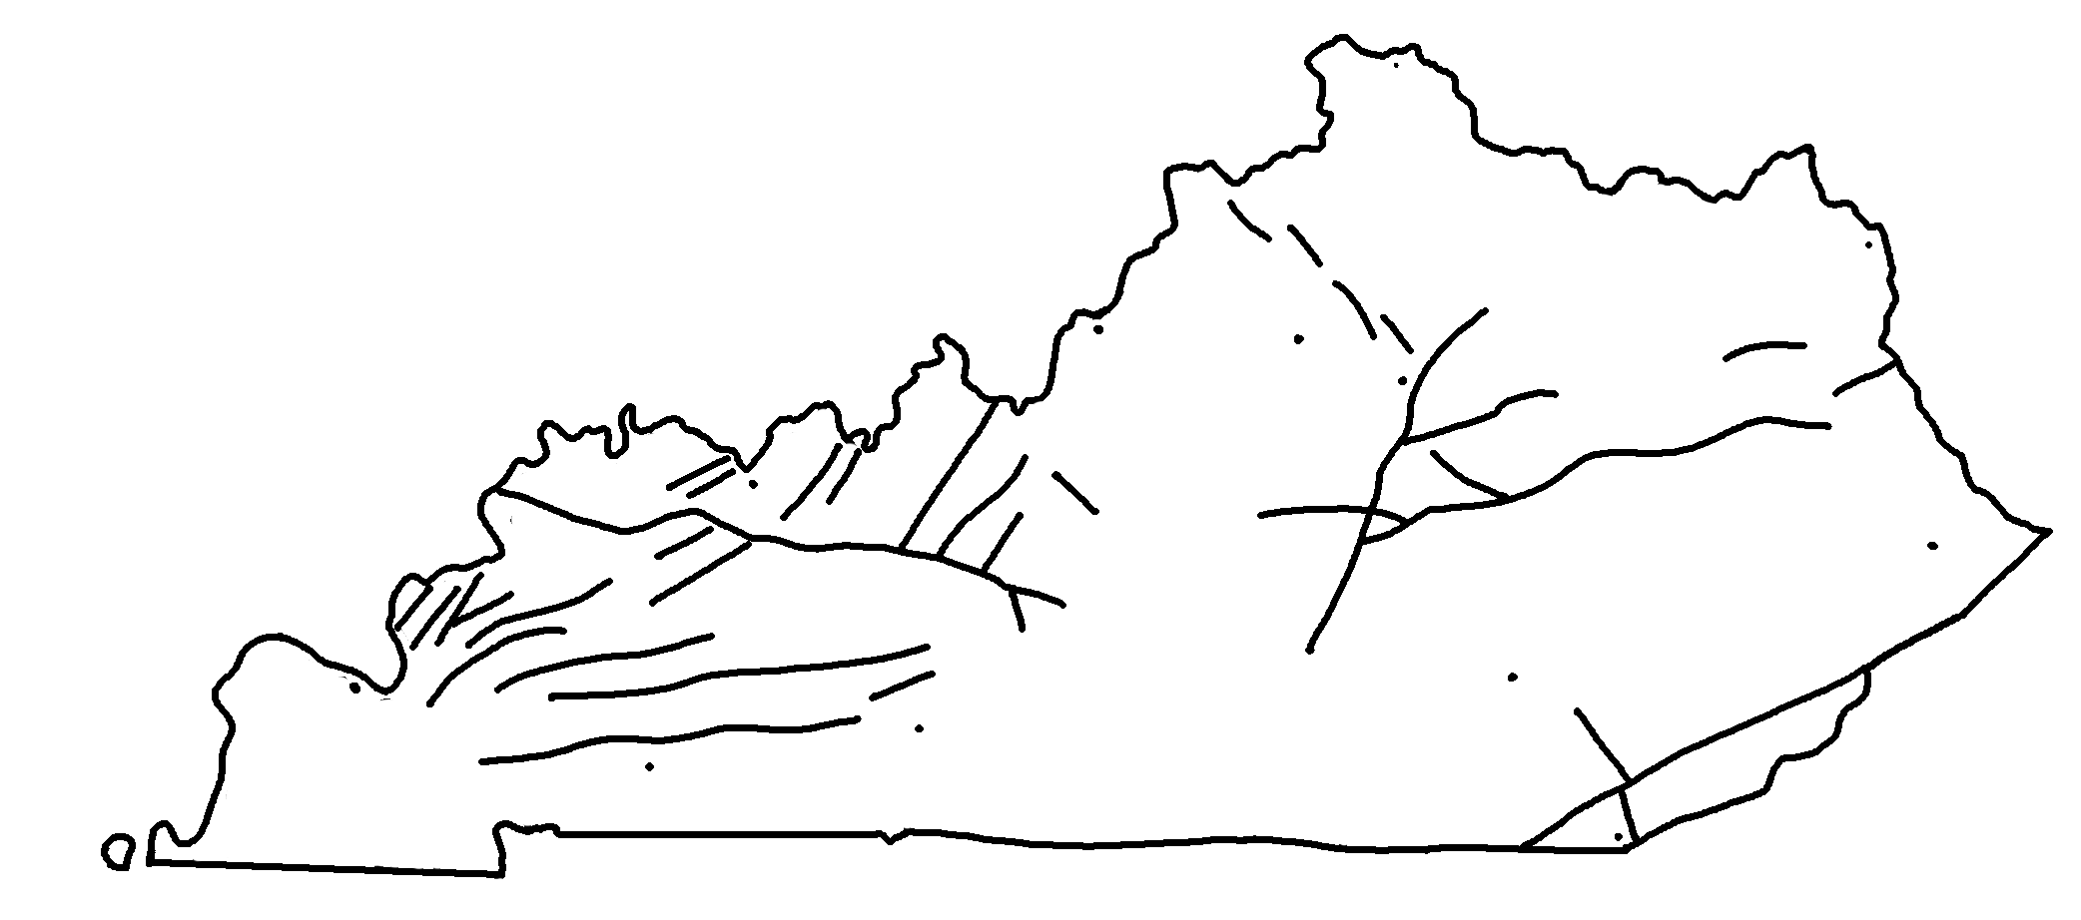
Map of Faults in Kentucky
✄
Major cities are unlabeled,
but shown as small dots.
modified from https://www.uky.edu/KGS/geoky/index.htm

Slide 2
⠠⠍⠁⠏⠀⠷⠀⠠⠋⠁⠥⠇⠞⠎⠀⠔⠀⠠⠅⠢⠞⠥⠉⠅⠽
✄
⠠⠍⠁⠚⠕⠗⠀⠉⠊⠞⠊⠑⠎⠀⠜⠑⠀⠥⠝⠇⠁b⠇⠫⠂
b ⠩⠪⠝⠀⠵⠀⠎⠍⠁⠇⠇⠀⠙⠕⠞⠎⠲

Slide 3
✄

