Slide 1
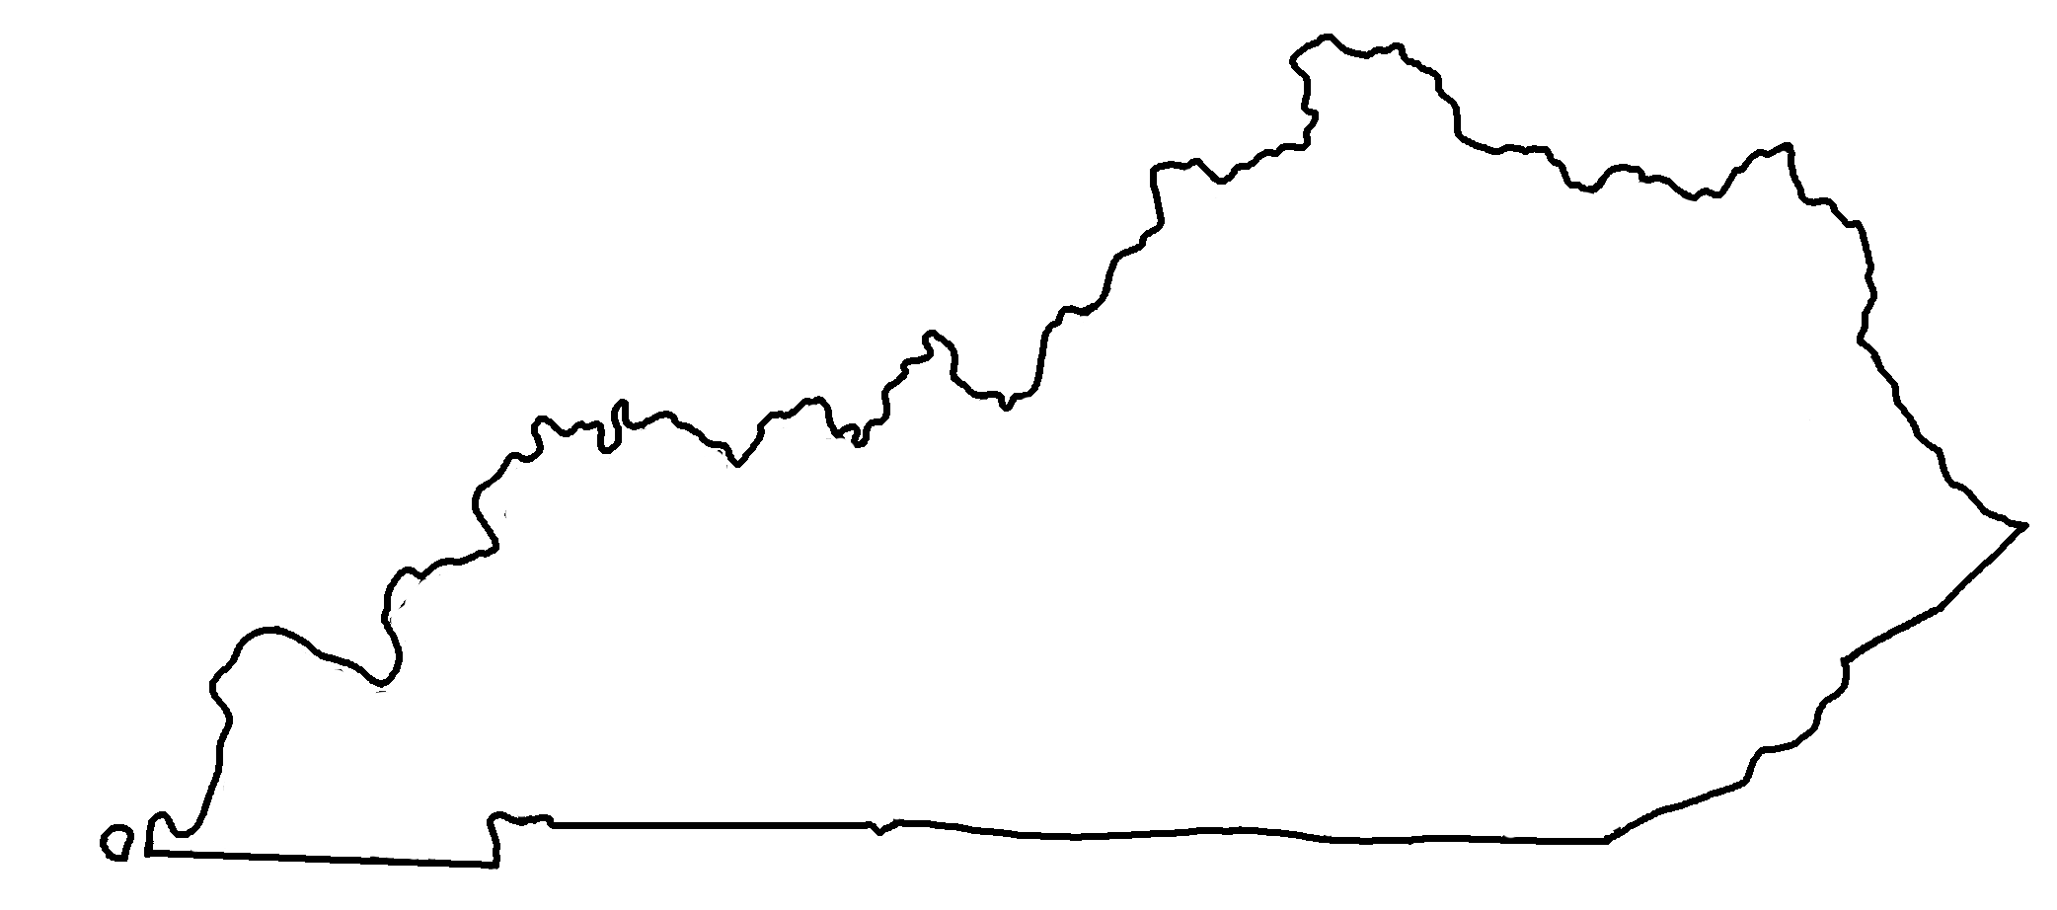

Kentucky Geologic Cross-Section A-B
✄
B
A
A
Mississippi Embayment
Illinois Basin
B
Cincinnati Arch
Appalachian Basin

Slide 2
✄
✄
Legend
Tertiary / Cretaceous
Pennsylvanian
Mississippian
Devonian
Silurian
Ordovician
Cambrian
Precambrian
modified from https://www.uky.edu/KGS/geoky/index.htm
modified from https://www.uky.edu/KGS/geoky/index.htm

Slide 3
⠠⠅⠢⠞⠥⠉⠅⠽⠀⠠⠛⠑⠕⠇⠕⠛⠊⠉⠀⠠⠉⠗⠕⠎⠎⠤⠎⠑⠉⠰⠝⠀⠠⠁⠤;,⠃
✄
;⠠⠃
⠠⠁
⠠⠁
⠠⠍⠊⠎⠎⠊⠎⠎⠊⠏⠏⠊
⠠⠑⠍⠃⠁⠽⠰⠞
⠠⠊⠇⠇⠔⠕⠊⠎⠀⠠⠃⠁⠎⠔
⠠⠁⠏⠏⠁⠇⠁⠡⠊⠁⠝⠀
⠠⠃⠁⠎⠔
;⠠⠃
⠠⠉⠔⠉⠔⠝⠁⠞⠊⠀⠠⠜⠡

Slide 4
✄
⠠⠇⠑⠛⠢⠙
✄
⠠⠞⠻⠞⠊⠜⠽⠀⠸⠌⠀⠠⠉⠗⠑⠞⠁⠉⠑⠳⠎
⠠⠏⠢⠝⠎⠽⠇⠧⠁⠝⠊⠁⠝
⠠⠍⠊⠎⠎⠊⠎⠎⠊⠏⠏⠊⠁⠝
⠠⠙⠑⠧⠕⠝⠊⠁⠝
⠠⠎⠊⠇⠥⠗⠊⠁⠝
⠠⠕⠗⠙⠕⠧⠊⠉⠊⠁⠝
⠠⠉⠁⠍⠃⠗⠊⠁⠝
⠠⠏⠗⠑⠉⠁⠍⠃⠗⠊⠁⠝
modified from https://www.uky.edu/KGS/geoky/index.htm
modified from https://www.uky.edu/KGS/geoky/index.htm

Slide 5
✄

