Slide 1
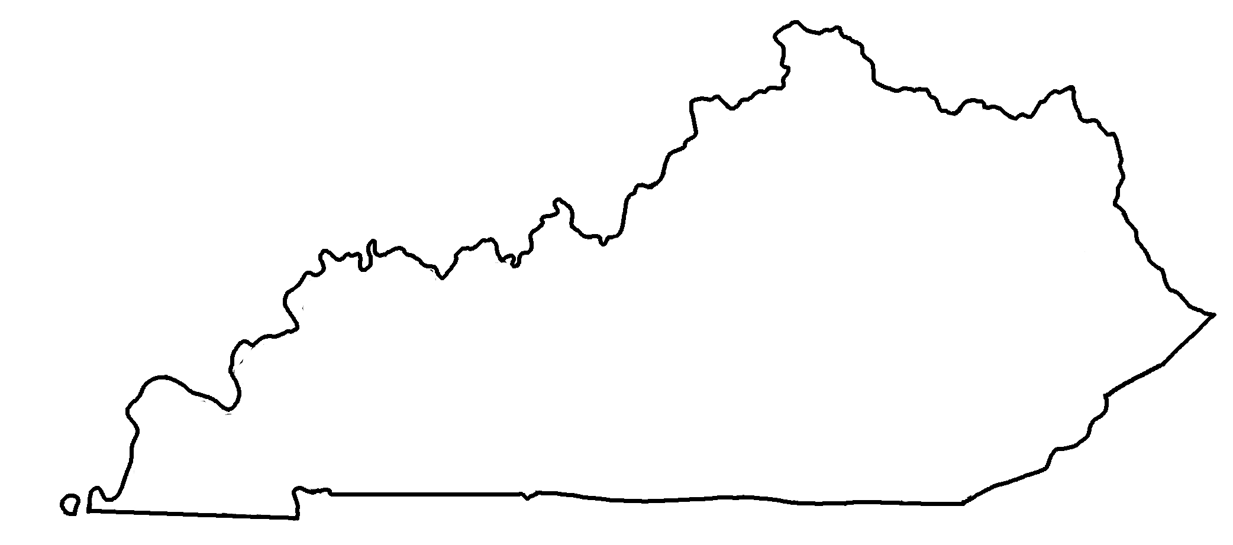
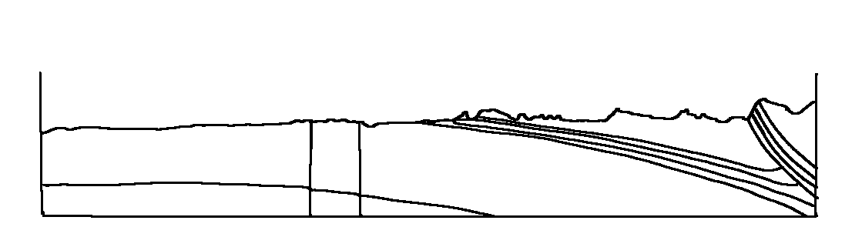
Kentucky Geologic Cross-Section C-D
✄
C
D
C
D
Appalachian Basin
Cincinnati Arch

Slide 2
✄
✄
Legend
Tertiary / Cretaceous
Pennsylvanian
Mississippian
Devonian
Silurian
Ordovician
Cambrian
Precambrian
modified from https://www.uky.edu/KGS/geoky/index.htm
modified from https://www.uky.edu/KGS/geoky/index.htm

Slide 3
⠠⠅⠢⠞⠥⠉⠅⠽⠀⠠⠛⠑⠕⠇⠕⠛⠊⠉⠀
⠠⠉⠗⠕⠎⠎⠤⠎⠑⠉⠰⠝⠀;⠠⠉⠤;,⠙
✄
;⠠⠉
;⠠⠙
;⠠⠉
⠠⠁⠏⠏⠁⠇⠁⠡⠊⠁⠝
⠠⠃⠁⠎⠔
;⠠⠙
⠠⠉⠔⠉⠔⠝⠁⠞⠊⠀⠠⠜⠡

Slide 4
✄
⠠⠇⠑⠛⠢⠙
✄
⠠⠞⠻⠞⠊⠜⠽⠀⠸⠌ ⠠⠉⠗⠑⠞⠁⠉⠑⠳⠎
⠠⠏⠢⠝⠎⠽⠇⠧⠁⠝⠊⠁⠝
⠠⠍⠊⠎⠎⠊⠎⠎⠊⠏⠏⠊⠁⠝
⠠⠙⠑⠧⠕⠝⠊⠁⠝
⠠⠎⠊⠇⠥⠗⠊⠁⠝
⠠⠕⠗⠙⠕⠧⠊⠉⠊⠁⠝
⠠⠉⠁⠍⠃⠗⠊⠁⠝
⠠⠏⠗⠑⠉⠁⠍⠃⠗⠊⠁⠝
modified from https://www.uky.edu/KGS/geoky/index.htm
modified from https://www.uky.edu/KGS/geoky/index.htm

Slide 5
✄

