Slide 1
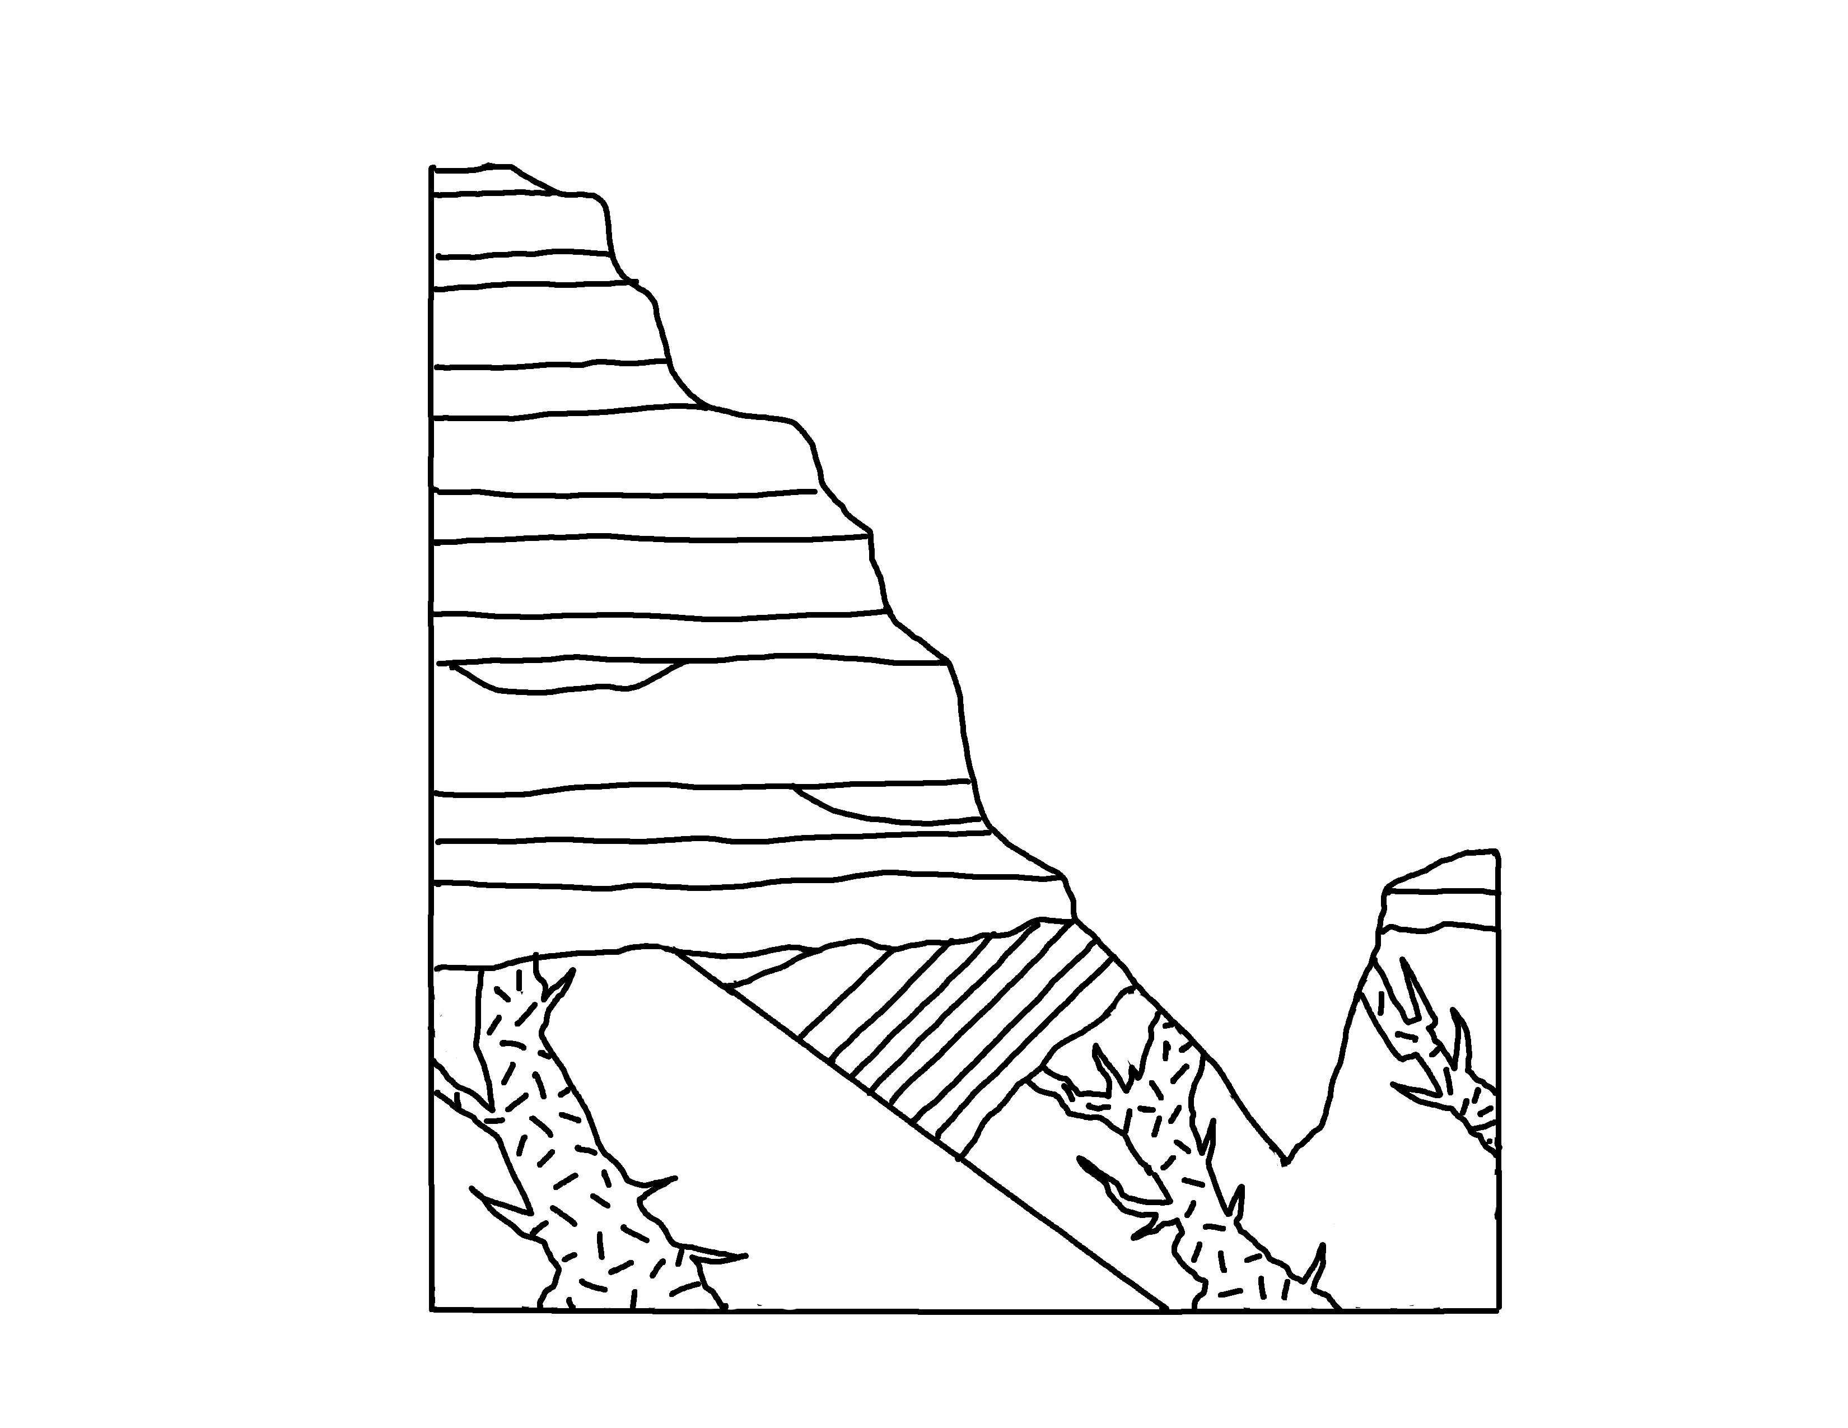
✄
1
Grand Cayon – Paleozoic Units
2
3
4
5
6
7
8
Great Unconformity
10
9
11
12

Slide 2
Key
✄
1 Moenkopi Fm.
2 Kaibab Fm.
3 Toroweap Fm.
4 Coconino Sandstone
5 Hermit Shale
6 Supai Group
7 Surprise Canyon Fm.
8 Redwall Limestone
9 Temple Butte Limestone
10 Muav Limestone⠀
11 Bright Angel Shale
12 Tapeats Sandstone

Slide 3
⠼1
✄
⠠⠛⠗⠯⠀⠠⠉⠁⠝⠽⠕⠝⠀⠠⠤⠀
⠠⠏⠁⠇⠑⠕⠵⠕⠊⠉⠀⠠⠥⠝⠊⠞⠎
⠼2
⠼3
⠼4
⠼5
⠼6
⠼ 9
⠠⠛⠗⠞⠀
⠠⠥⠝⠉⠕⠝⠤
⠿⠍⠰⠽
⠼7
⠼8
⠼ 10
⠼ 11
⠼ 12

Slide 4
⠠⠅⠑⠽
✄
⠼⠁ ⠠⠍⠕⠢⠅⠕⠏⠊⠀⠠⠋⠍⠲
⠼2 ⠠⠅⠁⠊⠃⠁⠃⠀⠠⠋⠍⠲
⠼3 ⠠⠞⠕⠗⠪⠂⠏⠀⠠⠋⠍⠲
⠼4 ⠠⠉⠕⠉⠕⠝⠔⠕⠀⠠⠎⠯⠌⠐⠕
⠼5 ⠠⠓⠻⠍⠊⠞⠀⠠⠩⠁⠇⠑
⠼6 ⠠⠎⠥⠏⠁⠊⠀⠠⠛⠗⠳⠏
⠼7 ⠠⠎⠥⠗⠏⠗⠊⠎⠑⠀⠠⠉⠁⠝⠽⠕⠝⠀⠠⠋⠍⠲
⠼8 ⠠⠗⠫⠺⠁⠇⠇⠀⠠⠇⠊⠍⠑⠌⠐⠕
⠼9 ⠠⠞⠑⠍⠏⠇⠑⠀⠠⠃⠥⠞⠞⠑⠀⠠⠇⠊⠍⠑⠌⠐⠕
⠼10 ⠠⠍⠥⠁⠧⠀⠠⠇⠊⠍⠑⠌⠐⠕
⠼11 ⠠⠃⠐⠗⠀⠠⠁⠝⠛⠑⠇⠀⠠⠩⠁⠇⠑⠀
⠼12 ⠠⠞⠁⠏⠂⠞⠎⠀⠠⠎⠯⠌⠐⠕

Slide 5
✄

