Slide 1
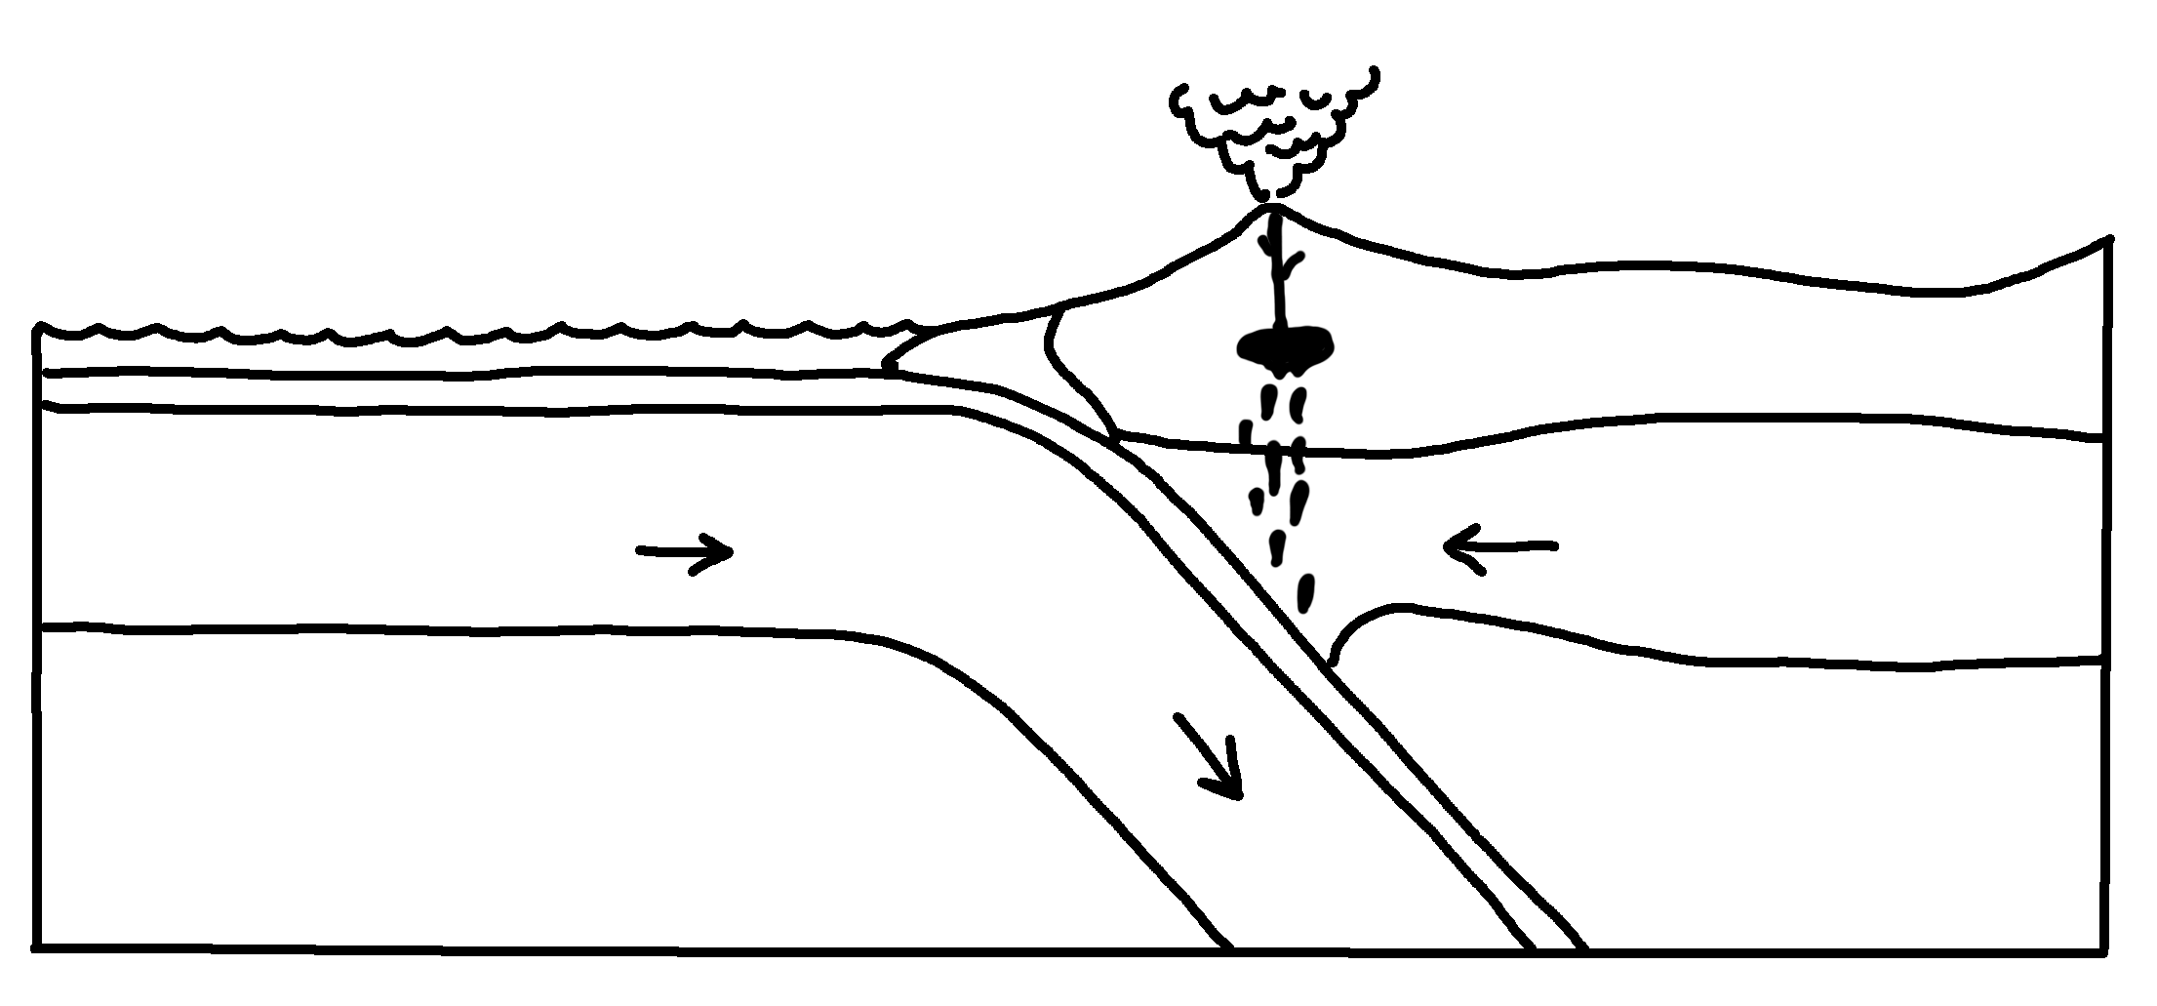
✄
Continental Margin Subduction Zone
volcanic arc
oceanic crust
accretionary wedge
trench
continental crust
lithospheric mantle
lith. mantle
asthenospheric mantle
asth. mantle

Slide 2
⠠3⠞⠔⠢⠞⠁⠇⠀⠠⠍⠜⠛⠔⠀⠠⠎⠥⠃⠙⠥⠉⠰⠝⠀⠠⠵⠐⠕
✄
⠕⠉⠂⠝⠊⠉⠀⠉⠗⠥⠌
⠧⠕⠇⠉⠁⠝⠊⠉⠀⠜⠉
⠁⠒⠗⠑;n⠜⠽⠀⠺⠫⠛⠑
⠞⠗⠢⠡
3⠞⠔⠢⠞⠁⠇⠀⠉⠗⠥⠌
⠇⠊?⠕⠎⠏⠓]⠊⠉⠀
⠍⠁⠝⠞⠇⠑
⠇⠊?⠲⠀
⠍⠁⠝⠞⠇⠑
⠁⠎!n⠕⠎⠏⠓]⠊⠉⠀
⠍⠁⠝⠞⠇⠑
⠁⠎?⠲⠀⠍⠁⠝⠞⠇⠑

Slide 3
✄

