Slide 1
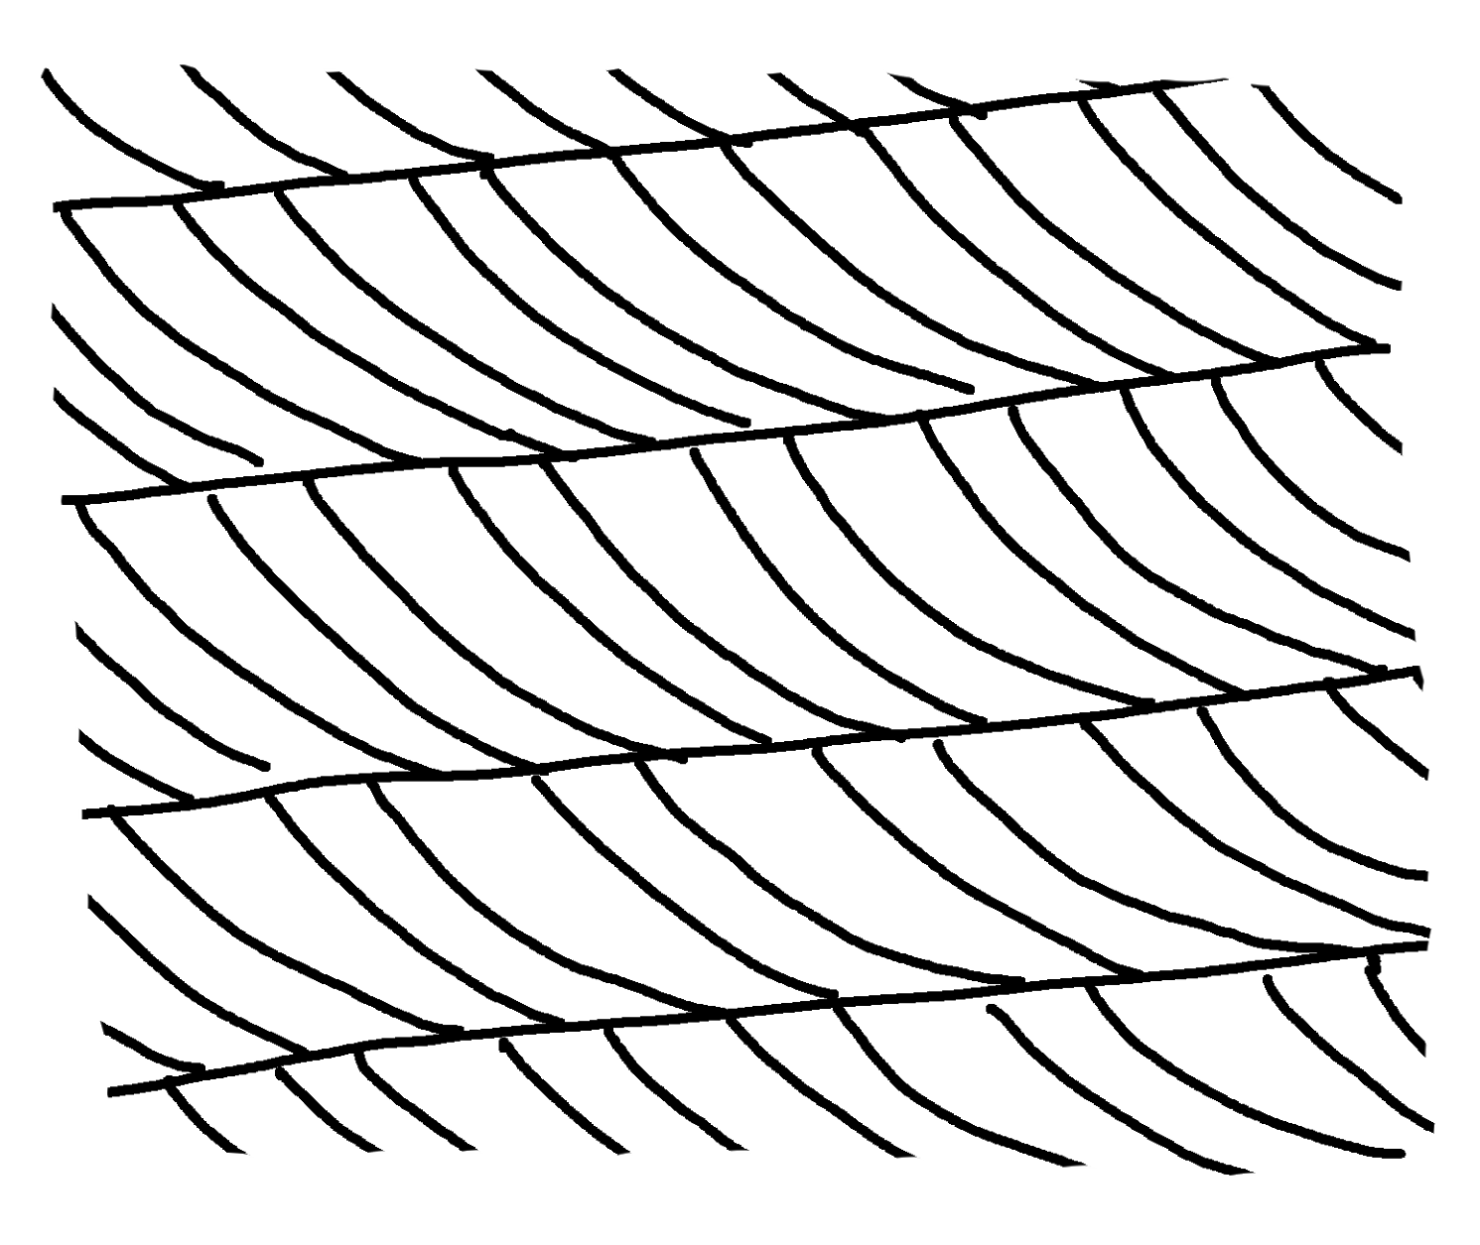
✄
Cross-Bedding
crossbeds
masterbed
masterbed
current
direction
masterbed

Slide 2
✄
⠠⠉⠗⠕⠎⠎⠤⠃⠫⠙⠬
⠉⠗⠕⠎⠎⠃⠫⠎
⠍⠁⠌⠻⠃⠫
⠍⠁⠌⠻⠃⠫
⠉⠥⠗r⠢⠞⠀⠙⠊⠗⠑⠉⠰⠝
⠍⠁⠌⠻⠃⠫

Slide 3
✄

