Slide 1
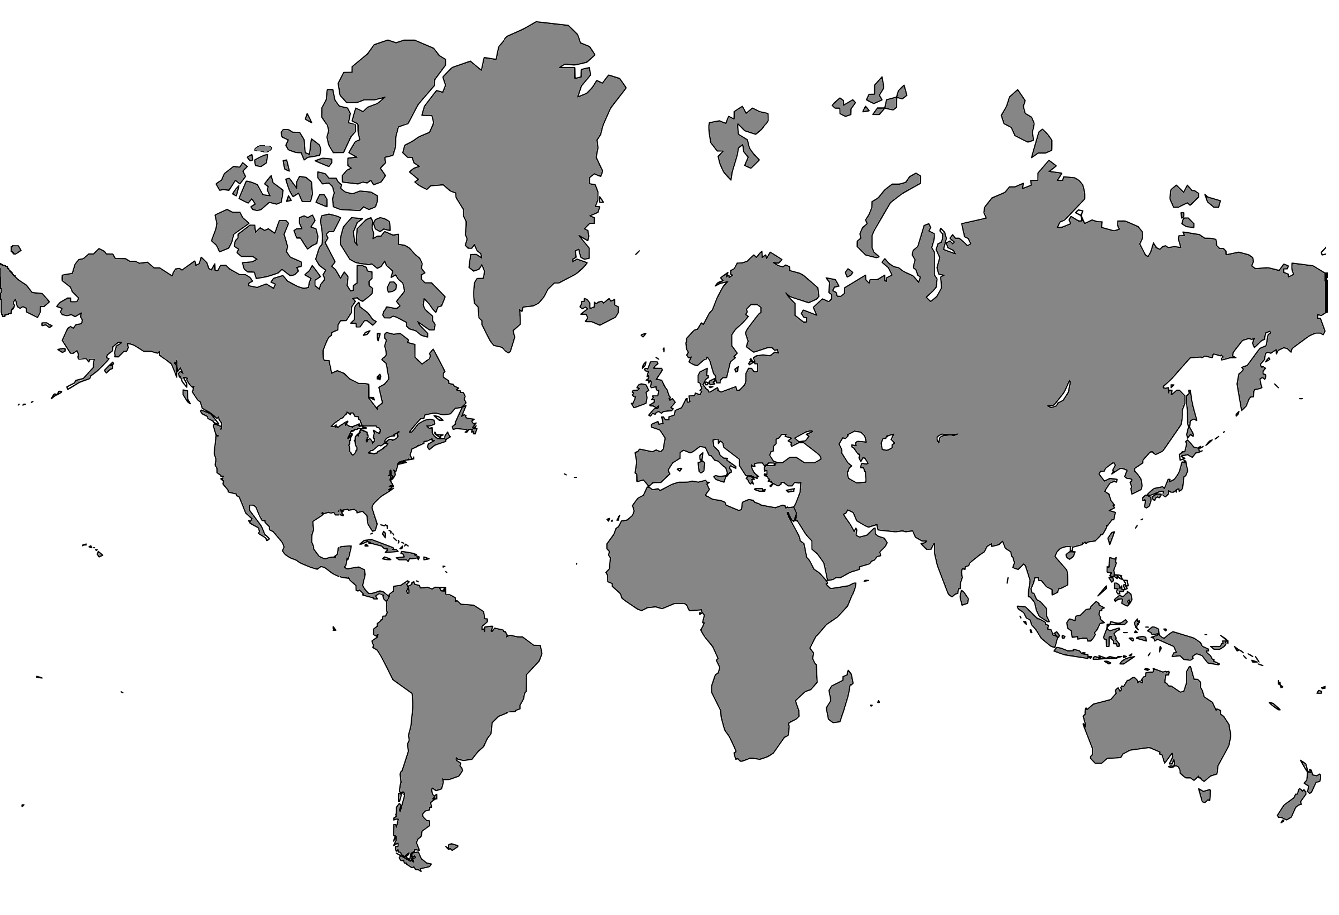
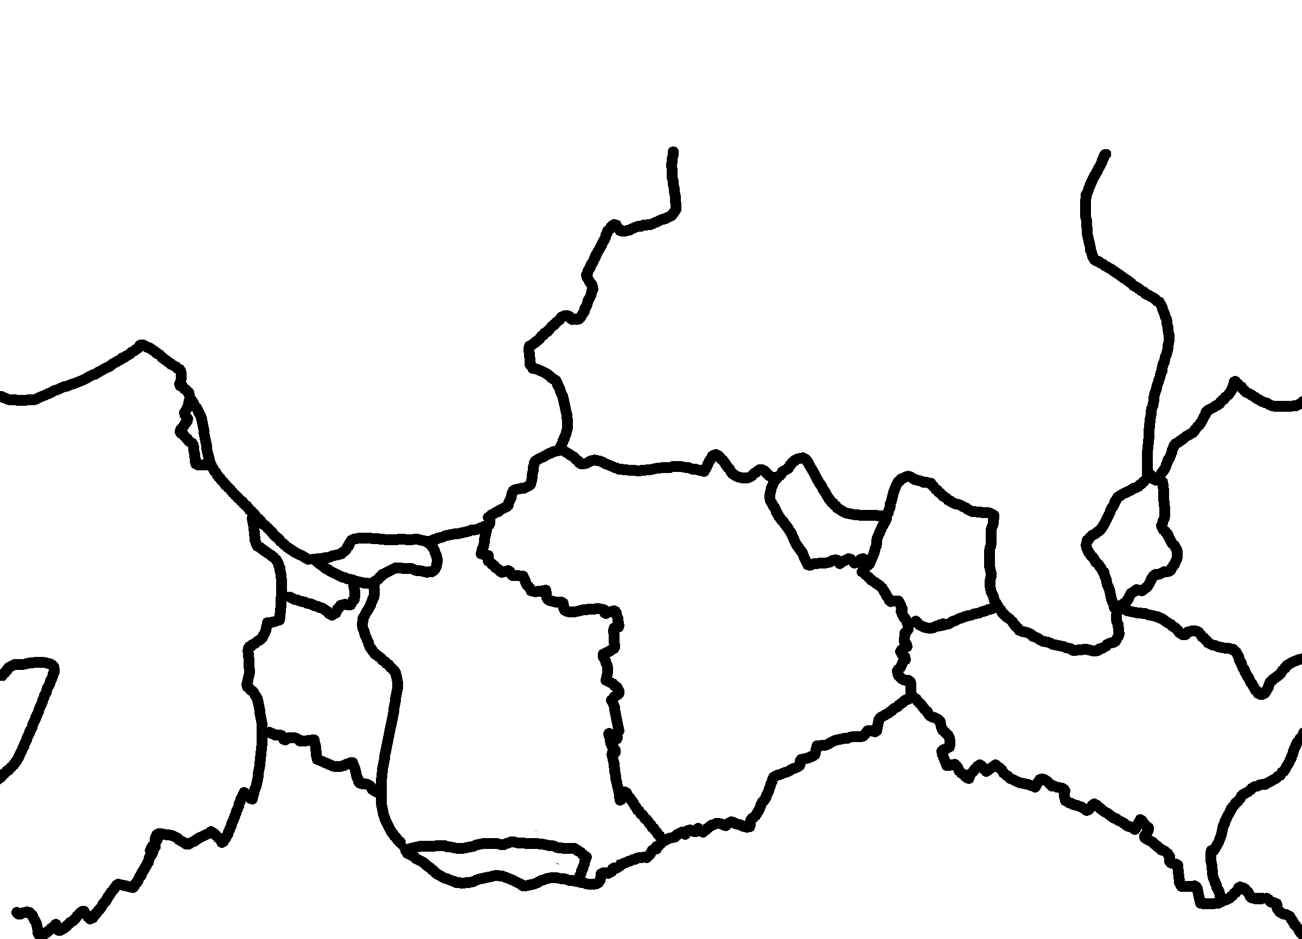
✄
Tectonic Plates (with continents)

Slide 2
⠠⠞⠑⠉⠞⠕⠝⠊⠉⠀⠠⠏⠇⠁⠞⠑⠎ "<) 3t95ts">
✄

Slide 3
✄

