Slide 1
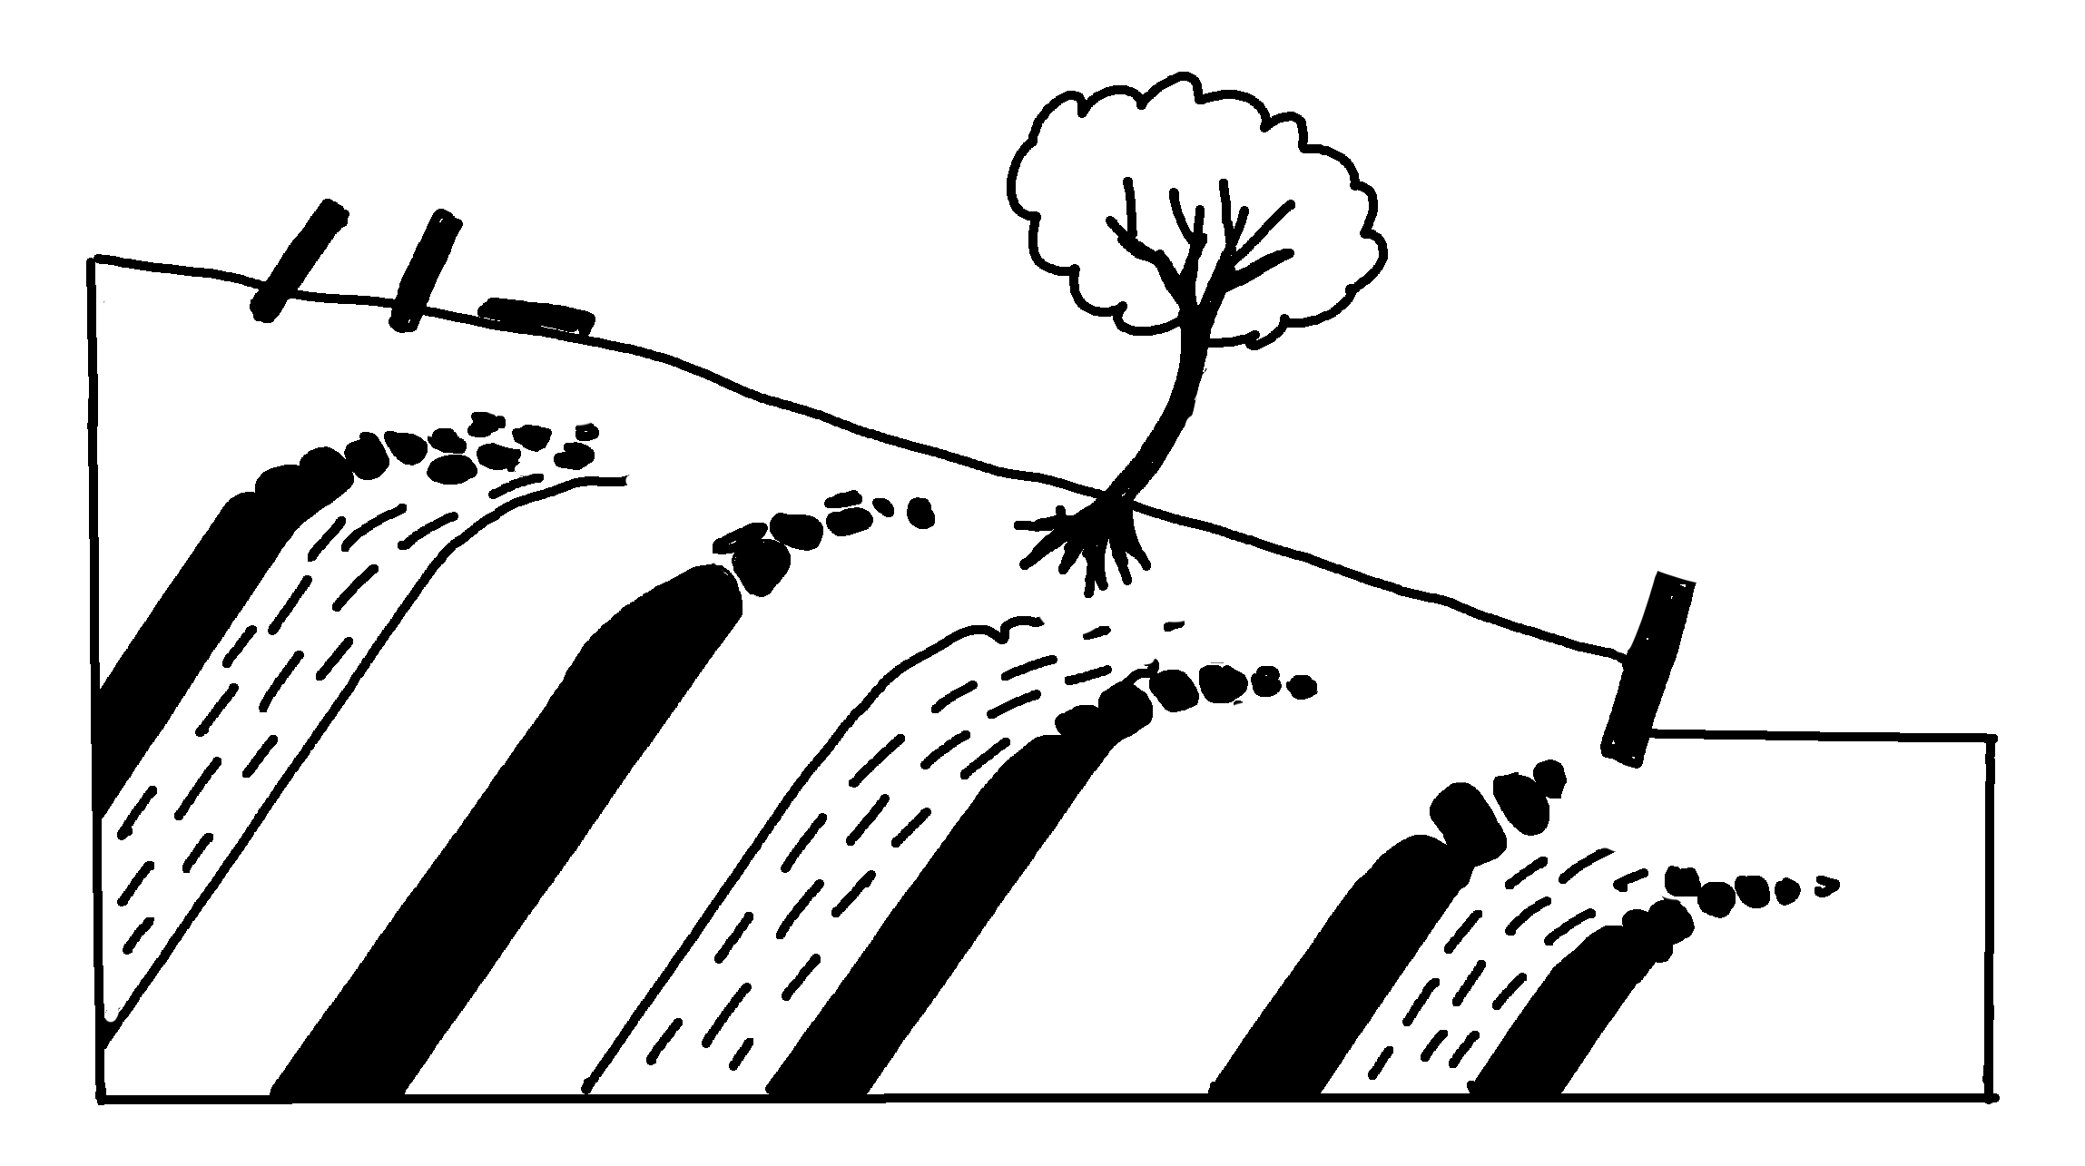
✄
Creep
leaning and toppled gravestones
tree with curved trunk
leaning retaining wall
soil
bedrock
layers
modified from https://wps.prenhall.com/esm_tarbuck_earth_8/19/5076/1299583.cw/index.html

Slide 2
✄
⠠⠉⠗⠑⠑⠏
⠇⠂⠝⠬⠀⠯⠀⠞⠕⠏⠏⠇⠫⠀⠛⠗⠁⠧⠑⠌⠐⠕⠎
⠞⠗⠑⠑⠀⠾⠀
⠉⠥⠗⠧⠫⠀⠞⠗⠥⠝⠅
⠇⠂⠝⠬⠀
⠗⠑⠞⠁⠔⠬⠀
⠺⠁⠇⠇
soil
⠃⠫⠗⠕⠉⠅
⠇⠁⠽⠻⠎

Slide 3
✄

