Slide 1
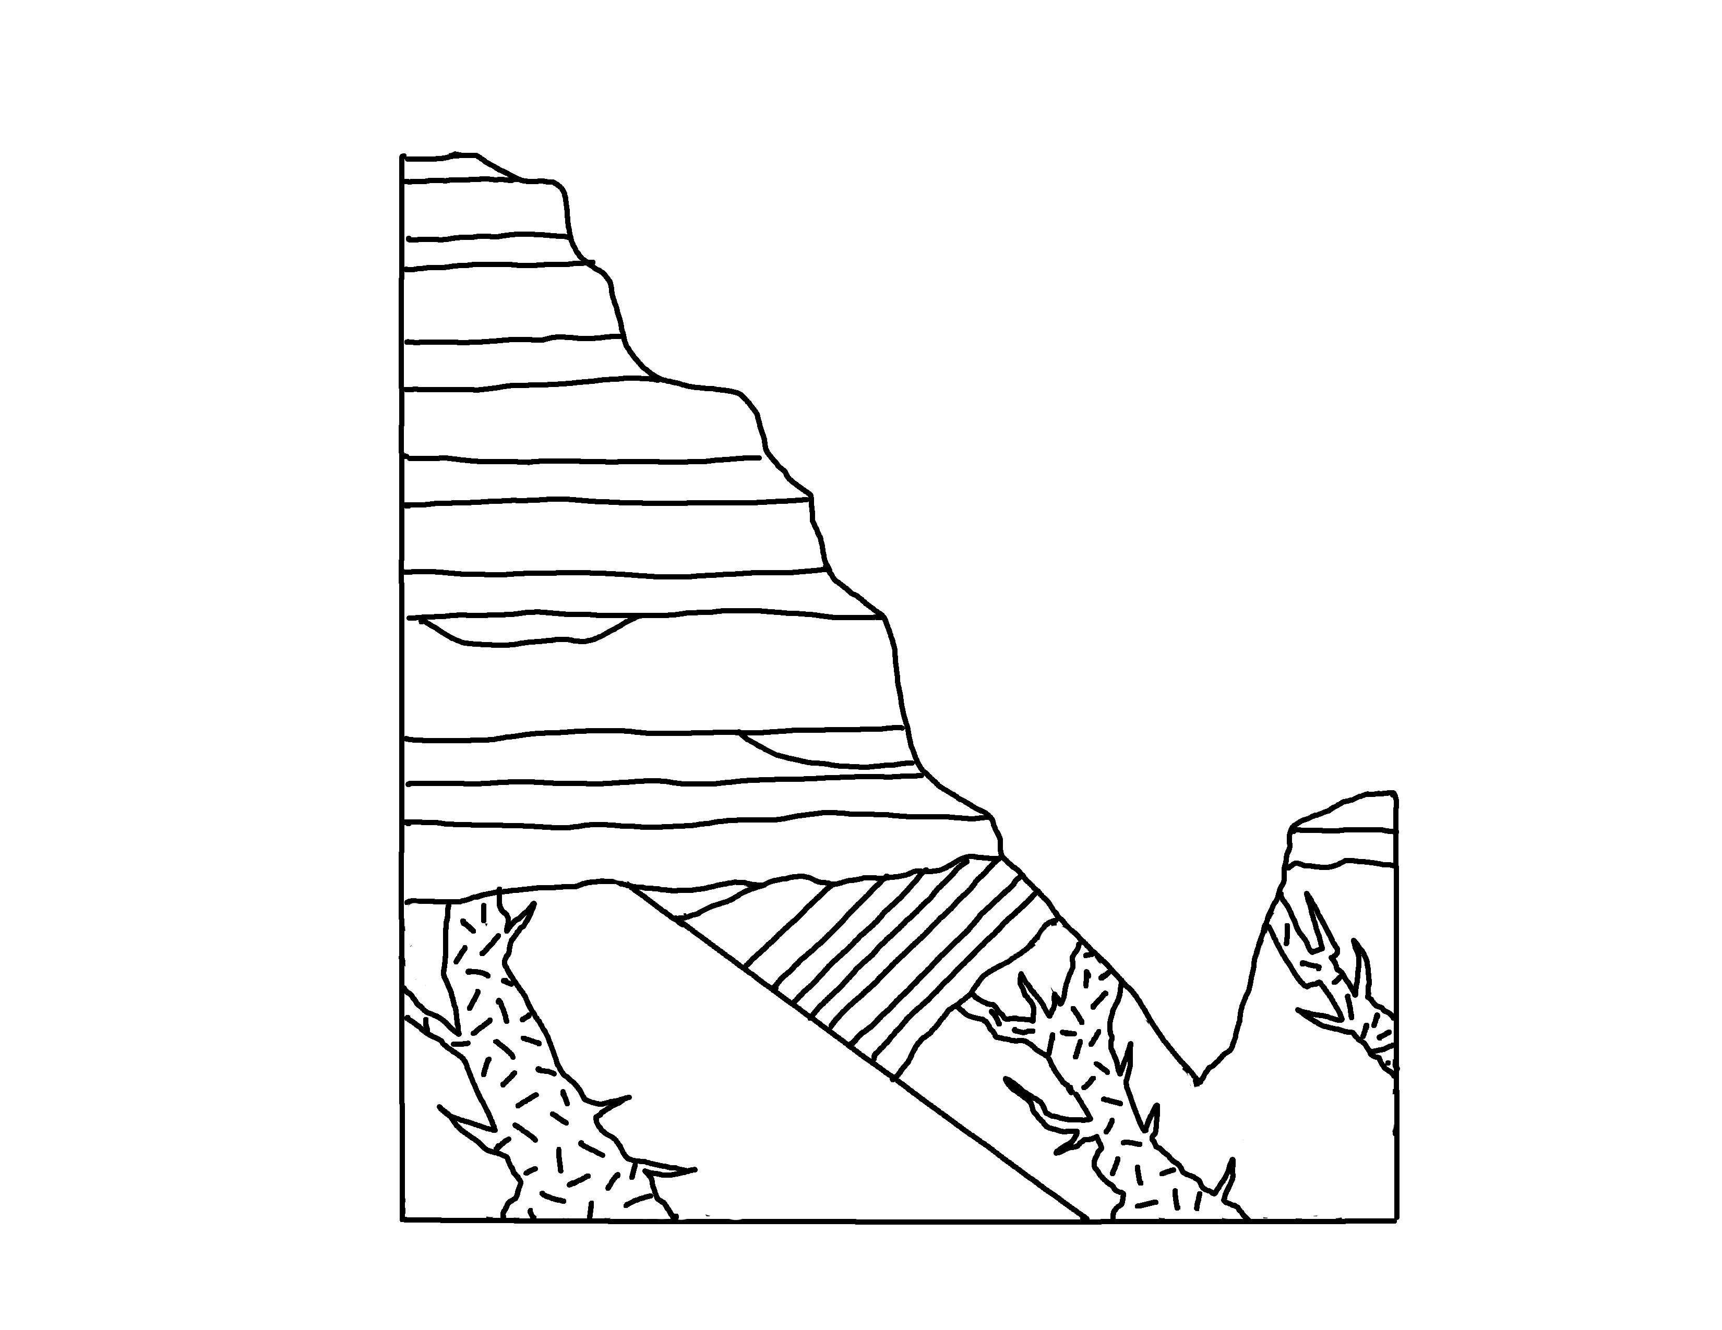
Grand Canyon
✄
1
2
3
4
5
Great Unconformity
6
Pal
7
Colorado River
8
9
10
Pro
11
13
13
12
12

Slide 2
Grand Canyon Legend
✄
1 Moenkopi Fm.
2 Kaibab Limestone
3 Toroweap Fm.
4 Coconino Sanstone
5 Hermit Shale
6 Supai Group
7 Redwall Limestone and Surprise Canyon Fm.
8 Muav and Temple Butte Limestones
9 Bright Angel Shale
10 Tapeats Sandstone
11 Grand Canyon Supergroup
12 Zoroaster Granite
13 Vishnu Schist
modified from
https://azgs.arizona.edu/photo/grand-canyon-stratigraphy

Slide 3
⠠⠛⠗⠯⠀⠠⠉⠁⠝⠽⠕⠝
✄
⠼⠁
⠼⠃
⠼⠉
⠼⠙
⠠⠛⠗⠞⠀
⠠⠥⠝⠉⠕⠝=⠍;⠽
⠼⠑
⠼⠋
⠠⠏⠁⠇
⠼⠛
⠠⠉⠕⠇⠕⠗⠁⠙⠕⠀
⠠⠗iv]⠲
⠼⠓
⠼⠊
⠼⠁⠚
⠠⠏⠗⠕
⠼⠁⠁
⠼⠁⠉
⠼⠁⠉
⠼⠁⠃
⠼⠁⠃

Slide 4
⠠⠛⠗⠯⠀⠠⠉⠁⠝⠽⠕⠝⠀⠠⠇⠑⠛⠢⠙
✄
#a ⠠⠍⠕⠢⠅⠕⠏⠊⠀⠠⠋⠍⠲
#b ⠠⠅⠁⠊⠃⠁⠃⠀⠠⠇⠊⠍⠑⠌⠐⠕
#c ⠠⠞⠕⠗⠪⠂⠏⠀⠠⠋⠍⠲
#d ⠠⠉⠕con⠔⠕⠀⠠⠎⠯⠌⠐⠕
#e ⠠⠓⠻⠍⠊⠞⠀⠠⠩⠁⠇⠑
#f ⠠⠎⠥⠏⠁⠊⠀⠠⠛⠗⠳⠏
#g ⠠⠗⠫⠺⠁⠇⠇⠀⠠⠇⠊⠍⠑⠌⠐⠕⠀⠯⠀
⠠⠎⠥⠗⠏⠗⠊⠎⠑⠀⠠⠉⠁⠝⠽⠕⠝⠀⠠⠋⠍⠲
#h ⠠⠍⠥⠁⠧⠀⠯⠀⠠⠞⠑⠍⠏⠇⠑⠀⠠⠃⠥⠞⠞⠑⠀
⠠⠇⠊⠍⠑⠌⠐⠕⠎
#i ⠠⠃⠐⠗⠀⠠⠁⠝⠛⠑⠇⠀⠠⠩⠁⠇⠑
#aj ⠠⠞⠁⠏⠂⠞⠎⠀⠠⠎⠯⠌⠐⠕
#aa ⠠⠛⠗⠯⠀⠠⠉⠁⠝⠽⠕⠝⠀⠠⠎⠥⠏⠻⠛⠗⠳⠏
#ab ⠠⠵⠕⠗⠕⠁⠌⠻⠀⠠⠛⠗⠁⠝⠊⠞⠑
#ac ⠠⠧⠊⠎⠝⠥⠀⠠⠎⠡⠊⠌

Slide 5
✄

