Slide 1
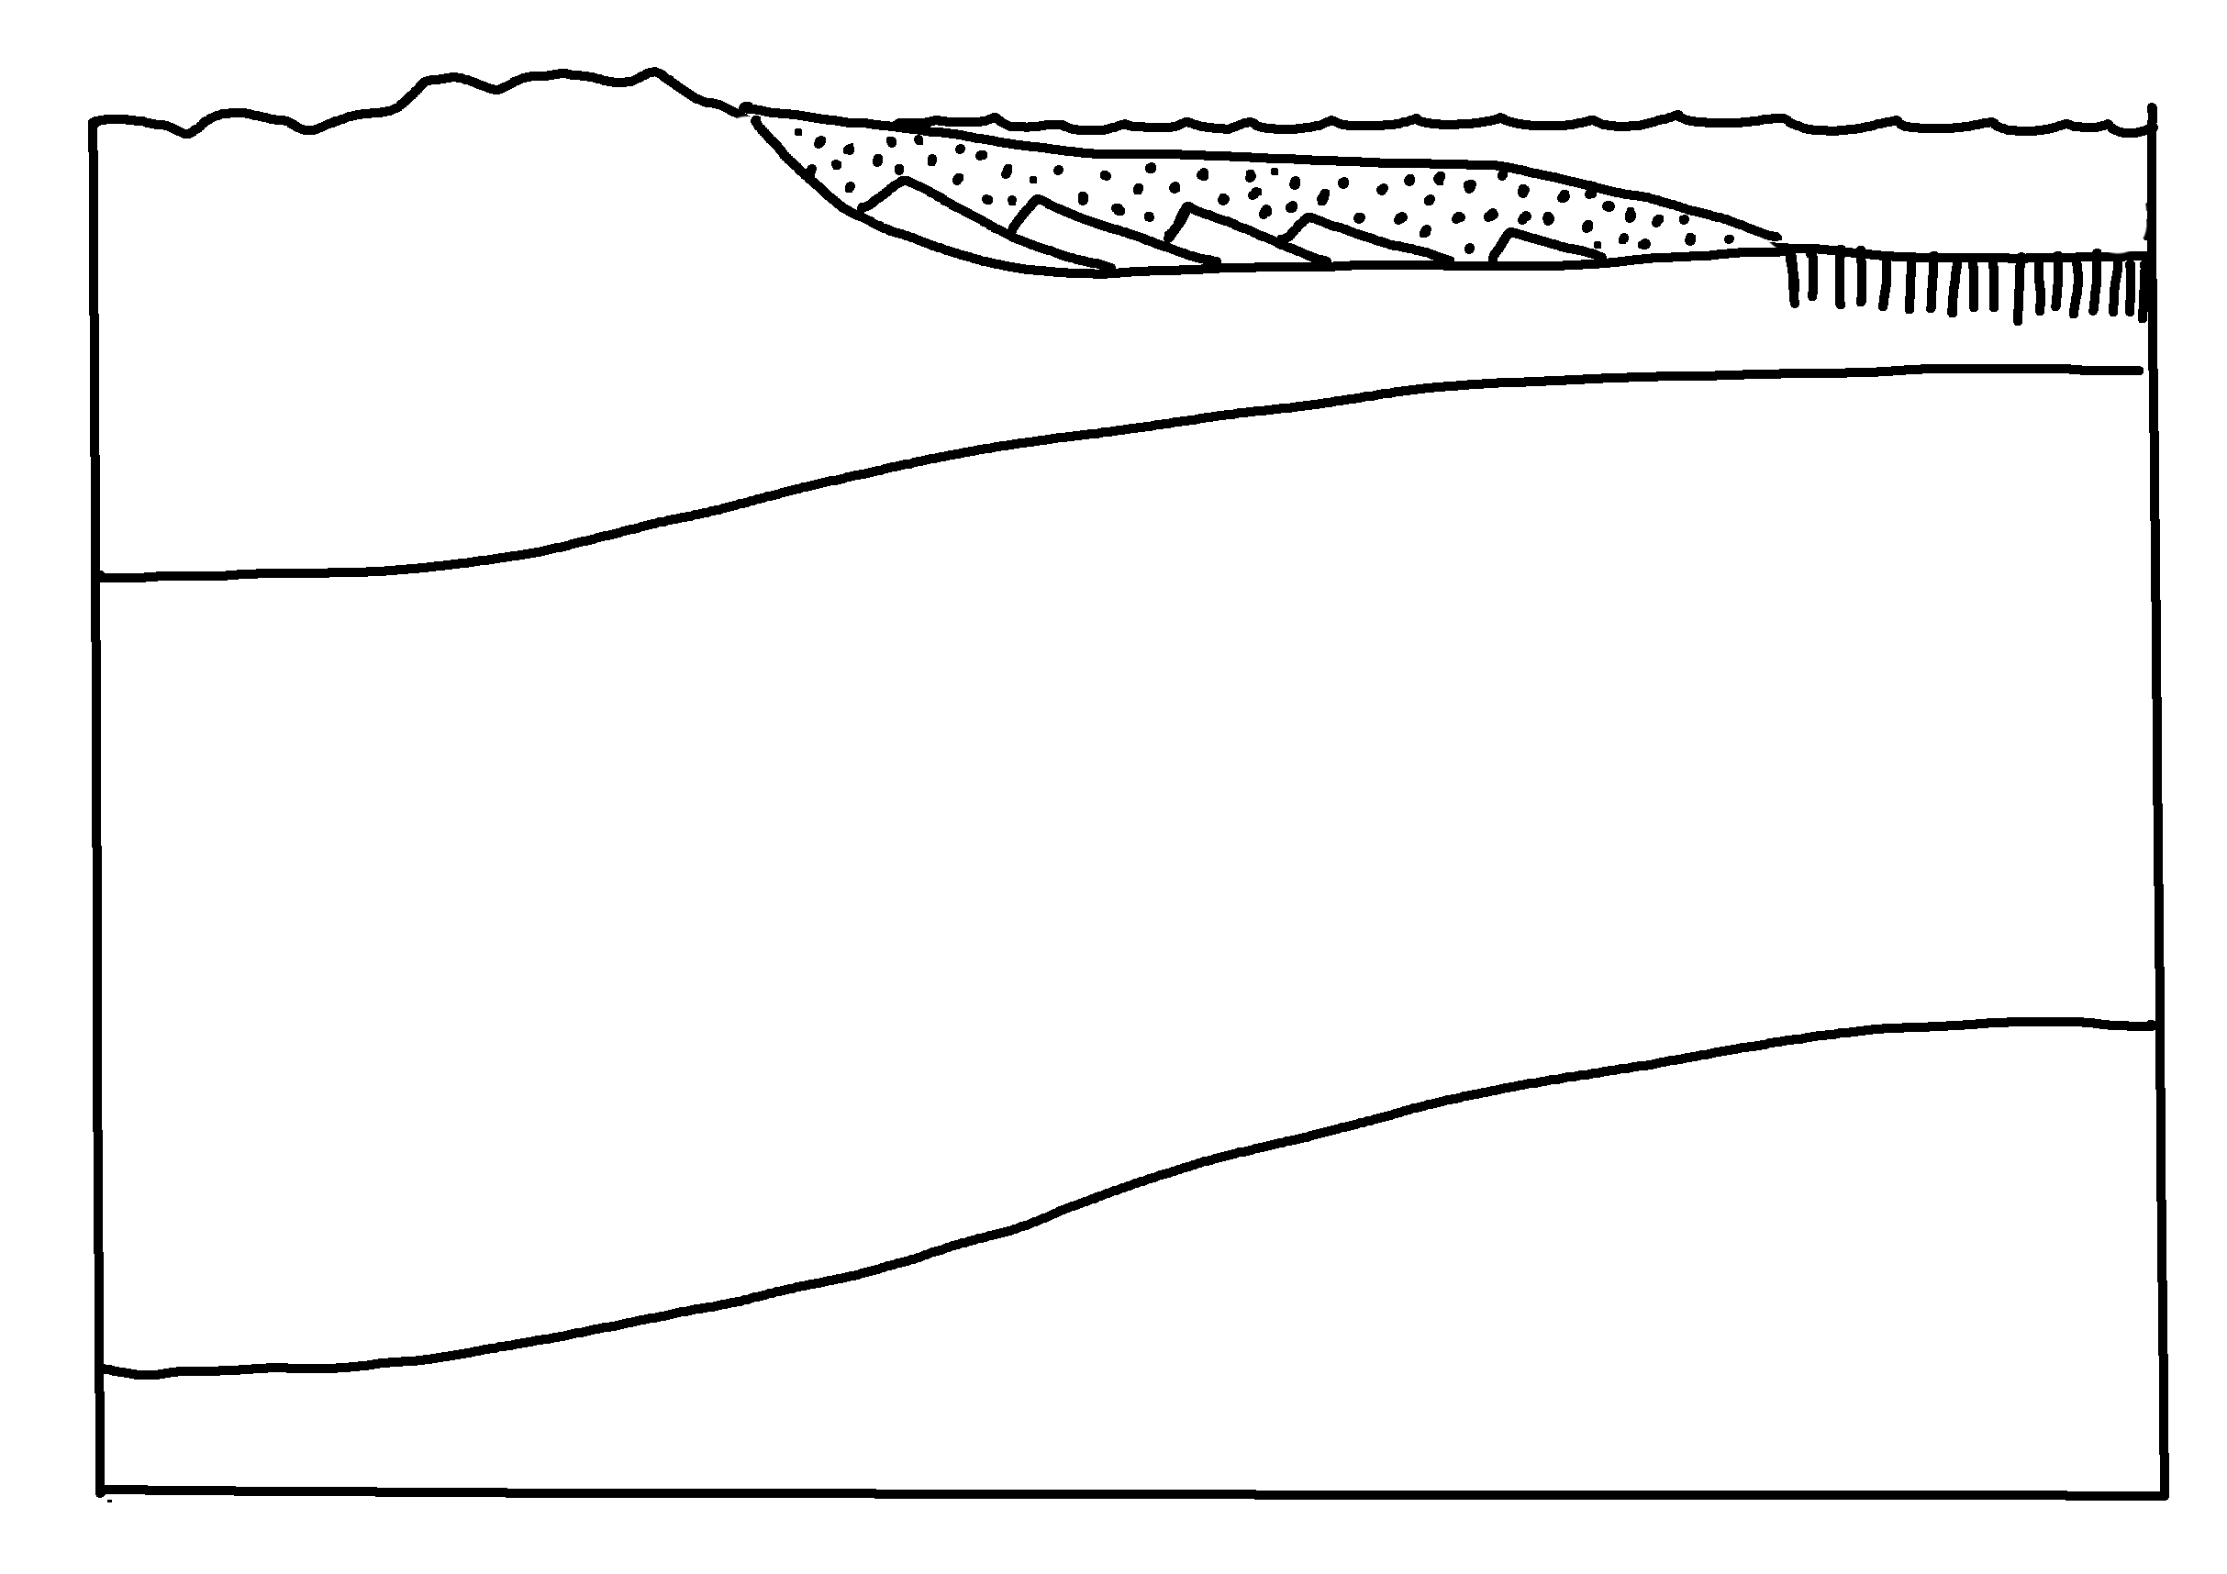
✄
Passive Continental Margin
continent
continental shelf
oceanic crust
continental crust
Moho
cl
ol
lithospheric mantle
asthenospheric mantle
Key: cl continental lithosphere
ol oceanic litohsphere
modified from Fig. 4.2 (a) in Marshak, 2019, Earth: Portrait of a Planet, 6th edition

Slide 2
,passive ,3t95tal ,m>g9
✄
3⠞⠔⠢⠞
3⠞⠔⠢⠞⠁⠇⠀⠩⠑⠇⠋
⠕⠉⠂⠝⠊⠉⠀⠉⠗⠥⠌
3⠞⠔⠢⠞⠁⠇⠀⠉⠗⠥⠌
⠠⠍⠕⠓⠕
ol
cl
⠇⠊?⠕⠎⠏⠓]⠊⠉⠀⠍⠁⠝⠞⠇⠑
⠁⠎!⠝⠕⠎⠏⠓]⠊⠉⠀⠍⠁⠝⠞⠇⠑
,key- cl 3t59tal li?osp"h
ol oc1nic li?osp"h

Slide 3
✄

