Slide 1
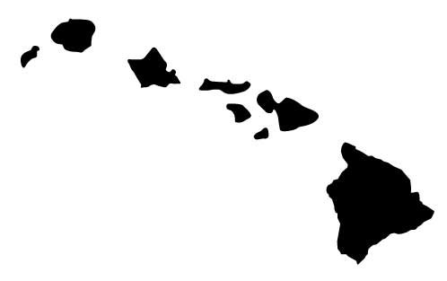
Hawaiian Islands
Hotspot Track
✄
North
100 km
Kauai
Oahu
Molokai
5.1 Ma
Maui
Hawaii
0.8 - 1.3 Ma
current motion of Placific Plate
0 - 0.43 Ma

Slide 2
⠠⠓⠁⠺⠁⠊⠊⠁⠝⠀⠠⠊⠎⠇⠯⠎⠀
⠠⠓⠕⠞⠎⠏⠕⠞⠀⠠⠞⠗⠁⠉⠅
✄
⠠⠝⠕⠗⠹
⠼⠁⠚⠚⠀⠅⠍
⠠⠅⠁⠥⠁⠊
⠠⠕⠁⠓⠥
⠠⠍⠕⠇⠕⠅⠁⠊
⠼⠑⠲⠁⠀⠠⠍⠁
⠠⠍⠁⠥⠊
⠠⠓⠁⠺⠁⠊⠊
⠼⠚⠲⠓⠀⠤⠀⠼⠁⠲⠉⠀⠠⠍⠁
⠉⠥⠗⠗⠢⠞⠀⠍⠕⠰⠝⠀⠷⠀
⠠⠏⠁⠉⠊⠋⠊⠉⠀⠠⠏⠇⠁⠞⠑
⠼⠚⠀⠤⠀⠼⠚⠲⠙⠉⠀⠠⠍⠁

Slide 3
✄

