Slide 1
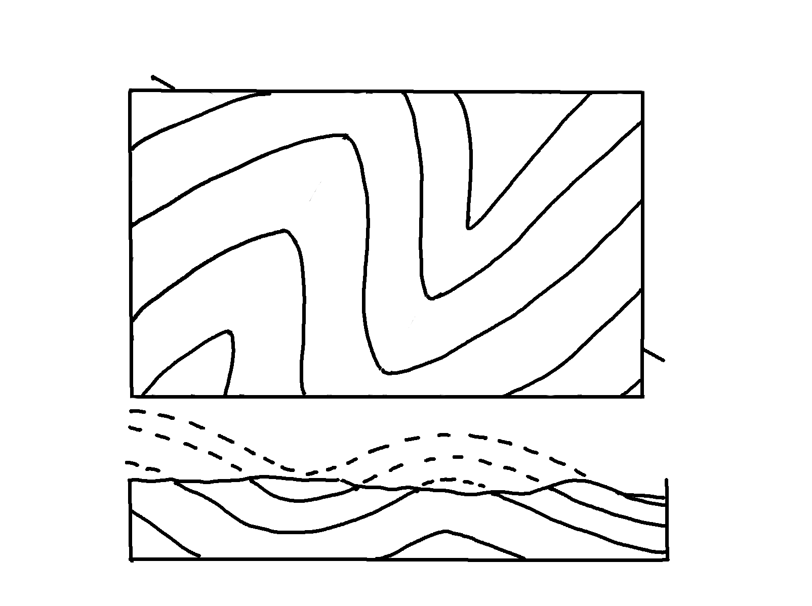
Plunging Folds – Cross-Section, A-B
✄
A
B

Slide 2
⠠⠏⠇⠥⠝⠛⠬⠀⠠⠋⠕⠇⠙⠎⠀⠤⠀⠠⠉⠗⠕⠎⠎⠤⠎⠑⠉⠰⠝1 ⠠⠁⠤;,⠃
✄
,a
,B

Slide 3
✄

