Slide 1
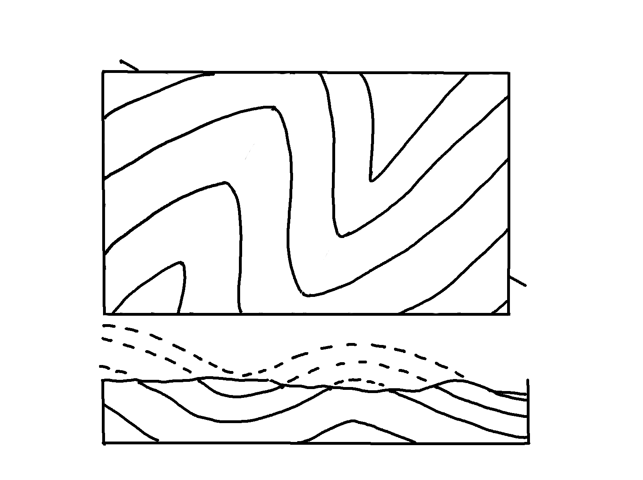
Plunging Folds – Cross-Section A-B, Projected
✄
A
B
5
4
4
3
3
2
2
1
1

Slide 2
⠠⠏⠇⠥⠝⠛⠬⠀⠠⠋⠕⠇⠙⠎⠀⠤⠀
⠠⠉⠗⠕⠎⠎⠤⠎⠑⠉⠰⠝⠀⠠⠁⠤⠃⠂⠀⠠⠏⠗⠕⠚⠑⠉⠞⠫
✄
⠠⠁
⠼⠋
⠼⠉
⠼⠙
⠼⠙
⠼⠑
⠼⠉
⠼⠃
⠼⠃
⠼⠉
⠼⠁
⠼⠁

Slide 3
✄

