Slide 1
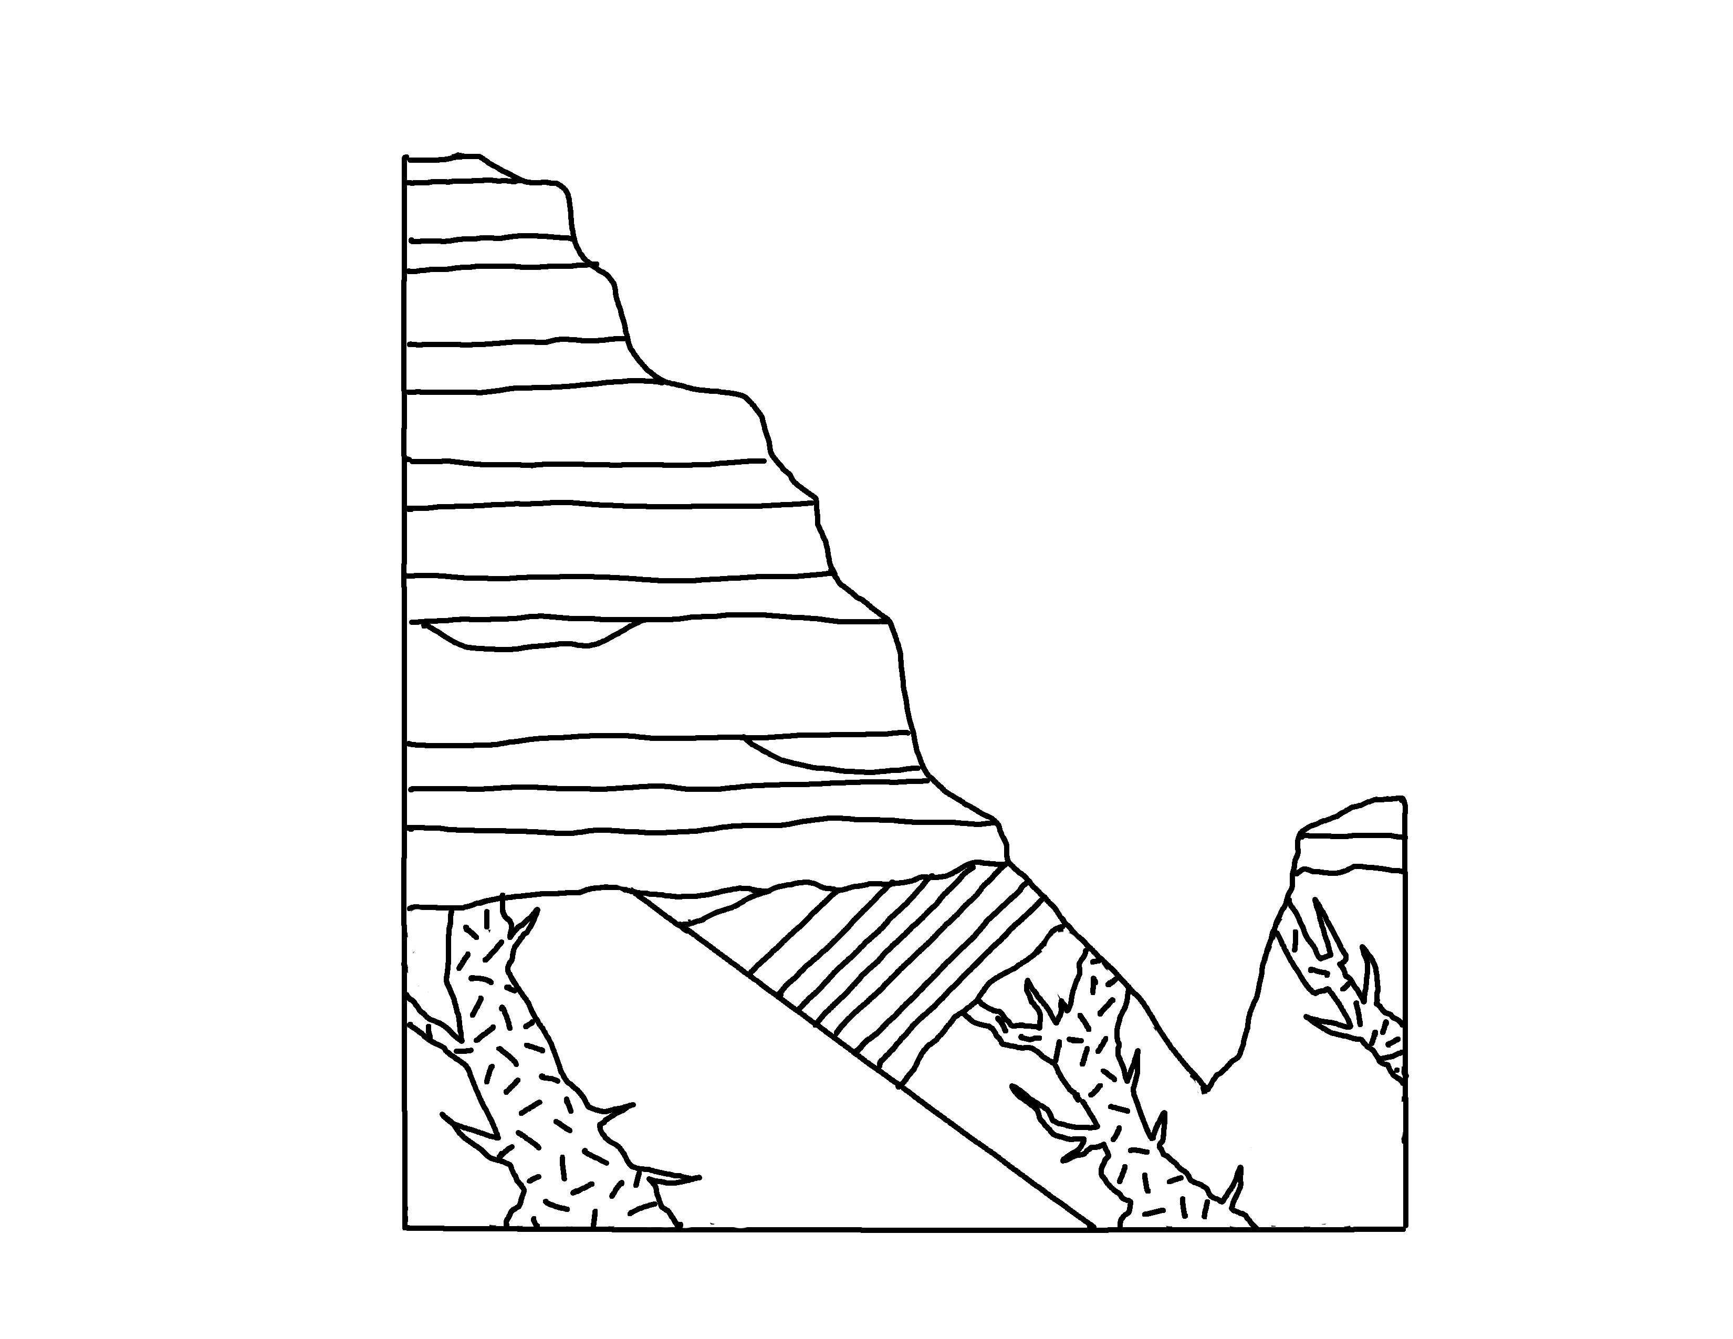
✄
Grand Canyon – Precambrian Units
Great Unconformity
pal
Tapeats Sandstone
GC Supergroup
pro
Vishnu Schist
Vishnu Schist
Zoroaster Granite
Zoroaster Granite
Key: pal Paleozoic, pro Proterozoic
12
12

Slide 2
⠠⠛⠗⠯⠀⠠⠉⠁⠝⠽⠕⠝⠀⠤⠀⠠⠏⠗⠑⠉⠁⠍⠃⠗⠊⠁⠝⠀⠠⠥⠝⠊⠞⠎
✄
⠠⠛⠗⠞⠀⠠⠥⠝⠉⠕⠝=⠍;y
⠏⠁⠇
⠠⠞⠁⠏1⠞⠎⠀⠠⠎&/"o
⠠⠠⠛⠉⠀
⠠⠎⠥⠏⠻⠤
⠛⠗⠳⠏
⠏⠗⠕
⠠⠧⠊%⠝⠥⠠⠎⠡⠊⠌
⠠⠧⠊%⠝⠥⠠⠎⠡⠊⠌
⠠⠵⠕⠗⠕⠁⠌⠻⠀⠠⠛⠗⠁⠝⠊⠞⠑
,key- Pal ⠠⠏⠁⠇⠑⠕⠵⠕⠊⠉1 Pro ⠠⠏⠗⠕⠞⠻⠕⠵⠕⠊⠉
12
12

Slide 3
✄
12
12

