Slide 1
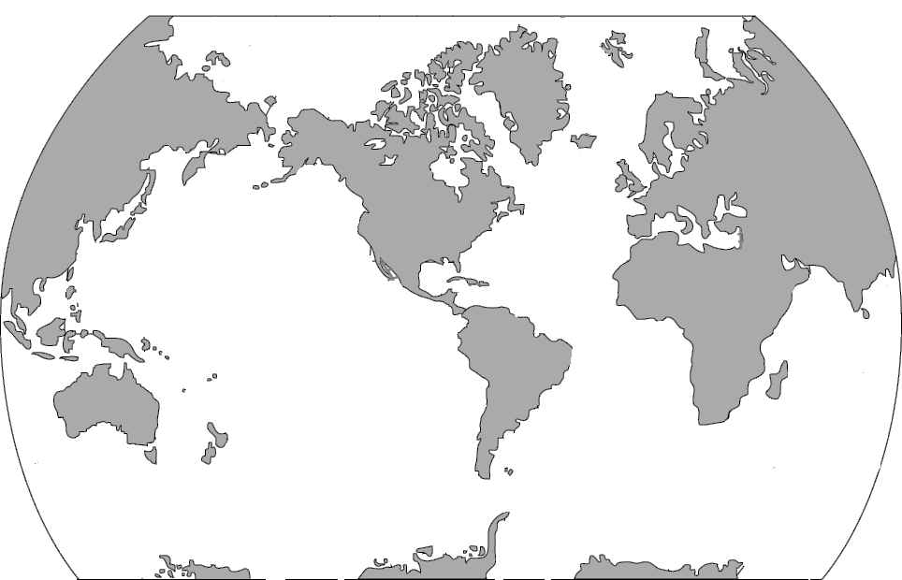
✄
Map of Mid-ocean Ridges
modified from https://pubs.usgs.gov/gip/dynamic/baseball.html

Slide 2
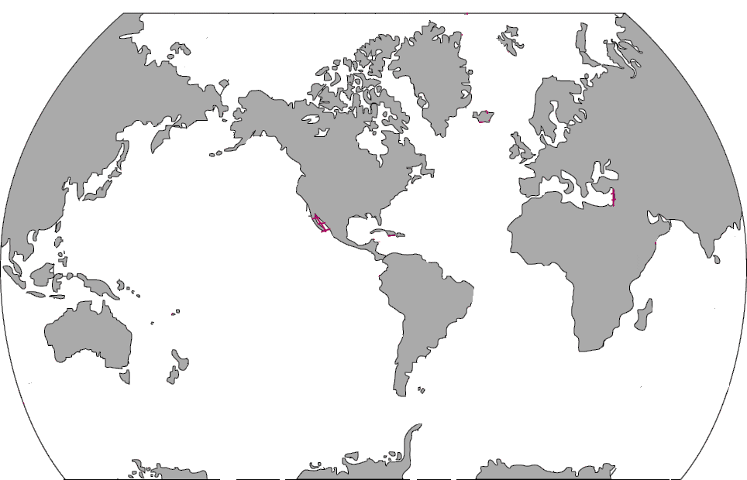
⠠⠍⠁⠏⠀⠷⠀⠠⠍⠊⠙⠤⠕⠉⠂⠝⠀⠠⠗⠊⠙⠛⠑⠎
✄

Slide 3
✄

