Slide 1
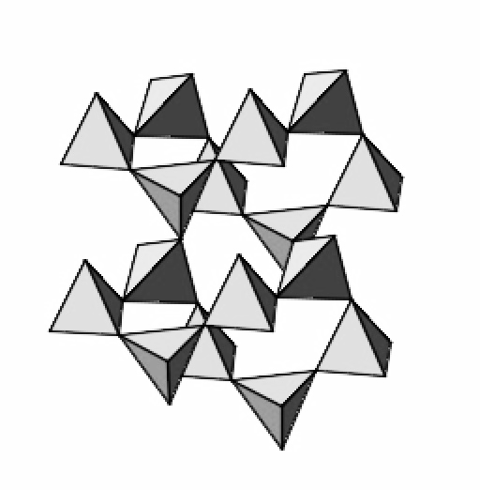
Silicate Mineral Structures
✄
isolated tetrahedra
single chain
double chain
sheet
framework

Slide 2
⠠⠎⠊⠇⠊⠉⠁⠞⠑⠀⠠⠍⠔⠻⠁⠇⠀⠠⠌⠗⠥⠉t⠥⠗⠑⠎
✄
⠊⠎⠕⠇⠁⠞⠫⠀
⠞⠑⠞⠗⠁⠓⠫⠗⠁
⠎⠬⠇⠑⠀⠡⠁⠔
⠙⠳⠃⠇⠑⠀⠡⠁⠔
⠩⠑⠑⠞
⠋⠗⠁⠍⠑⠐⠺

Slide 3
✄

